Slide 1



Slide 2
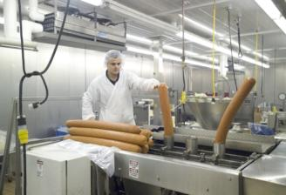
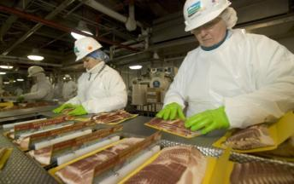
International Food Company
Operations in 12 countries
46,000+ employees
Sales to 60+ countries
12+ strategic brands
Annual sales > $13 billion

Slide 3
Food Industry Leader
#1 U.S. Packaged Pork Company
#1 World Pork Processor
#1 World Hog Producer
#1 Market share in several European countries

Slide 4
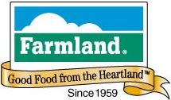

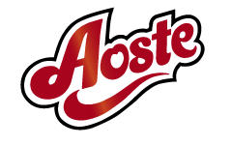


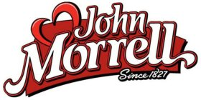








Our Brand Portfolio
United States
International

Slide 5
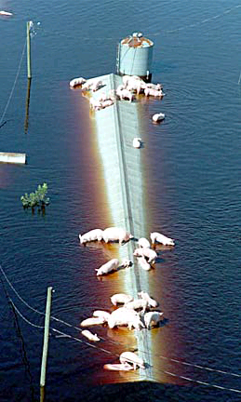
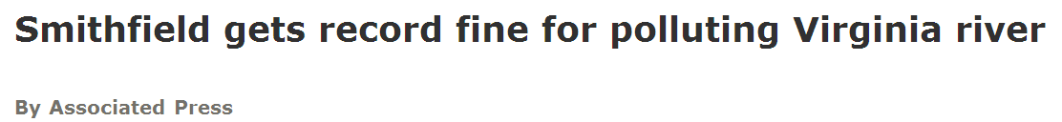
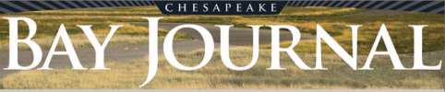
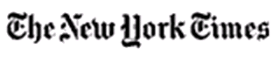
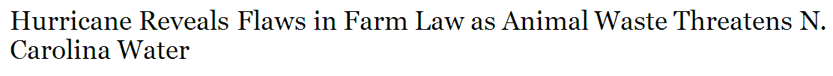
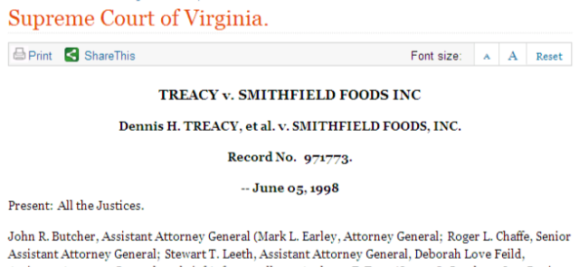
Where Our Journey Began
Notes:
Troubled Times
Between 1995 and 2000 Smithfield suffered three separate spills of more than 1 million gallons each. The company faced lawsuits in multiple states, including Virginia. Then in 1997 it was fined $12.6 million — at the time the largest civil fine in the history of the federal Clean Water Act — for illegal discharges into the Pagan River in Smithfield, a tributary of the James River and part of the Chesapeake Bay watershed.
A few years later Hurricane Floyd barreled across North Carolina, leaving hog farms flooded and lagoons breached. The industry as a whole was under intense fire.
Why It Was Right For Me
Why you agreed to come work for SFD
New Outlook
Our company had difficulties, had a realization that it needed to change, made significant strides and efforts to change, not only the way the public perceived us, but actually changed the culture of the company in a very real way.

Slide 6





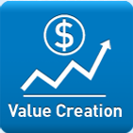
Smithfield’s Sustainability Program
ISO 14001 Certification and EMS Systems
Environmental Awards Program
Web-based Training Program
Environmental Compliance Committee (ECC)
PQA Plus® Certification
Conversion to Group Housing
Animal Welfare Committee
Limited use of Antibiotics
CO2 Stunning
State-of-the-Art Facilities/ Technology
Food Safety Policy
Food Safety Auditing
Traceability
Cloning Policy
Sodium Policy
Employee Injury Prevention
Management System (EIPMS)
Corporate Management
Safety Awards
Human Rights Policy
Learners to Leaders®
Helping Hungry Homes®
World Water Monitoring Day
FFA Environmental and Natural Resources Award
Reduced worker’s compensation costs by 25%
Saved $285 million through environmental improvement projects
Launched cause marketing campaigns to benefit social causes
All subsidiaries sponsored at least one health and wellness program
Contributed $1.2 million in education programs to benefit employees and their children

Slide 7

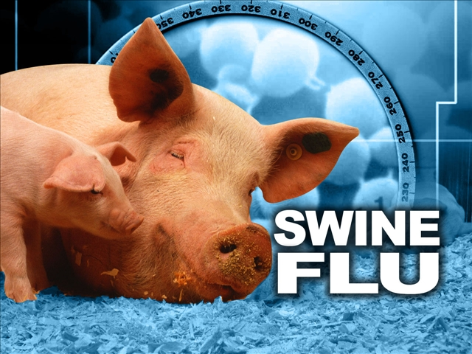
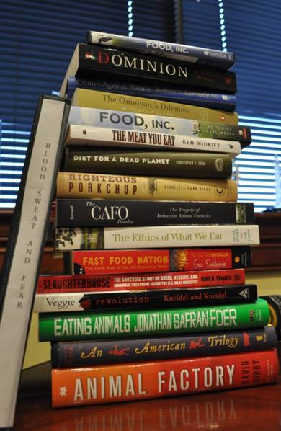
Processed
Inhumane
Factory Farm
Big Ag
Suffering
Abuse
Cruelty
CAFO
Confinement

Slide 8
Burger King asked to drop dairy farmer after abuse video surfaces –QSRWeb, Oct. 1, 2012
McFib? The Conditions at McDonalds’ McRib Supplier –The Atlantic, Nov. 3, 2011
Are factory farms inherently unsustainable? The environment at risk –The International, Sept. 20, 2012
Industrial farming cause of ecological damage –Deccan Chronicle, Oct. 15, 2012
Factory animal farms spew toxic chemical fumes, poisoning neighbors –Natural News, November 1, 2010
Industrial farming puts ecosystems at risk of collapse, warns Prince Charles–The Guardian October 25, 2010
Obesity in America: Are Factory Farms, Big Pharma and Big Food to Blame? –Huffington Post Oct. 25, 2010
What It Takes To Put Meat On Your Plate
–RadioBoston, Sept. 27, 2012
The Grim Realities of Factory Farms –Christianity Today November 5, 2010
How False Advertising by Big Food Is Driving Obesity –Huffington Post, Oct. 16, 2012

Slide 9
You and your employees are all going to spend an eternity in hell. I can only hope and pray that someday someone would do this to you and your entire family until the day you die. You can all listen to each other scream in pain and agony as you suffer unimaginable physical pain and go completely insane!
You are sick scumbags. I will never purchase your products -- ever. You pieces-of-sh*$ need to die, soon.
May the laws of karma come crashing down on you utterly despicable greedy bastards.
Your hunger for $$$ has turned you into EVIL,VILE, HEARTLESS AND MERCILESSNESS SICK SOCIOPATHS!!!!!
Sadly, your mothers deserve most of the shame.
Please be more socially responsible. Stop contributing to the obesity epidemic in our country
What a heartless killer and pathetic liar you are Mr. Treacy. How can you live with yourself?
Stop hiring illegal immigrants, start paying living wages, and being fair, moral, ethical, and legal. You owe it to your country.
why can't you guys come clean about the recruitment of Mexican workers, their employment by you all. WTF? And do you think it is good that your pork never sees the light of day while it is alive?

Slide 10
Animal Care Program
Animal Care Policy
Internal Audit Program*
Zero Tolerance
Antibiotics Policy
PQA+ Program
Corporate Animal Care Council
Safe Transport—Animal Rescue Units*
CO2 Stunning
Conversion to Group Housing*

Slide 11
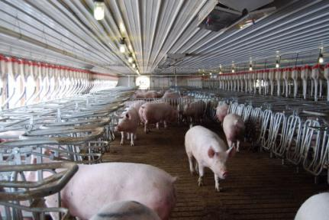
Conversion to Group Housing
30% complete as of Dec. 2011
100% complete by 2017.

Slide 12
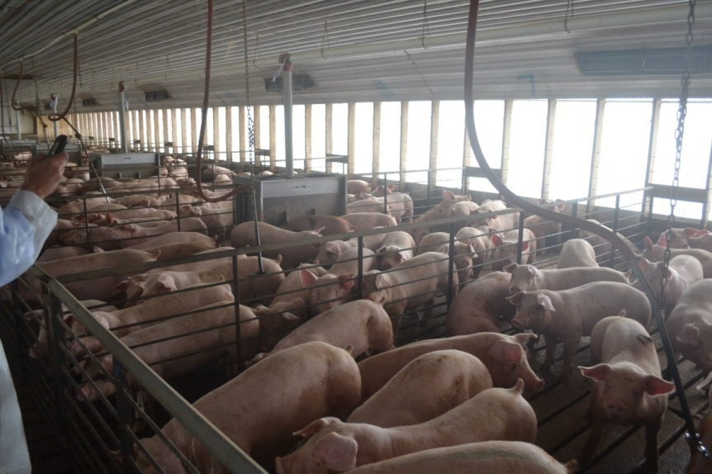
Internal Audit Program
Comprehensive audits on every company farm every year
Measures compliance with company Animal Care Policy, delivery of sound animal care
Auditors trained and calibrated by PAACO certified trainers
Animal Care Committee oversight & approval
Evaluates effectiveness of employee training

Slide 13
Animal Rescue Units
5 Trailers in strategic locations
Training for local emergency responders
Internal personnel always on call
Equipment includes: lights, penning equipment, saws, water, generators, etc.
Unique to Murphy-Brown

Slide 14
Is Modern Agriculture Bad For Animals & For You?

Slide 15
500
400
300
200
100
Number of Trichinosis Cases
Reported to CDC
2011
1947 1952 1957 1962 1967 1972 1977 1982 1987 1992 1997 2002 2007
A 2011 study by Peter R. Davies, a professor in the University of Minnesota College of Veterinary Medicine, revealed an 80-fold greater risk (per pig produced) of trichina infections resulting from eating niche market versus commercial pork products. The study concludes that pigs raised in outdoor systems inherently confront higher risks of exposure to foodborne parasites.

Slide 16
NAS Report Conclusions
Traditional, family-based systems do not produce enough food or income to assure that even the producing family has a nutritious diet.
Modern food systems produce reliable supplies of food, but sometimes not affordable for all families.
More resource-efficient means for producing additional volumes of food are needed to feed a global population of nine billion people by 2050.
Advocate “Sustainable Intensification”—Expanding of production rather than expanding land used for agriculture
Stress the importance of using all available technology (GMO’s, etc)
Organic systems cannot provide the needed productivity increases
A Sustainability Challenge: Food Security for All

Slide 17
17

Slide 18
Farm Notices of Violation

Slide 19
Transparency
is key

Slide 20
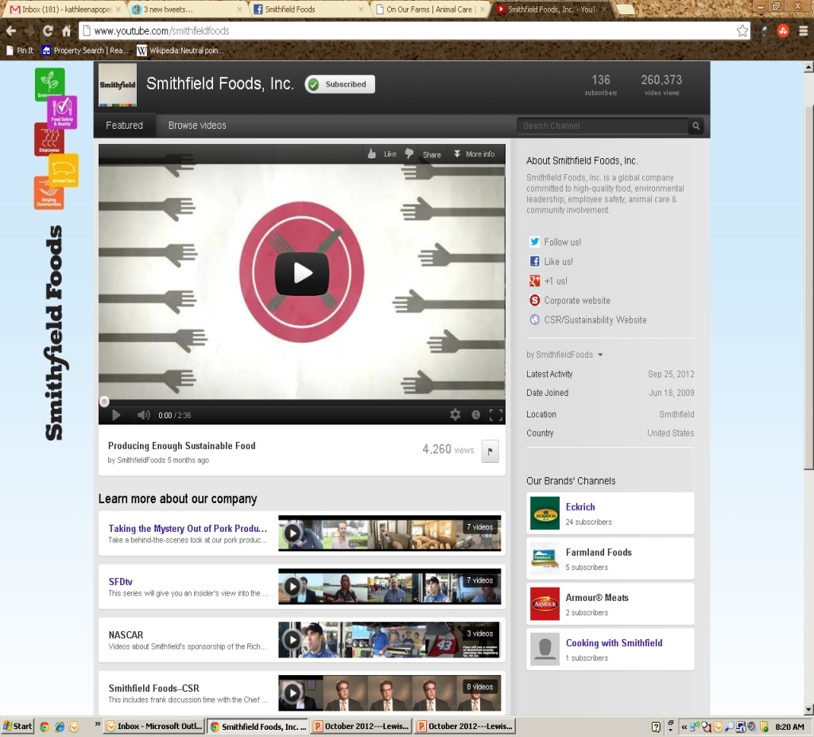
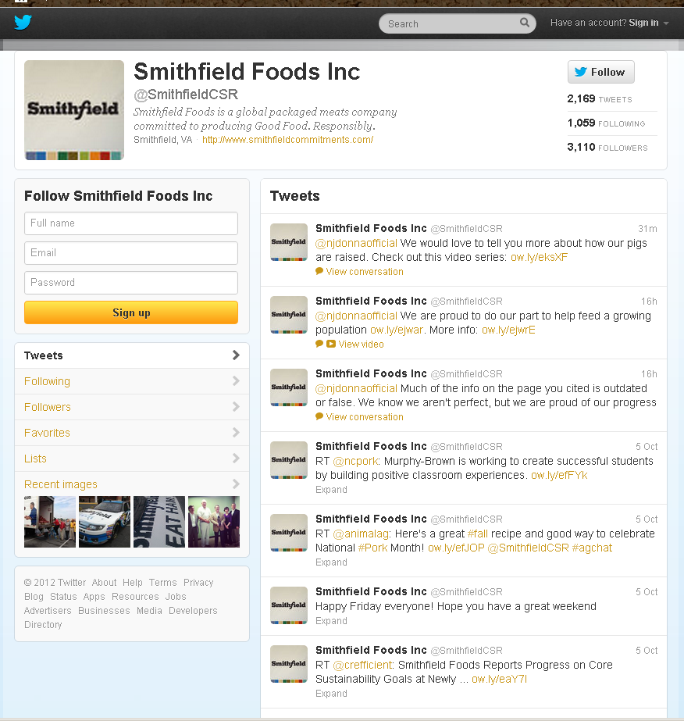
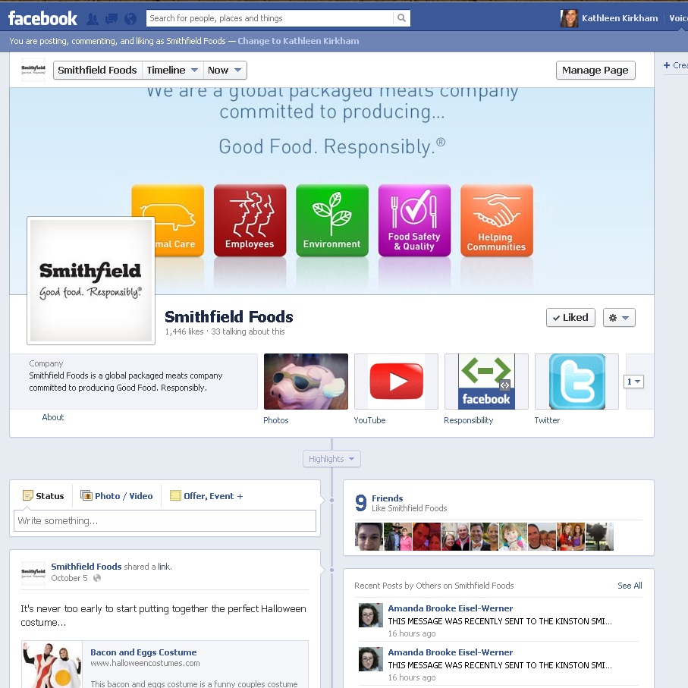
Social Media

Slide 21
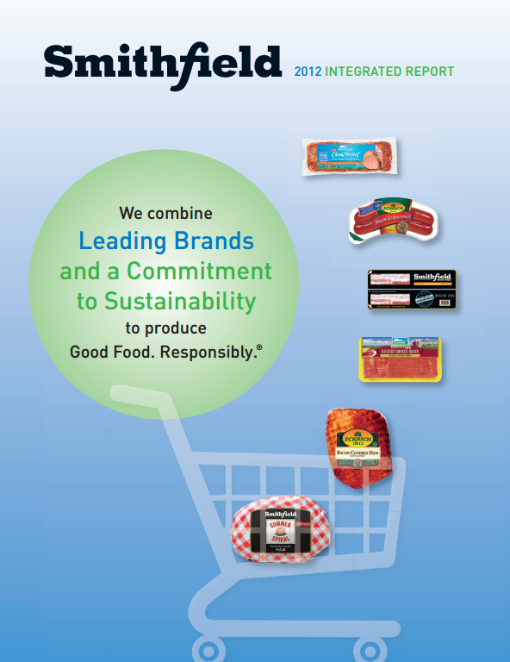
Integrated Report

Slide 22
Think Big. Think Differently.
Think like EPA
Think like an animal lover
Think like a neighbor
Think like someone who has never been on a farm
Think like a customer
Think like a philosopher
Think like a consumer

Slide 23



smithfieldfoods
smithfieldcsr
smithfieldfoods
www.smithfieldcommitments.com

