Slide 1

Animal Enterprise Terrorism Act
Odette J. Wilkens, Esq.
Executive Director
Equal Justice Alliance

Slide 2
What is “Terrorism”?
State Department
Homeland Security
FBI
USA Patriot Act

Slide 3
“Domestic Terrorism”
USA Patriot Act - 18 USC 2331(5)
  Involves acts dangerous to human life
  Coerces civilian population
  Affects government conduct by:
    Mass destruction
    Assassination
    Kidnapping

Slide 4
Liberty vs. Security
False dichotomy
“I can give up your rights for my safety”
Apprehend the “Terrorist” and protect the upstanding citizen
~ David Shipler, “The Rights of the People: How Our Search for Safety Invades Our Liberties;” NYT Op-Ed 6/23/11

Slide 5


Slide 6
Animal Enterprise Terrorism Act (“AETA”) - 18 USC 43
5 Elements:
Facility “of” interstate commerce
Intend to “damage or interfere with” an animal enterprise
Cause “real or personal property” loss
Successful Boycott =
20 years in jail

Slide 7
AETA’s 5 Elements (continued)
“Intend to cause the reasonable fear of death or serious bodily injury … by a course of conduct involving threats, vandalism, property damage, criminal trespass, harassment, or intimidation.”
Conspiracy

Slide 8
Excessive Penalties
Exceeds 2005 Federal Sentencing Guidelines:
  Sexual Abuse = 4.5 years
  Manslaughter = 3 years
  Larceny = 4 months
  Up to 20 years
  Penalties can be increased by target’s actions taken after the fact, e.g., security system or guards

Slide 9
AETA’s Rules of Construction
Nominally Exempt:
First Amendment Activity
“Lawful Boycotts” –
but not lost profits

Slide 10
AETA Terrorism Enhancements for:
Leafletting and Demonstrating
Profit loss from Successful Boycotts
Petty State Violations and Misdemeanors
    Trespass
    Harassment
    Vandalism

Slide 11
Terrorism Enhancements for:
Animal Rights Ideology
Liable for illegal acts of unknown third parties through guilt by association

Slide 12
Course of Conduct
“2 or more acts evidencing a continuity of purpose”

Slide 13
“Course of Conduct”
Acts not illegal
Purpose not illegal
Not necessarily same person
No conspiracy
No temporal concurrence / imminence
Demo example

Slide 14
RICO for
Animal Activists
RICO - engaged in the same enterprise
AETA - “continuity of purpose”
No conspiracy required

Slide 15
US v Fullmer (“SHAC 7”)
Animal Enterprise Protection Act 2002
Stop Huntingdon Animal Cruelty (SHAC)
Successful Economic Boycott on the Internet
Convicted of Animal Enterprise Terrorism

Slide 16
SHAC Campaign Results
  Marsh, Inc. leaves HLS
  Deloitte & Touche leaves HLS
  Board Members leave HLS
  Delayed relisting on NYSE

Slide 17
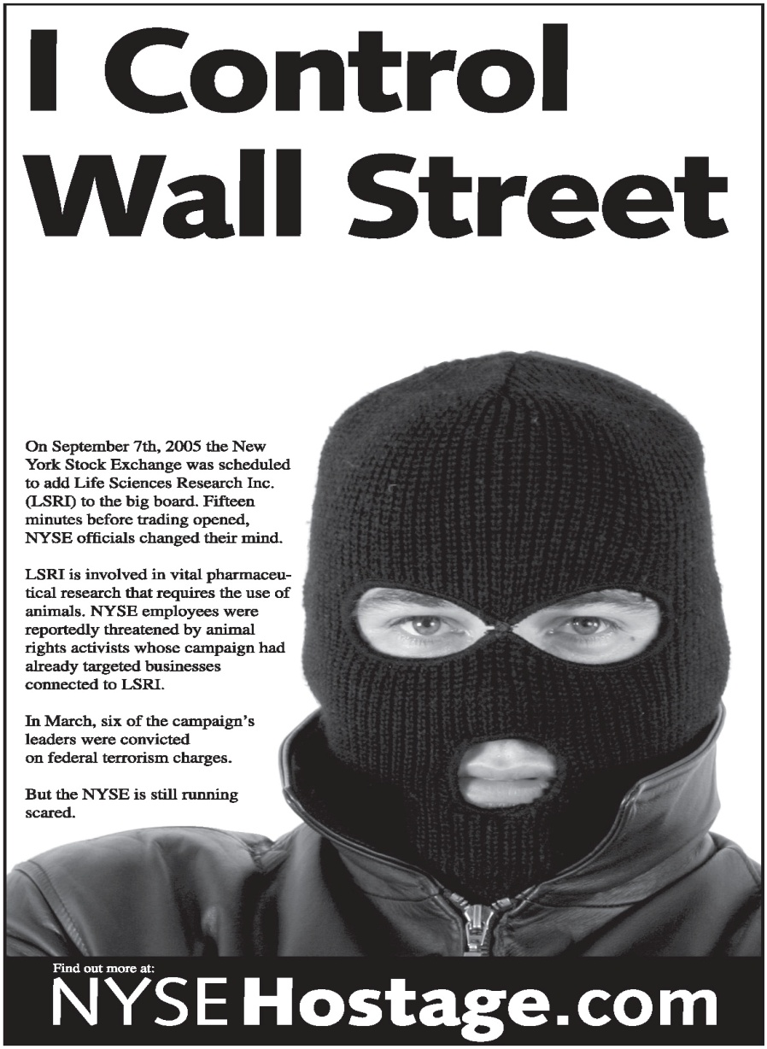

Slide 18
US v Fullmer (SHAC 7)
3rd Circuit Decision
No direct evidence of wrongdoing
No direct evidence of conspiracy
Convictions affirmed by the “totality of the circumstances”
584 F.3d 132 (2009)

Slide 19
Guilt by Association
“Direct action” goal to shut down HLS
  Anyone with this shared ideology acting in agreement was engaging in criminal conduct and conspiracy.
  “Black” faxes

Slide 20
Guilt by Association
Josh Harper
Engaged exclusively in protected First Amendment activity
Conviction for Conspiracy Upheld
  Friendship with Kevin Kjonaas and
  His longstanding political and personal support for the cause of animal rights
  ~ Cert Petition, p.23

Slide 21
Judge Fisher’s Dissent
Government never proved its case.
“[E]ven viewing the evidence in the light most favorable to the Government … no rational trier of fact could have found the essential elements to violate the AEPA beyond a reasonable doubt.”

Slide 22
Verdict
1 - 6 years in Federal Prison
$1,000,001 Restitution
Terrorism Designation

Slide 23
Conspiracy
You no longer need an overt act to prove conspiracy

Slide 24
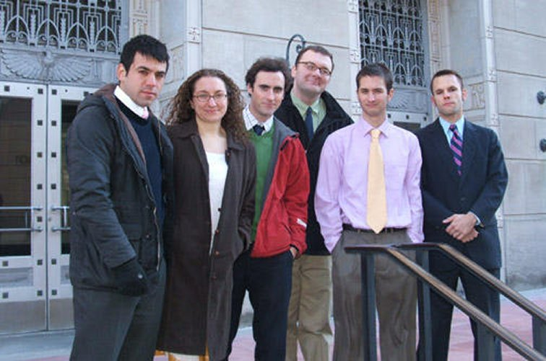
Source: Center for Constitutional Rights

Slide 25
“I was three weeks away from taking the Law School Admissions Test in 2004 when I was arrested and charged with domestic terrorism.
“I hadn’t hurt anyone or vandalized any property.
[T]he indictment didn’t allege that I’d committed any independent crime … only that I’d ‘conspired’ to publish a website that advocated and reported on protest activity against a notorious animal testing lab in New Jersey.”
~ Lauren Gazzola, SHAC 7 defendant, EGPNews.com Jan. 12, 2012

Slide 26
Violates 1st Amendment
Guilt by Association
NAACP v. Claiborne Hardware, 458 US 886 (1982)
Brandenburg v. Ohio, 395 US 444 (1969)

Slide 27
US v Buddenberg (2009)
Indictment
Buddenberg, Khajavi, Pope and Stumpo
“Intentionally plac[ing] a person in reasonable fear of death, or serious bodily injury … by a course of conduct involving threats, … harassment or intimidation”
Maximum penalty 5 years

Slide 28
US v Buddenberg
Criminal Complaint
  Protesting
  Chanting
  Using a bullhorn
  Conducting internet research
  Leafletting
  Wearing bandanas
  Chalking up the sidewalk

Slide 29
US v Buddenberg
Indictment Dismissed
No facts to support indictment
Rejects government’s argument that:
  “[I]t will rely on the defendants' conduct as a whole ... If individual acts did not amount to a threat or an act of intimidation or harassment, what conduct as a whole did?”
  ~ Order Dismissing Indictment, p.13.

Slide 30
Mission Accomplished!
Taken off the street
House arrest
Prior restraint
Reputational damage
Passports taken away
Sends a message

Slide 31
Judge Whyte
AETA can apply to anyone, including workers

Slide 32

Source: Center for Constitutional Rights

Slide 33
Challenging the AETA
Blum, Shapiro, Lehr, Gazzola and Johnson v. Holder
  U.S. District Ct, MA
  Filed Dec. 15, 2011

Slide 34
Animal Enterprises
Protected even if engaged in illegal activity
“Lawful” used only once in definition
Treated as a Protected Class
Recidivist Violators of Animal Welfare Act

Slide 35
Animal Enterprises
      Circuses
      Pet Stores
      Puppy Mills
      Factory Farms
      Animal Testing Labs
      Automobile Makers
      Department Stores
      Luncheonettes
      Porn Shops
Notes:
35

Slide 36
Animal Enterprises
“Vandalizing a circus billboard makes the vandal a terrorist, but vandalizing a circus protest sign remains a petty [state] crime.”
~ Jerry Friedman, “Why the Animal
Enterprise Terrorism Act Became Law,” 2007
Notes:
36

Slide 37
AETA Passes
Non-controversial bill
5 Votes in House
House: Bobby Scott (D-VA) & Tom Petri (R-WI)
Senate: Dianne Feinstein (D-CA) & James Inhofe (R-OK)
American Legislative Exchange Council

Slide 38


Slide 39
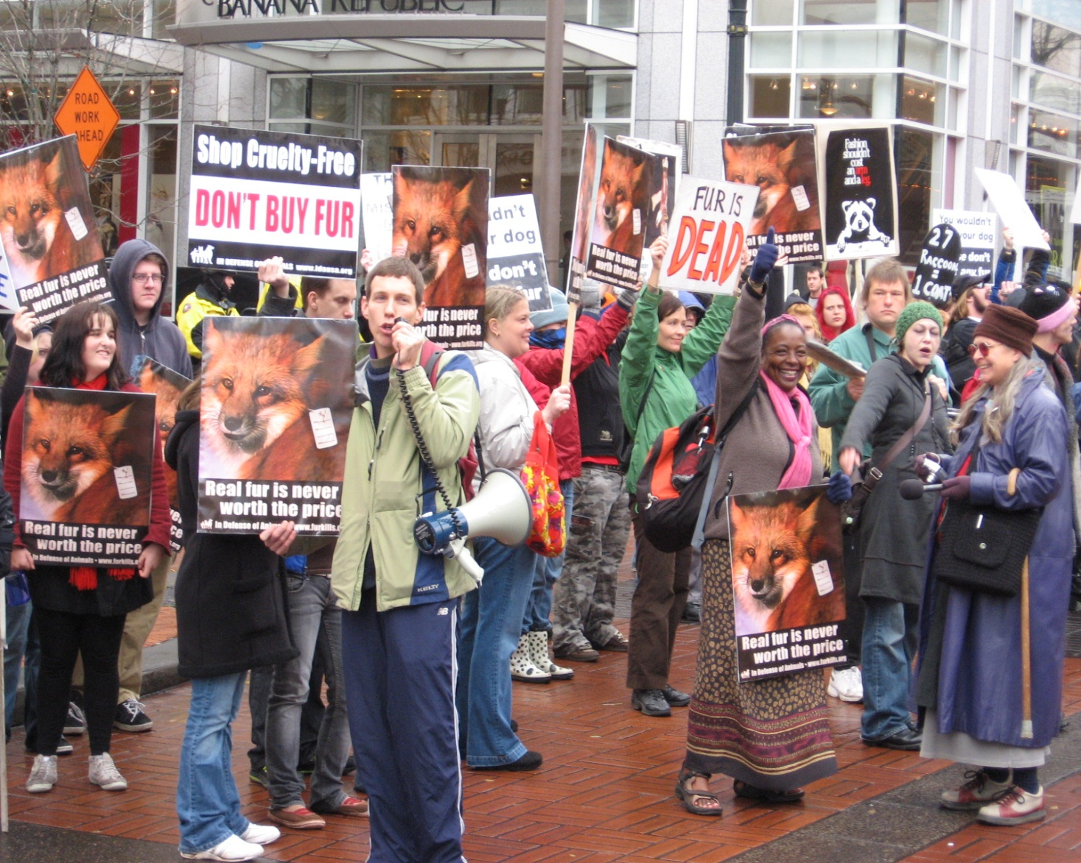

Slide 40
Infringes on State Sovereignty
ABA Task Force on Federalization of Criminal Law, 1998
Cites 3X Animal Enterprise Protection Act of 1992

Slide 41
Compare
Animal Activists:
  #1 Domestic Terrorism Threat
  1200 “incidents”
  No Murders

Slide 42
Anti-Abortionists
8 Murders
700 Blockades
33,000 Arrests
163,000 Disruptions
(e.g. picketing, bomb threats)
5000 Incidents of Violence
(41 bombings)
Source: National Abortion Federation

Slide 43
“Nuremberg Files”
Planned Parenthood of Columbia / Willamette, Inc. v. American Coalition of Life Activists, 290 F.3d 1058 (9th Cir. 2002)
Website postings - true threat
Civil case

Slide 44
Sarah Palin’s PAC Map
Bulls-Eye on Congresswoman Gabrielle Giffords’ District
“Don’t Retreat -- Instead, Reload”
GreenIsTheNewRed.com “If Sarah Palin Were an Animal Rights Activist, She’d Have Already Been Convicted of ‘Terrorism’” Jan. 9, 2011

Slide 45
Compare
White Supremacists
Militia Movement
Computer Programmers
Subprime Mortgage Crisis
  “Inside Job” - Best Documentary

Slide 46
Liberty vs. Security
Military Commissions Act 2006
John Warner Defense Authorization Act 2007
National Defense Authorization Act 2012

Slide 47
Liberty vs. Security
Bill of Rights:
Use it or Lose it

Slide 48
Liberty vs. Security
“Those who would give up essential liberty to purchase a little temporary safety, deserve neither liberty nor safety.”
~ Benjamin Franklin

Slide 49

Who will be my voice?
Repeal The Animal Enterprise Terrorism Act!

Slide 50
You Can Do Something About it!
Contact Your Legislators
Join AR 2013 Lobby Day
Go to noAETA.org

Slide 51
Green Is the New Red:
An Insider’s Account of a Social Movement Under Siege
By Will Potter
GreenIsTheNewRed.com

Slide 52
Odette J. Wilkens, Esq.
Equal Justice Alliance owilkens@equaljustice alliance.org

