Slide 1
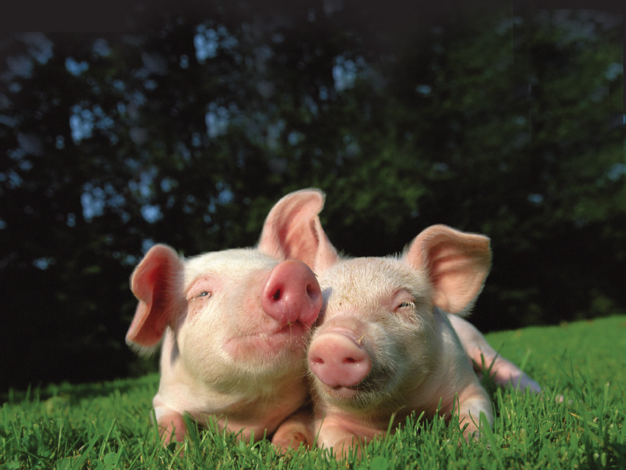
The Ethics & Viability of
Eating Animals
Bruce G. Friedrich
Farm Sanctuary
Bruce@FarmSanctuary.org

Slide 2
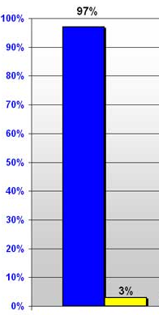
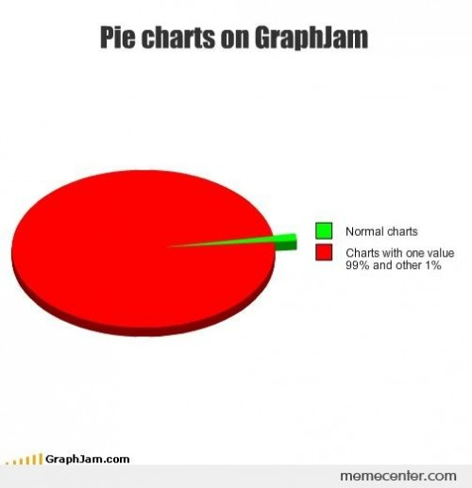
Near unanimity in the U.S.: We want animals to be protected, and we care about the environment.

Slide 3
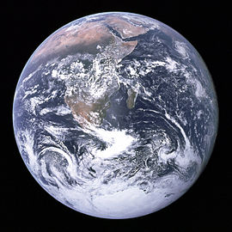

Aligning Ethics & Action:
1) the environment;
2) concern for animals.

Slide 4
1) The environment.

Slide 5
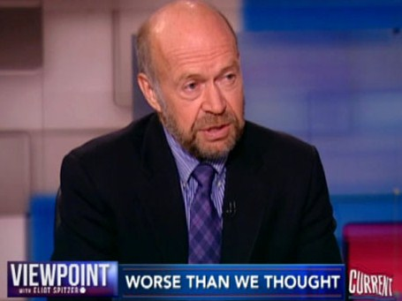
“Every major national science academy in the world has reported that global warming is real, caused mostly by humans, and requires urgent action… We can’t wait any longer to avoid the worst and be judged immoral by coming generations.”
  James Hansen, Director, NASA Goddard Institute for Space Studies

Slide 6
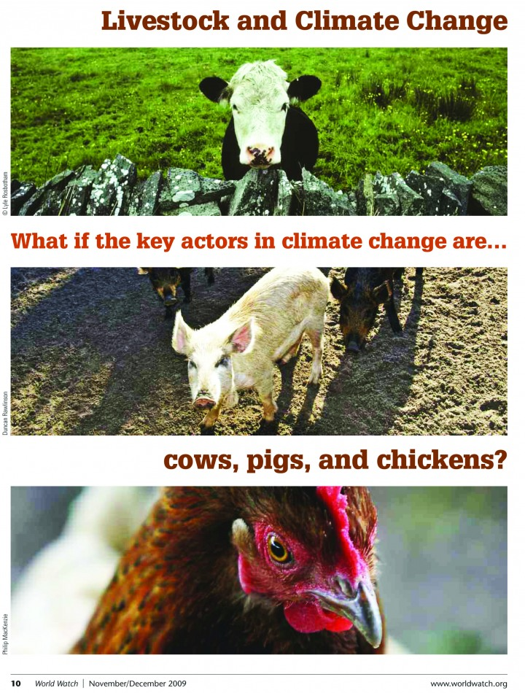
Meat has “been vastly underestimated as a source of GHGs, and in fact account for at least half of all human-caused GHGs.”
World Bank agricultural economists Robert Goodland and Jeff Anhang

Slide 7
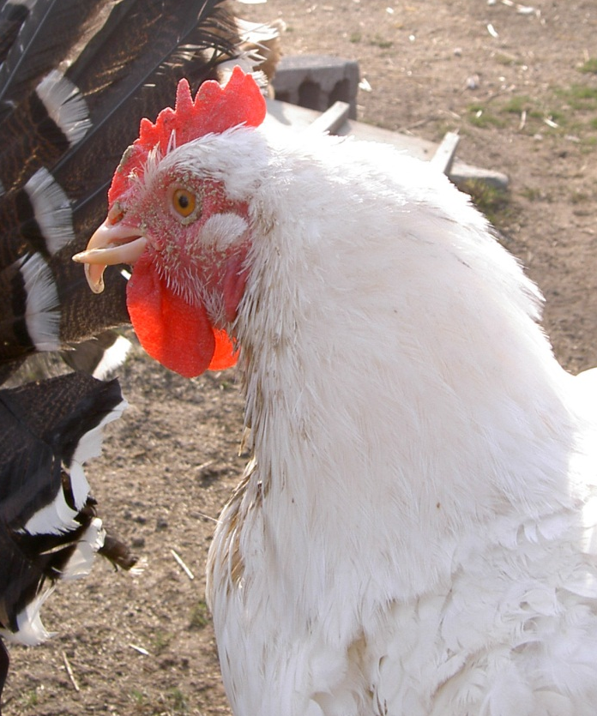
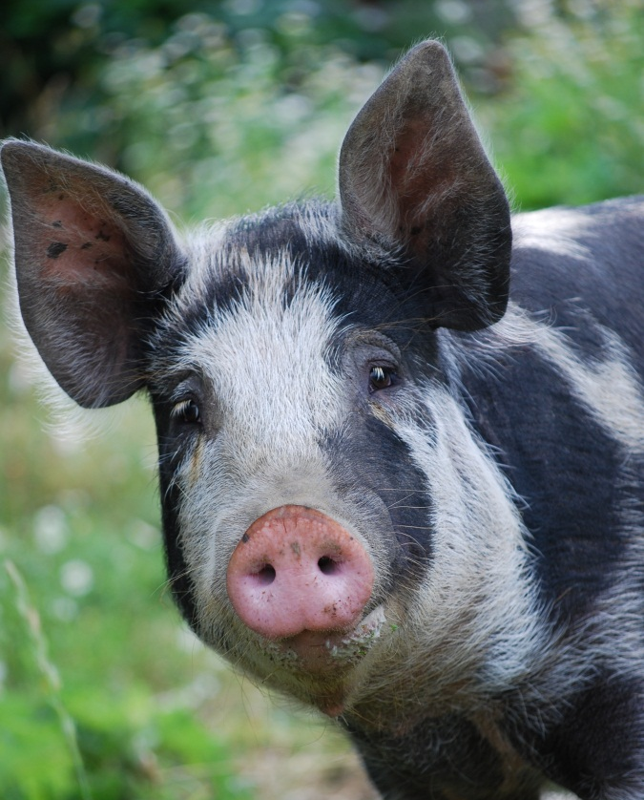
2) All meat entails eating:
Someone, not something.
Beaky Fiona

Slide 8
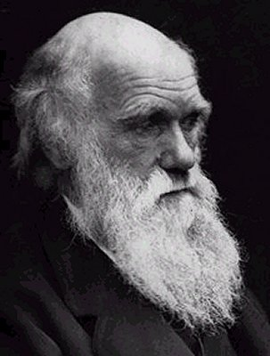
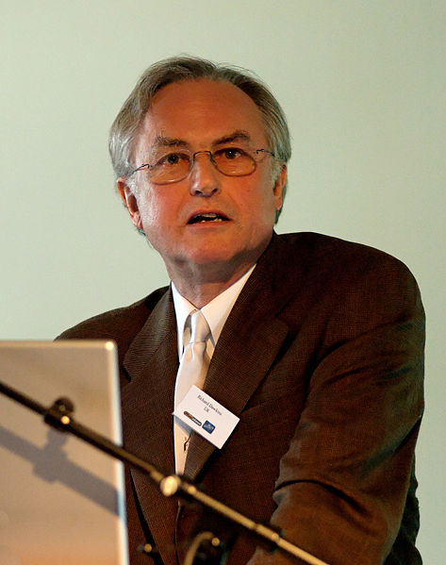
Animals are Someone, not Something

Slide 9
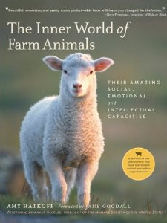
‎"Farm animals feel pleasure and sadness, excitement and resentment, depression, fear, and pain. They are far more aware and intelligent than we ever imagined . . . [T]hey are individuals in their own right.”
Dr. Jane Goodall
Someone, not something

Slide 10
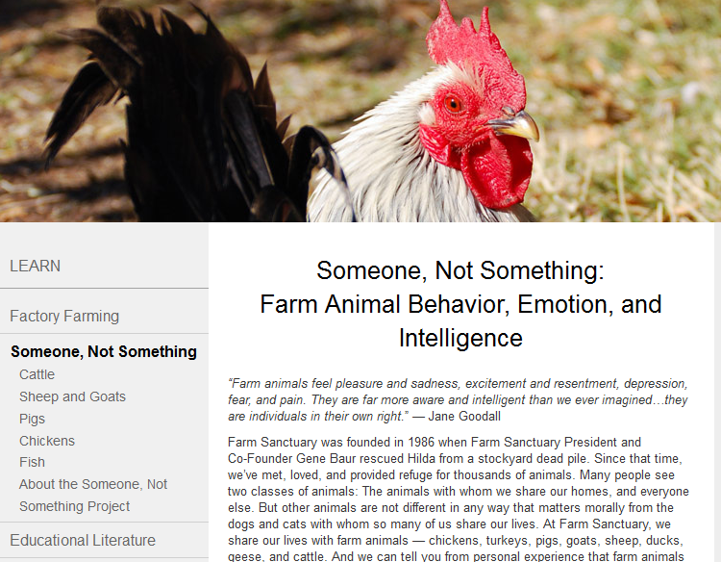

Slide 11

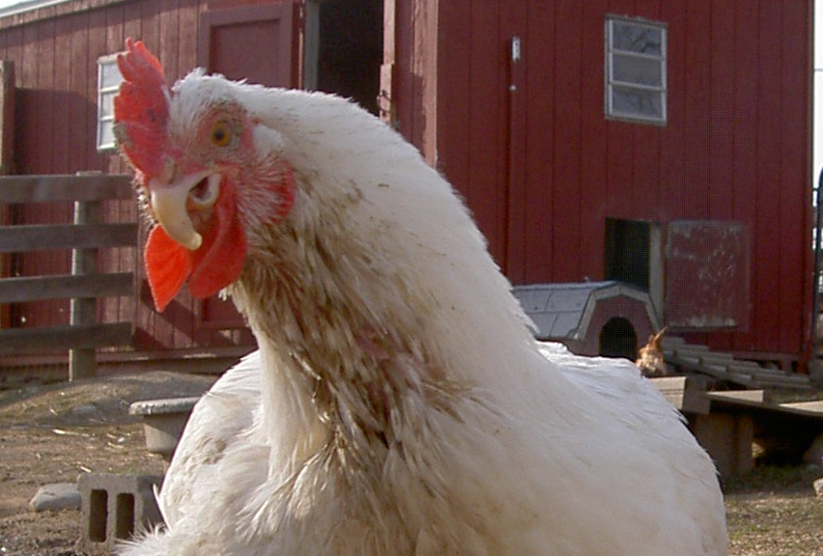
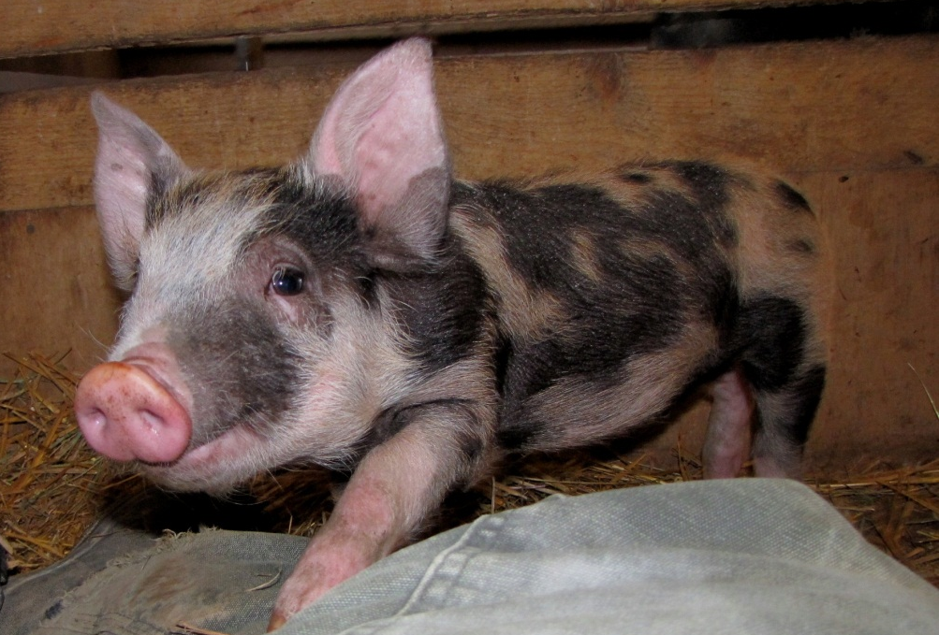
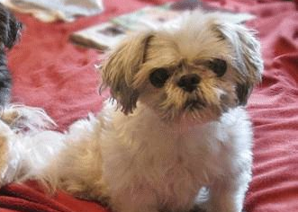
Intuition Backs Science
Notes:
No diff. between eating a cat or a chicken, a dog or a pig. Rena, Beaky, Viona, Chompers.

Slide 13
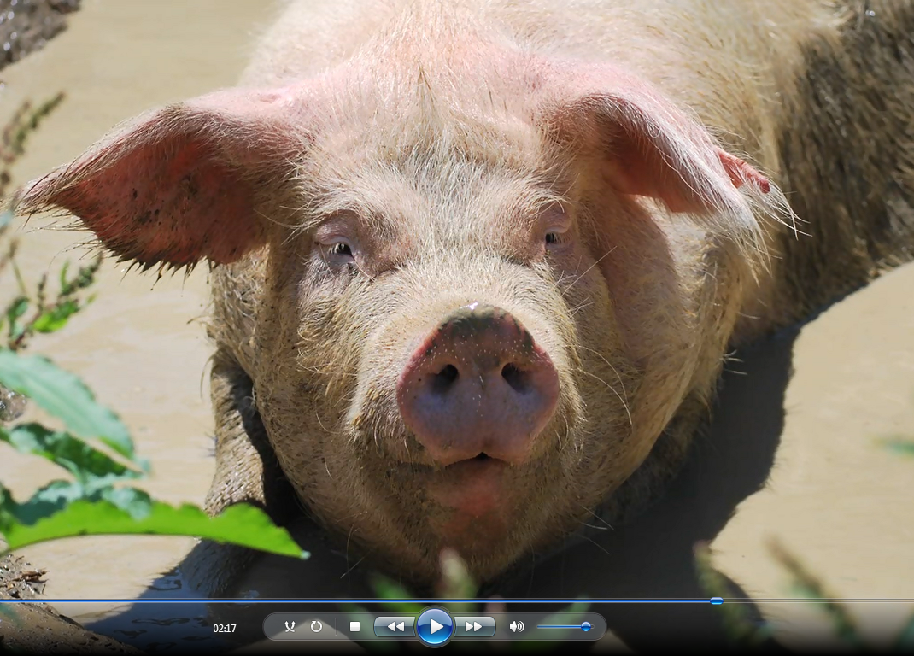
The Doctor

Slide 14

Is Eating
Meat Ethical?

Slide 15
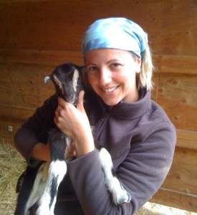
Opt. 1: Buy only from heritage producers.
"Self certify it. The only way you know it is okay with you is if you see it for yourself."

Slide 16
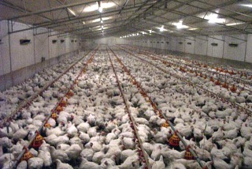
Option 2: Stop eating birds.

Slide 17
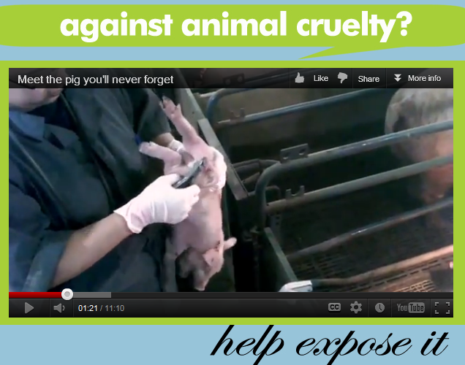
Just to be clear:

Slide 18
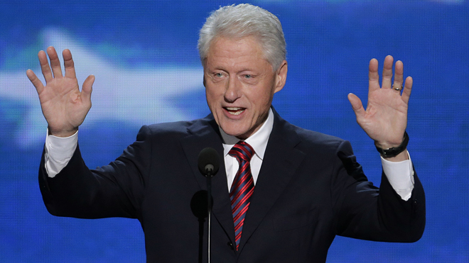
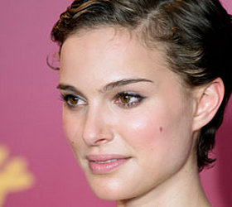
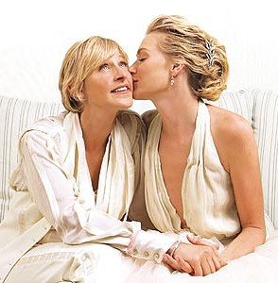
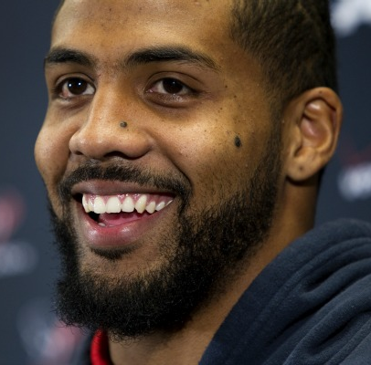
Opt. 3: Just Do It—Go Veg!

Slide 19


Slide 20
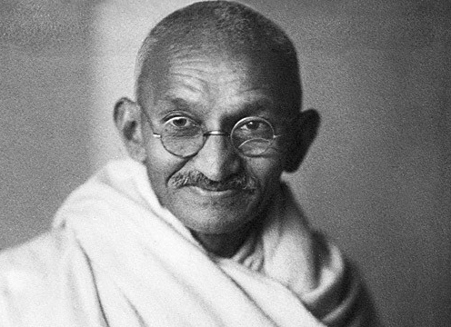
Spiritual health.
“Happiness is when what you think, what you say, and what you do are in harmony.”

Slide 21
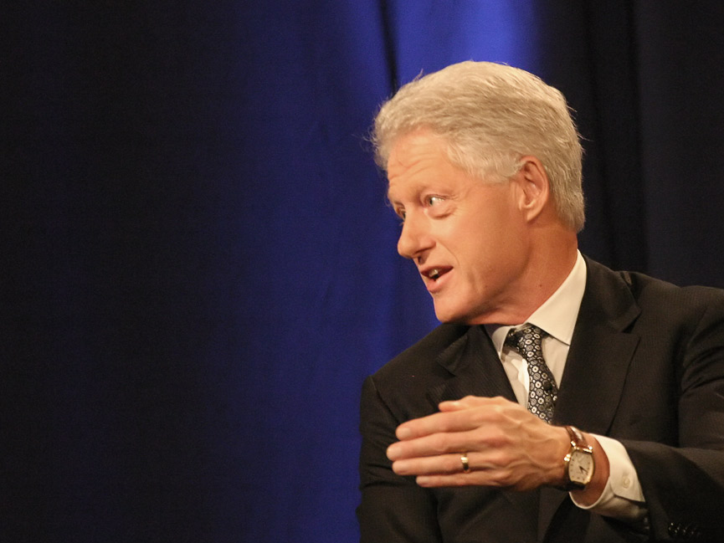
Physical health.
“It’s just a good thing to do. It’ll be healthier for you...” –Bill Clinton
Obesity Rates:
  Meat-eaters: 65%
  Vegetarians: 20%
  Vegans 3%

Slide 22
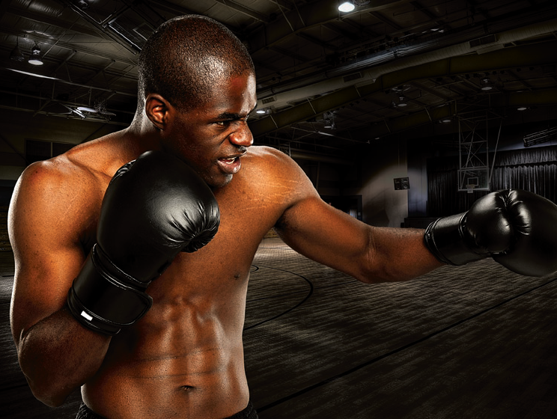
“When you don’t consume animal protein, you…feel completely different. I feel
superior over any athlete I get in the ring with…You have so much energy. I think it would benefit every athlete out there.”
Timothy Bradley
  Undefeated Welterweight Boxing Champion

Slide 23
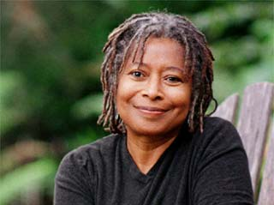
“Activism is my rent for living on this planet.”

Slide 24
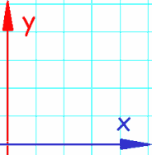
The Effect of Simple Activism
Veg Kit Stand
Meatless Monday table
Column in school
paper
Sticker on Laptop
You
100
200
300
400
500

Slide 25
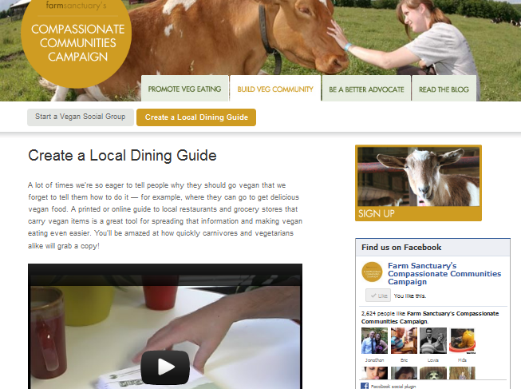

Slide 26
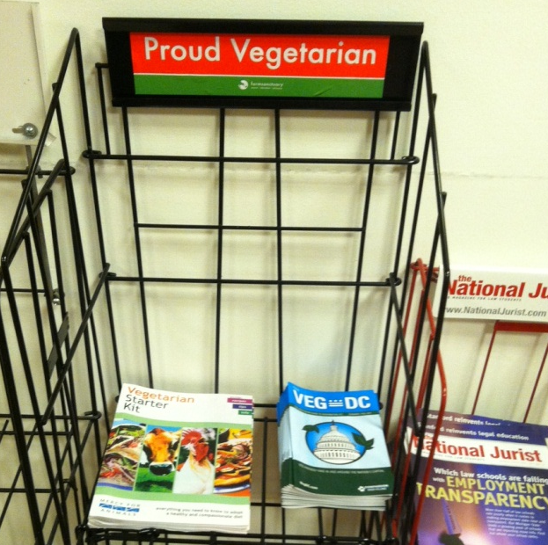
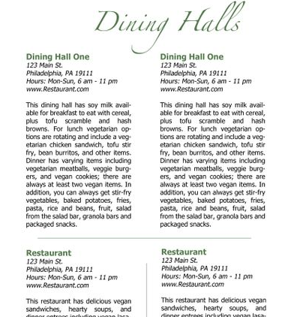
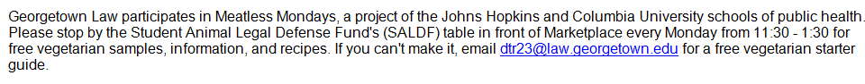
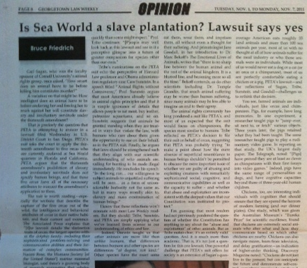
Multiply your impact in law school:
1) Veg. Stand; 2) Veg. Guide; 3) School paper.

Slide 27
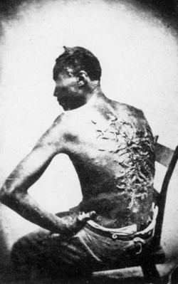
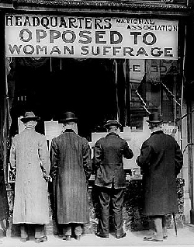
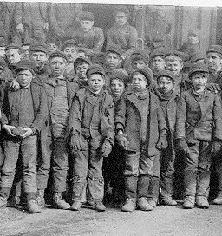
Historical Perspective

Slide 28
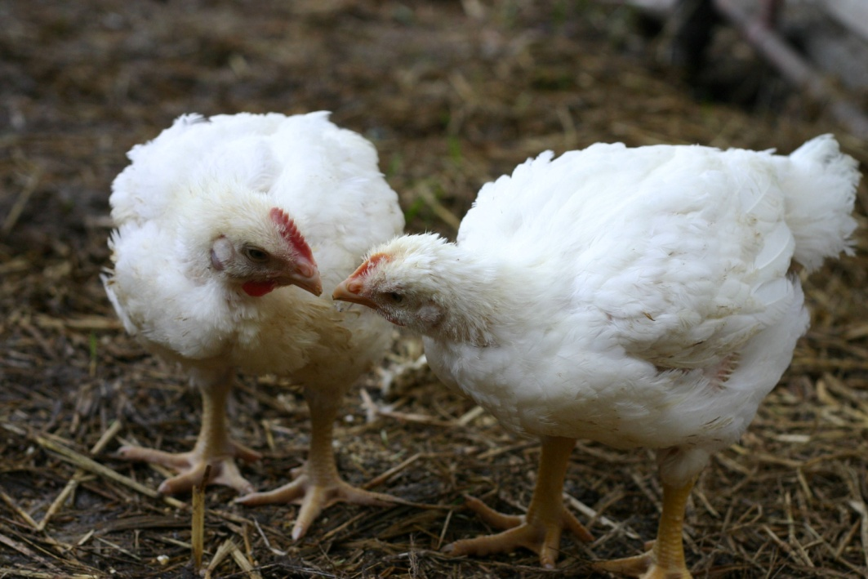
Thank you!
Bruce Friedrich, Farm Sanctuary
CompassionateCommunities.org
Bruce@FarmSanctuary.org

Slide 29

“If every American skipped one meal of chicken per week and substituted vegetables and grains…the carbon dioxide savings would be the same as taking more than 500,000 off of U.S. roads.”

Slide 30
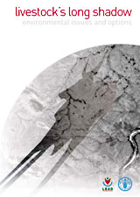
Eating animals is “one of the most significant contributors to the most serious environmental problems, at every scale from local to global.”

Slide 31
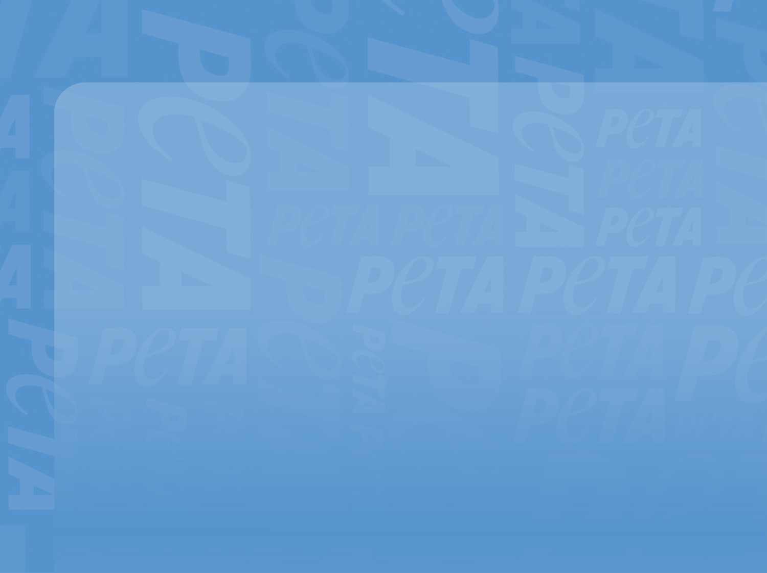
Going vegetarian is “the single most effective thing you can do to reduce your carbon footprint.”
—Live Earth Global Warming Survival Handbook
“A major shift toward plant-based diets is imperative if we are to have even a chance of preventing catastrophe …”
—Dr. Rajendra Pachauri, Intergovernmental Panel on Climate Change, Nobel Peace Prize winner

Slide 32
United Nations Report
The different methodologies do not invalidate the conclusions of Livestock’s Long Shadow, including the conclusion that livestock production contributes 18 percent to total global climate change in both direct and indirect ways. Gerber told the Columbia Journalism Review, “We stand entirely behind the 18 percent figure.”

Slide 33
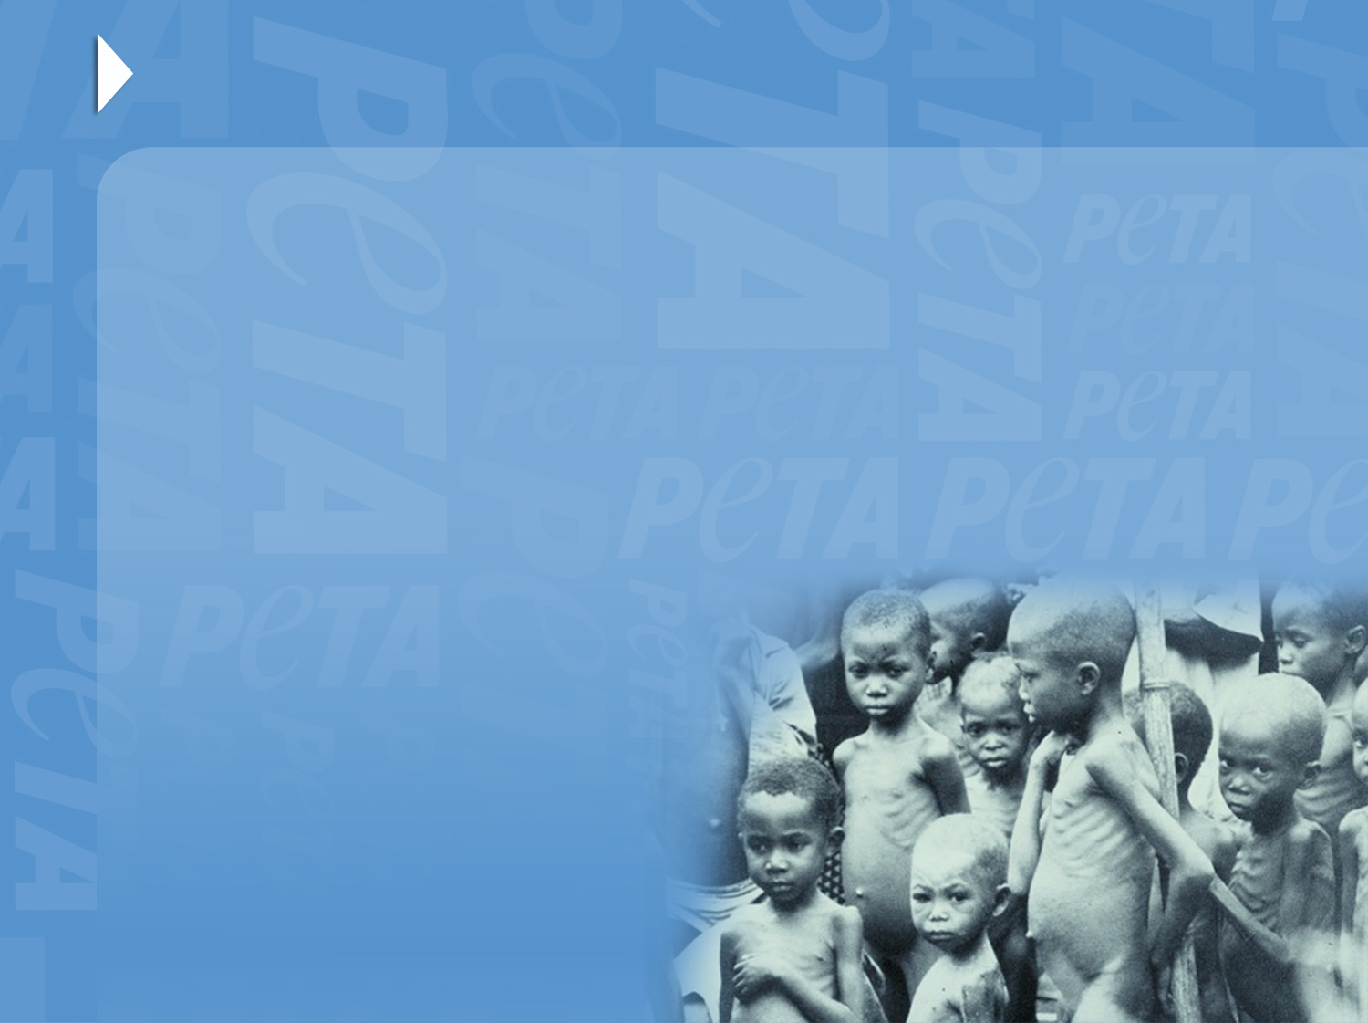
Global Poverty
  “Meat production is an inefficient use of grain―the grain is used more efficiently when consumed directly by humans. Continued growth in meat output is dependent on feeding grain to animals, creating competition for
  grain between affluent
  meat eaters and the
  world’s poor.”
  ―WorldWatch Institute

Slide 34
Health
According to the American Dietetic Association (2010):
Vegetarians have lower rates of heart disease, diabetes, high blood pressure, cancer, and obesity than meat-eaters.
Vegetarian and vegan diets are appropriate for all life stages, including infancy and pregnancy.
Vegetarian diets have health benefits in the prevention and treatment of certain diseases.
Obesity Rates: Meat-eaters 65%
Vegetarians 20%
Vegans 3%

Slide 35
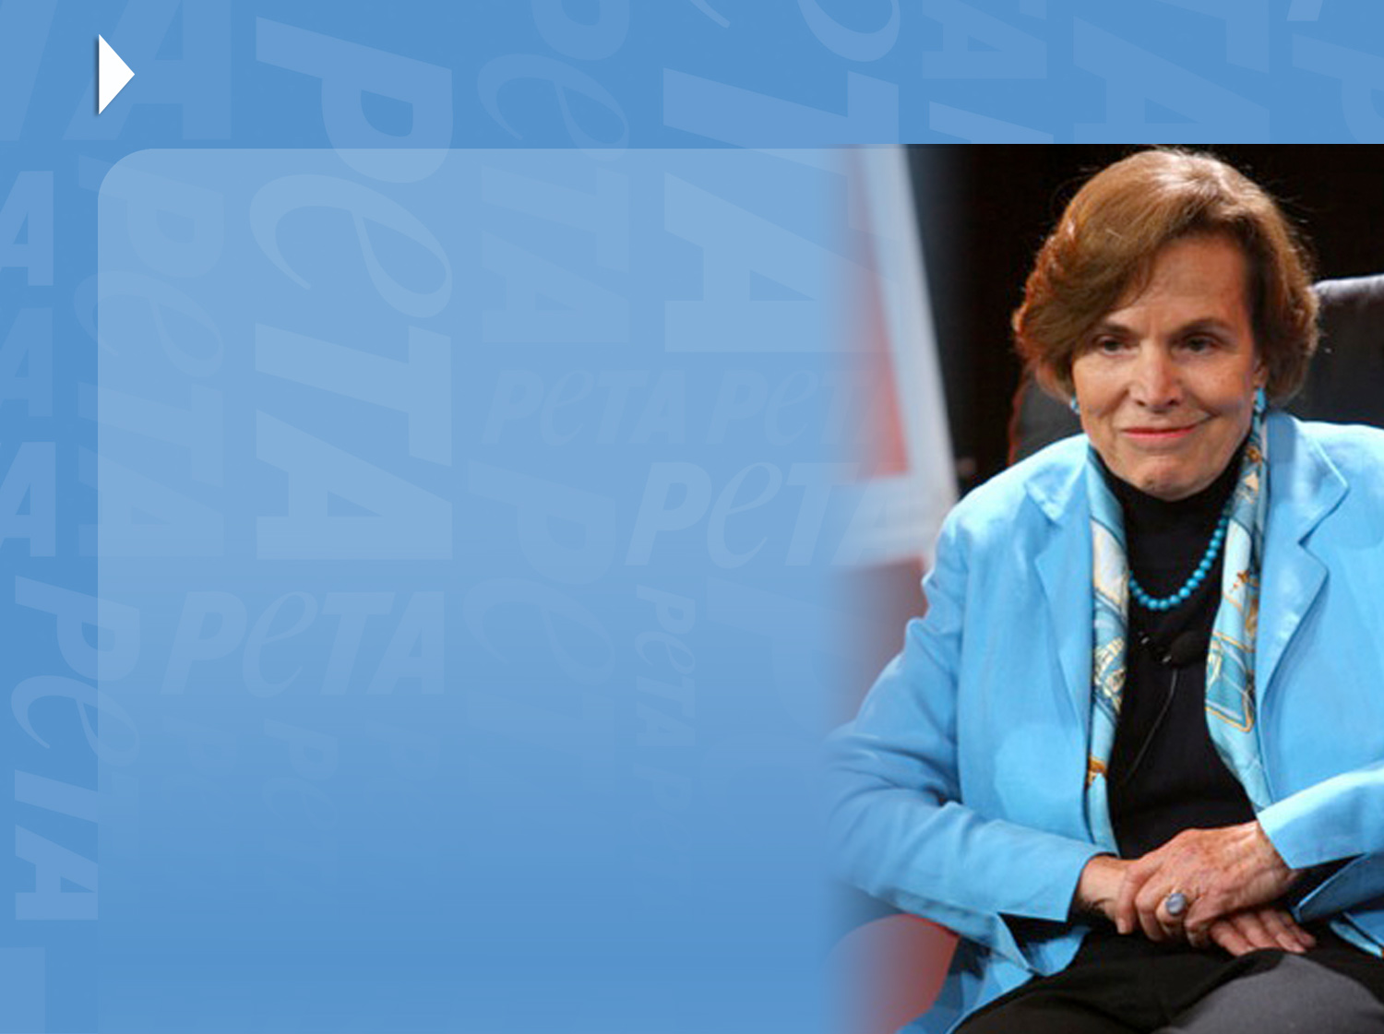
Fish
“I never eat anyone
I know personally.
I wouldn't deliberately eat a grouper any more than I’d eat a cocker spaniel. They're so good-natured, so curious. You know,
fish are sensitive, they have personalities,
they hurt when
they’re wounded.”

