Slide 1
Thirteenth Amendment to the U.S. Constitution
“Neither slavery nor involuntary servitude, except as a punishment for crime whereof the party shall have been duly convicted, shall exist within the United States, or any place subject to their jurisdiction.”

Slide 2
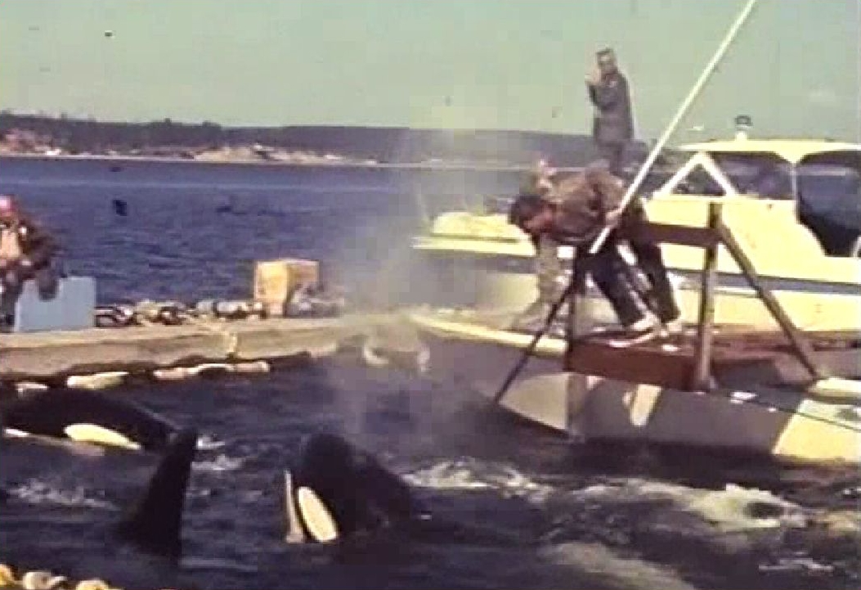

Slide 3
Thirteenth Amendment to the U.S. Constitution
“Neither slavery nor involuntary servitude, except as a punishment for crime whereof the party shall have been duly convicted, shall exist within the United States, or any place subject to their jurisdiction.”

Slide 4
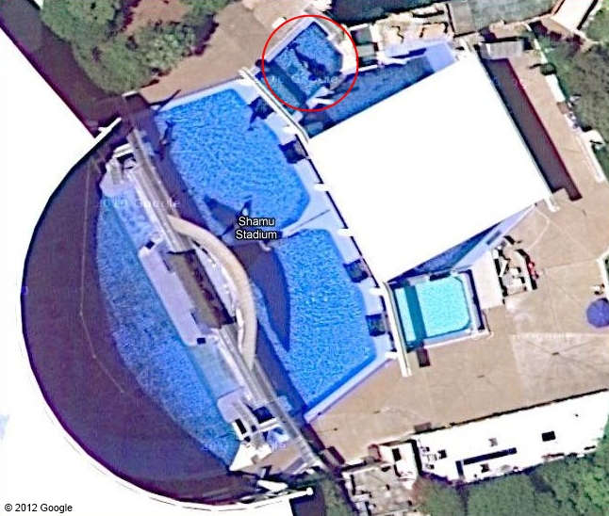

Slide 5
Thirteenth Amendment to the U.S. Constitution
“Neither slavery nor involuntary servitude, except as a punishment for crime whereof the party shall have been duly convicted, shall exist within the United States, or any place subject to their jurisdiction.”

Slide 6
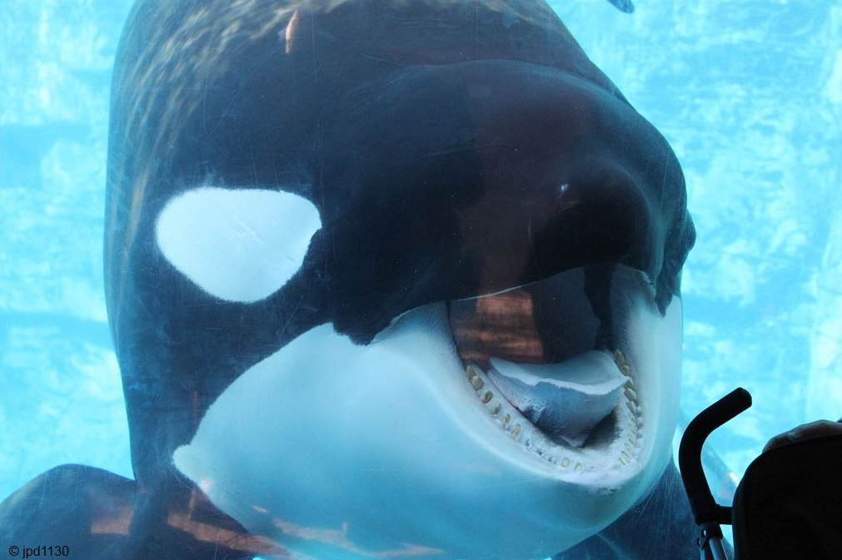

Slide 7
Thirteenth Amendment to the U.S. Constitution
“Neither slavery nor involuntary servitude, except as a punishment for crime whereof the party shall have been duly convicted, shall exist within the United States, or any place subject to their jurisdiction.”

Slide 8
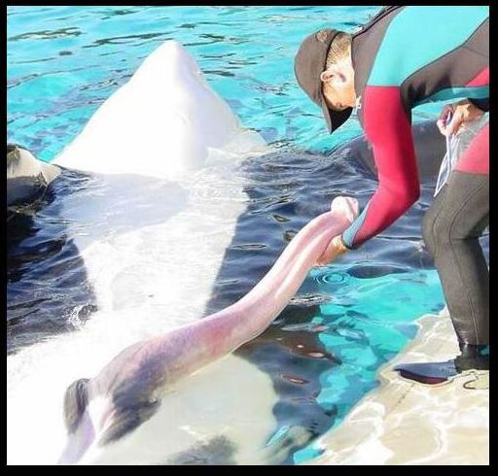

Slide 9
Thirteenth Amendment to the U.S. Constitution
“Neither slavery nor involuntary servitude, except as a punishment for crime whereof the party shall have been duly convicted, shall exist within the United States, or any place subject to their jurisdiction.”

