Slide 1
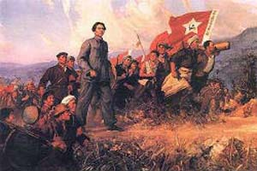

Slide 2

CONTENT
RSPCA Introduction
East Asia Legislation
Approach to China
Internal and External Pressures for Animal Protection
China’s Draft Law
Civil Society and Social Media
Challenges
Looking Forward

Slide 3
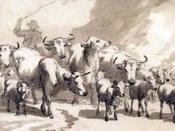

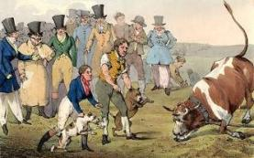
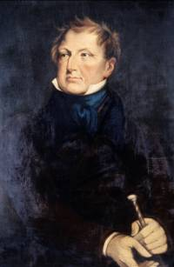

RSPCA INTRODUCTION
1824, world’s oldest animal welfare organisation
Charity, no government funding
Enforces animal protection law in England/Wales
Lobbies, campaigns and educates
Income in 2011 of $170m; 1,650 staff

Slide 4

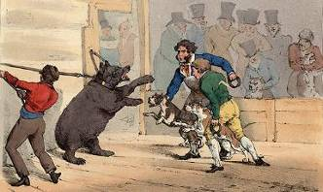
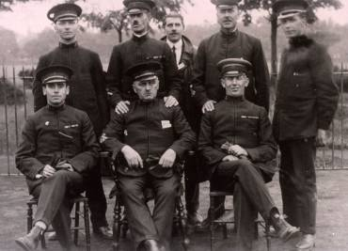
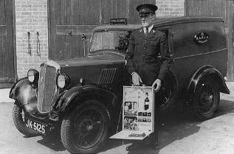
RSPCA INTRODUCTION

Slide 5
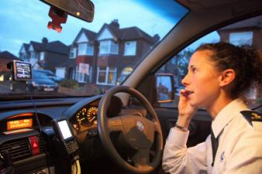

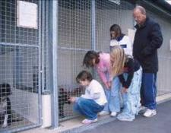
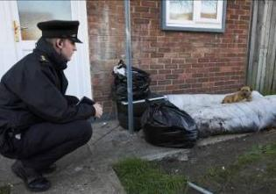
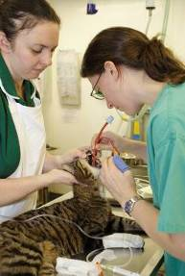
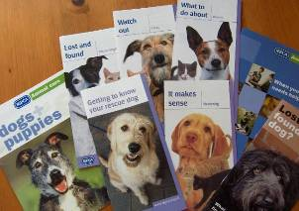
RSPCA INTRODUCTION

Slide 6
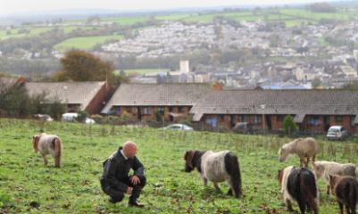
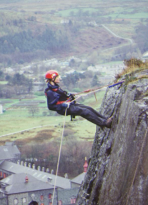
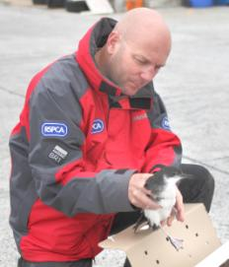
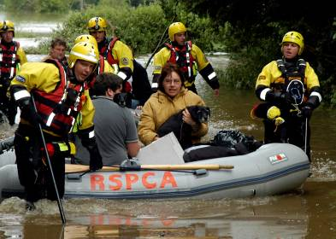
RSPCA INTRODUCTION

Slide 7
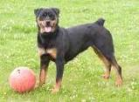
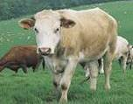
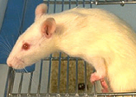
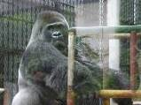
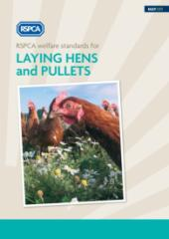
RSPCA INTRODUCTION
30 scientific staff, 4 departments
Farm animal welfare standards, reports, care guidance
http://www.rspca.org.uk/sciencegroup/farmanimals/standards
Advise UK government, EU bodies

Slide 8
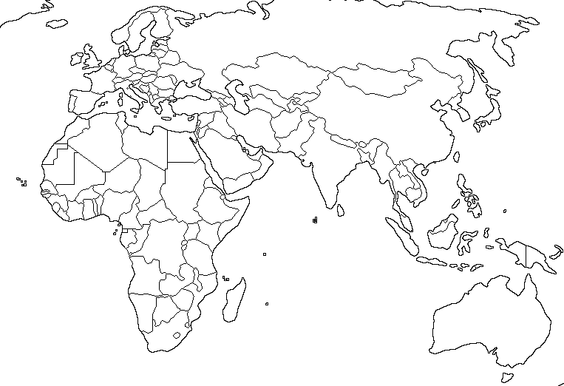




RSPCA INTERNATIONAL

Slide 9

RSPCA INTERNATIONAL’S APPROACH
We are a small team, no offices abroad
We start from where the country is in its development
We build country-specific and regional knowledge
We seek out effective partnerships
We have a long-term commitment
We are principled but also pragmatic – we choose our battles
Notes:
Intro 1

Slide 10
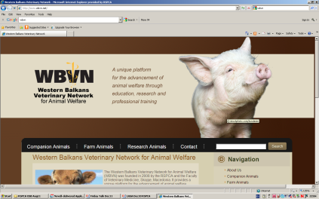
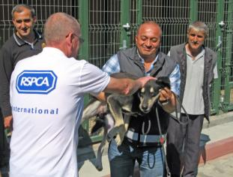
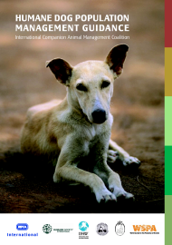
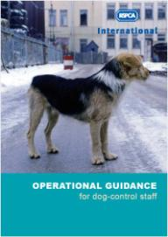
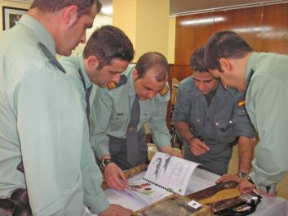
RSPCA INTERNATIONAL

Slide 11
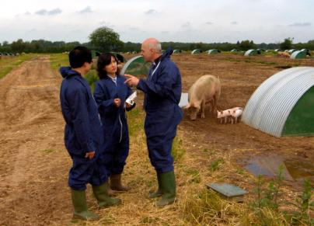
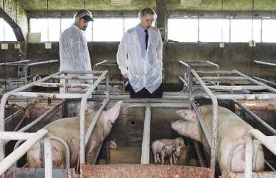
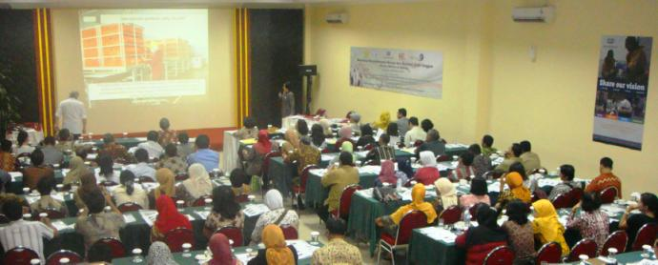
RSPCA INTERNATIONAL

Slide 12
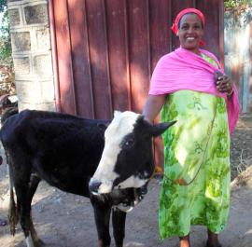
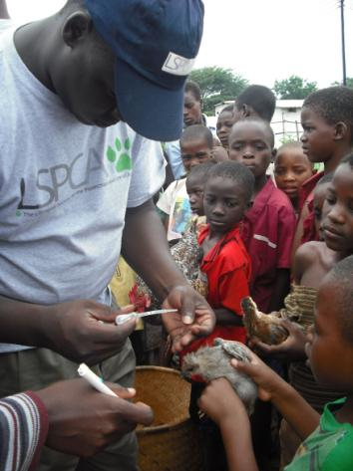
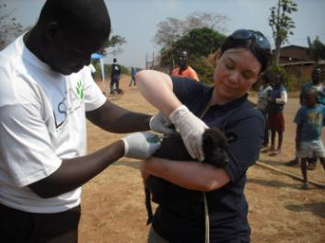
ONE HEALTH

Slide 13
EAST ASIA: ANTI-CRUELTY LEGISLATION
Country/Region | Status | RSPCA activity 1999-2012
CHINA | No legislation for domestic animals | 99, 09, 11: Support for animal law textbooks 07, 08, 10: International animal law fora, Jinan/Beijing; continued input into draft law development
HK | SPCA inspectors, law being revised | 06-07: Inspectors seconded to RSPCA 08-09: law enforcement training in HK
TAIWAN | 1998 APL – local govt inspectors | 99-04: four law enforcement training courses; UK study tour 09: consultancy on training programme development 10: investigation/animal welfare assessment training 11: pet shop inspection training
JAPAN | 2005 revised APL – local govt inspectors | RSPCA input on revised legislation 09, 12: two law enforcement training courses, MoE/JAWS/local govt
KOREA | 2008 revised APL – local govt inspectors | RSPCA input on revised legislation 10-11: participation in regional training for honorary inspectors

Slide 14
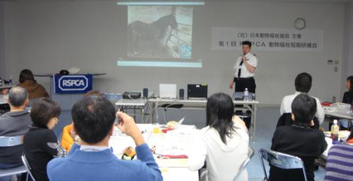
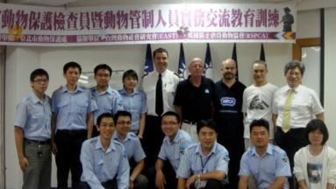
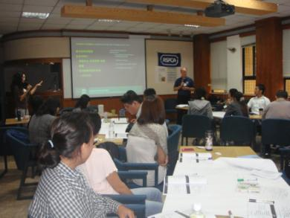
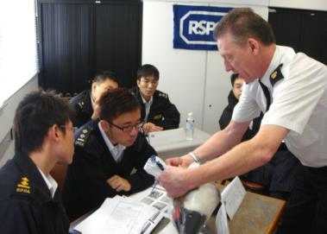
EAST ASIA: ANTI-CRUELTY LEGISLATION

Slide 15
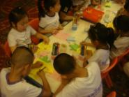
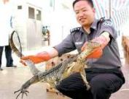
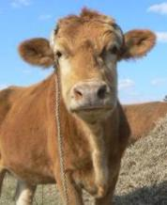
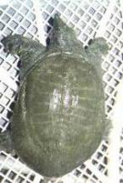
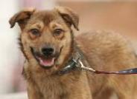
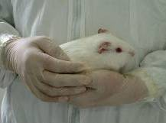
APPROACH TO CHINA
EDUCATION
LEGISLATION
Companion
Research
Farm
Wild
Notes:
Intro 1

Slide 16
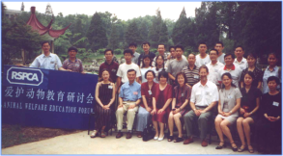
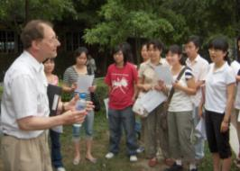
EDUCATION
2000: Animal Welfare Education Forum, pioneering event with 40 participants
2004-12: Animal welfare education training with Jane Goodall Institute, delivering training and a manual to 600 school and university groups across China
2008-12: China National Institute for Educational Research, training 250 teachers and delivering textbooks and teachers’ guides across 12 provinces

Slide 17
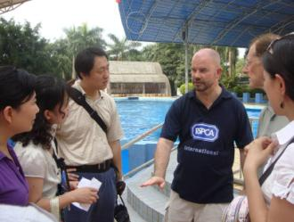
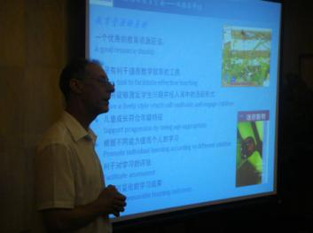
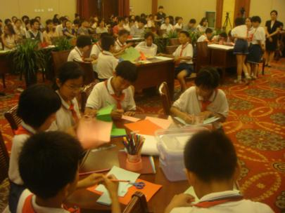
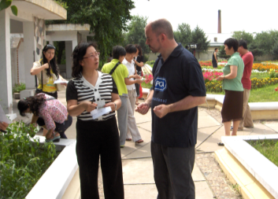
EDUCATION

Slide 18
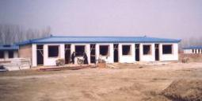




COMPANION ANIMALS

Slide 19


FARM ANIMALS
2005: International Forum on Animal Welfare and Meat Safety, 100 participants, opened the door for international farm animal welfare organisations
2006: Launch of humane slaughter training led by WSPA, development of pig slaughter standards, potential impact on half the world’s pigs
2008-09: The Importance of Farm Animal Welfare Science to Sustainable Agriculture conferences: officials, academics, researchers and producers
2011-12: Food and Climate Change, long-term planning for China’s increasing meat/dairy consumption

Slide 20






FARM ANIMALS

Slide 21


RESEARCH ANIMALS
2007: China Association for Laboratory Animal Science translation of RSPCA lab animal care materials
2008: RSPCA participation in 3rd AFLAS Congress, Beijing, 800 participants
2009-12: CALAS, training courses reaching 300 scientists, researchers and lab technicians, opportunity to shape new regulations and standards in 2013, influencing conditions for 16m lab animals (cf EU 12m)

Slide 22



RESEARCH ANIMALS

Slide 23



RESEARCH ANIMALS

Slide 24



INTERNAL PRESSURES FOR ANIMAL PROTECTION
2002: Liu Haiyang’s acid attack on bears
2004: ‘Animal Welfare’ tv documentary: sympathetic media begins calling for law
2005: investigation into fur farming
2006: cat killing pictures online
2007: first ‘hijacking’ of cat transporters destined for food trade
Legal void persists: captive wild and domestic animals not protected
Notes:
Intro 1

Slide 25



EXTERNAL DRIVERS FOR ANIMAL PROTECTION
Disease control and food safety; avian influenza 1999-2009, SARS 2003, FMD 2007
OIE Strategic Plan 2001-2005, developing terrestrial codes including animal welfare
2007 China resumed full participation in OIE
International responses to dog culls, cruel animal performances etc
China’s response to animal issues from outside: bullfighting, rodeos, greyhounds, foie gras, seal products, shark-finning
Notes:
Intro 1

Slide 26



THE SPACE FOR DEBATE
Academics, intellectuals
Chinese animal protection groups
International organisations
Officials
Professional bodies
Media, investigative journalists
Social media
Notes:
Intro 1

Slide 27


CURRENT ANIMAL LAW
Wildlife Protection Law (1988)
Article 1.1
‘This law is enacted in order to protect and rescue valuable or endangered wild animals; to protect, develop and rationally use wildlife resources; and to maintain ecological balance.’

Slide 28



THE DRAFTING PROCESS
2007: Animal law seminar, Shandong University
2008: RSPCA/Chinese Academy of Social Sciences International Forum on Animal Protection Law in China
2008: Centre for Animal Law Studies established in Xi’an; drafting committee formed
2009: ‘Animal Protection Law’ draft released for public consultation; revision followed
2010: RSPCA/CASS/Animal Guardians Forum, reworked ‘Prevention of Cruelty to Animals Law’ draft released and discussed, refined
2011: Draft ‘Prevention of Cruelty to Animals Law’ tabled at the National People’s Congress
Notes:
Intro 1

Slide 29
CHINA’S DRAFT LAW
Prevention of Cruelty to Animals Law of the PRC (Experts’ Draft Proposal, Dec 2010)
Chapter 1 General Principles
Chapter 2 Principal Systems for the Prevention of Cruelty to Animals
Chapter 3 Cruelty Prevention Measures for Each Animal Category
Section (i) Cruelty Prevention Measures for Wild Animals
Section (ii) Cruelty Prevention Measures for Economic Animals
Section (iii) Cruelty Prevention Measures for Pet Animals
Section (iv) Cruelty Prevention Measures for Laboratory Animals
Section (v) Cruelty Prevention Measures for Other Animals
Chapter 4 Cruelty Prevention Measures in Respect of Veterinary Treatment
Chapter 5 Cruelty Prevention Measures in Respect of the Transport of Animals
Chapter 6 Cruelty Prevention Measures in Respect of the Slaughter of Animals
Chapter 7 Legal Liability
Chapter 8 Appendix
Notes:
Intro 1

Slide 30
CHINA’S DRAFT LAW
Article 3 (Basic Definitions)
In this Law ‘cruelty’ refers to the deliberate use of brutal means or methods to cause unnecessary suffering or harm to an animal, or the use of brutal means or methods to kill an animal.
In this Law ‘abandonment’ refers to such acts as the deliberate disposal of animals whose abandonment in the wild is improper or inappropriate. This Law stipulates that abandonment shall be regarded as cruelty and penalised accordingly.
Notes:
Intro 1

Slide 31

CHINA’S DRAFT LAW
Article 17 (Conditions for the Rearing of Animals and Record-Keeping Systems)
Those who rear, use and care for animals should guarantee that animals enjoy suitable space, a clean environment, appropriate temperature, and should provide other necessary conditions.
Notes:
Intro 1

Slide 32


CHINA’S DRAFT LAW
Article 18 (Systems for Restrictions and Prohibitions on Conduct)
[…] The organising or advertising of fights between animals or fights between humans and animals are prohibited.
The publication in media for the purposes of promoting or encouraging cruelty towards animals, of photographic or video images or sounds of cruelty towards animals is prohibited.
Notes:
Intro 1

Slide 33


CHINA’S DRAFT LAW
Article 25 (Prohibition on the Slaughter, Consumption and Abandonment of Dogs and Cats)
People’s Governments […], in accordance with the requirements of local ethnic groups and customs, may decide areas in which to prohibit the slaughter for food of dogs and cats, and prohibit the sale and transportation of products made from their meat, organs, skin or fur.
Notes:
Intro 1

Slide 34

CHINA’S DRAFT LAW
Article 39 (Cruelty Prevention Measures for Performing Animals)
[…] The forcing of animals at work or in performances to exceed their natural ability is prohibited; the kicking, whipping, and other violent or cruel methods of driving them to perform or compete are prohibited.
The use of cruelty towards, or harassment or humiliation of animals in the content of performances is prohibited; the feeding in public of a live animal to a carnivore, causing the former fear, terror, harm or death for the purposes of enjoyment or commercial gain, is prohibited.
Notes:
Intro 1

Slide 35


IMPACT OF THE DRAFT LAW
Created a language around animal abuse and welfare: drawn on later
Process of writing, reviewing, refining was collaborative, allowed broad input
Draft drew criticism, allowing proponents to identify nature and scale of opposition to animal protection
Influenced writing of standards, interim measures before full legislation can be achieved
Notes:
Intro 1

Slide 36




IMPACT OF THE DRAFT LAW
National People’s Congress
Chinese People's Political Consultative Conference
2011: ‘Prevention of Cruelty to Animals’ Draft Law formally proposed at the NPC
‘Although our society has progressed very rapidly in recent years, many people’s concepts around the treatment of animals remain extremely outdated…Without regulation to coordinate the relationship between humans and nature, we are bound to reap the consequences in the future.’
Jing Yidan, NPC Representative, People’s Daily online 9 March 2012
Jing Yidan

Slide 37


IMPACT OF THE DRAFT LAW
Zoo Management Regulations, 2010
Mar : ‘Prevention of Cruelty to Animals’ draft law released
Jul: State Forestry Bureau banned close contact between visitors and wild animals, and performances involving cruelty
Oct: Ministry of Housing and Urban-Rural Development issued an order banning all animal performances, effective Jan 2011
Notes:
Intro 1

Slide 38



CHINA’S ANIMAL PROTECTION COMMUNITY
Local animal protection groups, capacity building
Asia for Animals Conference 2011, Chengdu
Weibo – microblogging (300 million users)
QQ – IM (720 million users)
Notes:
Intro 1

Slide 39






STATUS OF DOGS

Slide 40


PET-KEEPING TRENDS
33 million households in China keep a cat or dog (Euromonitor, 2012)
Expenditure on pet care increased 46% from 2007 to 2012, reaching 7.84 billion yuan (USD1.25bn)
By 2017 market for pet food, health care and dietary supplements will increase a further 64%
2012: 14% of population is over 60 (United Nations)
2050: 30% of population will be over 60

Slide 41



THE ROLE OF SOCIAL MEDIA
January 2012, Chongqing: motorist reported transport of dogs
Police and local officials intervened
1,100 dogs (some with collars and clothing)
Forged quarantine certificate
Dogs handed over to animal protection groups, without payment made to the driver

Slide 42




THE ROLE OF SOCIAL MEDIA
Aug 2012, Tianjin: volunteers of Tianjin Stray Animal Rescue Group discovered a place where stolen cats were kept waiting to be transported

Slide 43


THE ROLE OF SOCIAL MEDIA
Live extraction of bear bile
February 2012: Gui Zhen Tang Pharmaceutical Company sought listing on stock exchange

Slide 44

THE ROLE OF SOCIAL MEDIA
The company’s new blog received tens of thousands of critical comments, ignited debate on animal welfare before the NPC

Slide 45

THE ROLE OF SOCIAL MEDIA
2012: Ban on bear bile proposed at the CPPCC
‘Live extraction of bear bile is really very cruel, brutal. Creating a man-made wound on the animal’s body, a wound which will never heal during its entire life, we seek to make profit from this mercenary procedure. This practice will have a negative influence on the values we are seeking to establish in our society. It has also damaged the image of our country’s civilisation, it is extremely inhumane and incompatible with contemporary culture in our society.’
Feng Jicai, CPPCC Representative, http://news.youth.cn/
Feng Jicai

Slide 46

THE ROLE OF SOCIAL MEDIA
Call for ban on live bear bile extraction was 8th most discussed topic online
http://news.sina.com.cn/z/2012qglh/weishuju.html

Slide 47
BREAKING NEWS…
‘General Rules on Animal Welfare’ announced 28 Sep 2012
Drafted by the Standardization Administration of the PRC, responsible for ensuring that economic development keeps pace with international standards
Non-compulsory code of recommendations , encouraging better understanding of the needs of animals and discouraging abuse
Practical interim measure to raise public awareness before the eventual passage of full legislation
First time the government will send a clear message about the treatment of all animals – one step away from legislation

Slide 48


CHALLENGES
China’s rural diversity
Policy of increased meat and dairy consumption
Impact on environment
Food cultures
Enforcement of standards and legislation

Slide 49


FUTURE TRENDS
Momentum for legislation continues, law in other areas strengthened
Moral education continues to be concern, reaction to cruelty
12th Five Year Plan 2011-2015: environment, consolidation of pharmaceuticals and biotechnology
Food safety, quality, consumer protection , export opportunities remain factors in influencing meat/dairy production
Li Keqiang
Xi Jinping

Slide 50

THANK YOU
www.rspca.org.uk

