Slide 1
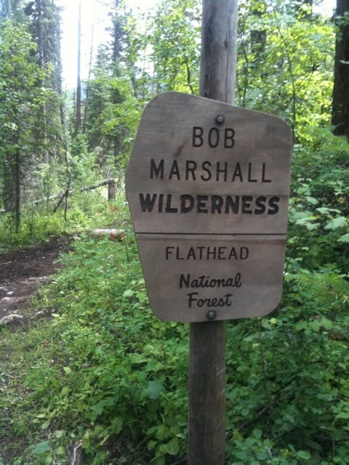
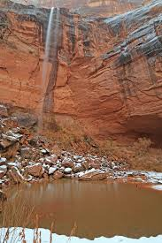

Why The Forest Service and the BLM Have Different Wilderness Management Histories
The Wilderness Act at 50
Lewis and Clark Law School
April 11, 2014
Robert L. Glicksman
J.B. & Maurice C. Shapiro Professor of Environmental Law
The George Washington University Law School

Slide 2


Potential Explanatory Factors
Physical characteristics
Agency history, culture, and organizational structure
Statutory mandates
Agency policies and practices
Congressional interest and commitment
Judicial review of agency wilderness management decisions

Slide 3
Potential Explanatory Factors
Physical characteristics
Agency history, culture, and organizational structure
Statutory mandates
Agency policies and practices
Congressional interest and commitment
Judicial review of agency wilderness management decisions
Physical characteristics
Agency history, culture, and structure
Statutory mandates
  ─ Planning
  ─ Interactions between organic statutes and other laws
Congressional commitment

Slide 4
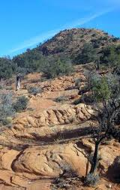
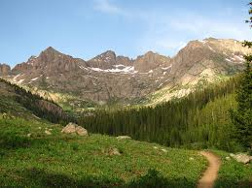
Physical Characteristics
Lack of human imprint
Opportunities for solitude
Ecological, geological, or other features of scientific, educational, scenic, or historical value
Red Mountain Wilderness Area
San Juan National Forest

Slide 5


History: Timing of Wilderness Assessment and Protection
Forest Service
  Early FS commitment to preservation of primitive areas
  Endorsed when Congress designated 9 million acres of “instant wilderness” in 1964
BLM
  Temporary public ownership
  No official retention policy until the adoption of FLPMA in 1976
1920s:
FS Reg L-20
1964: Wilderness Act
1976: FLPMA Inventory Requirement
Aldo Leopold

Slide 6
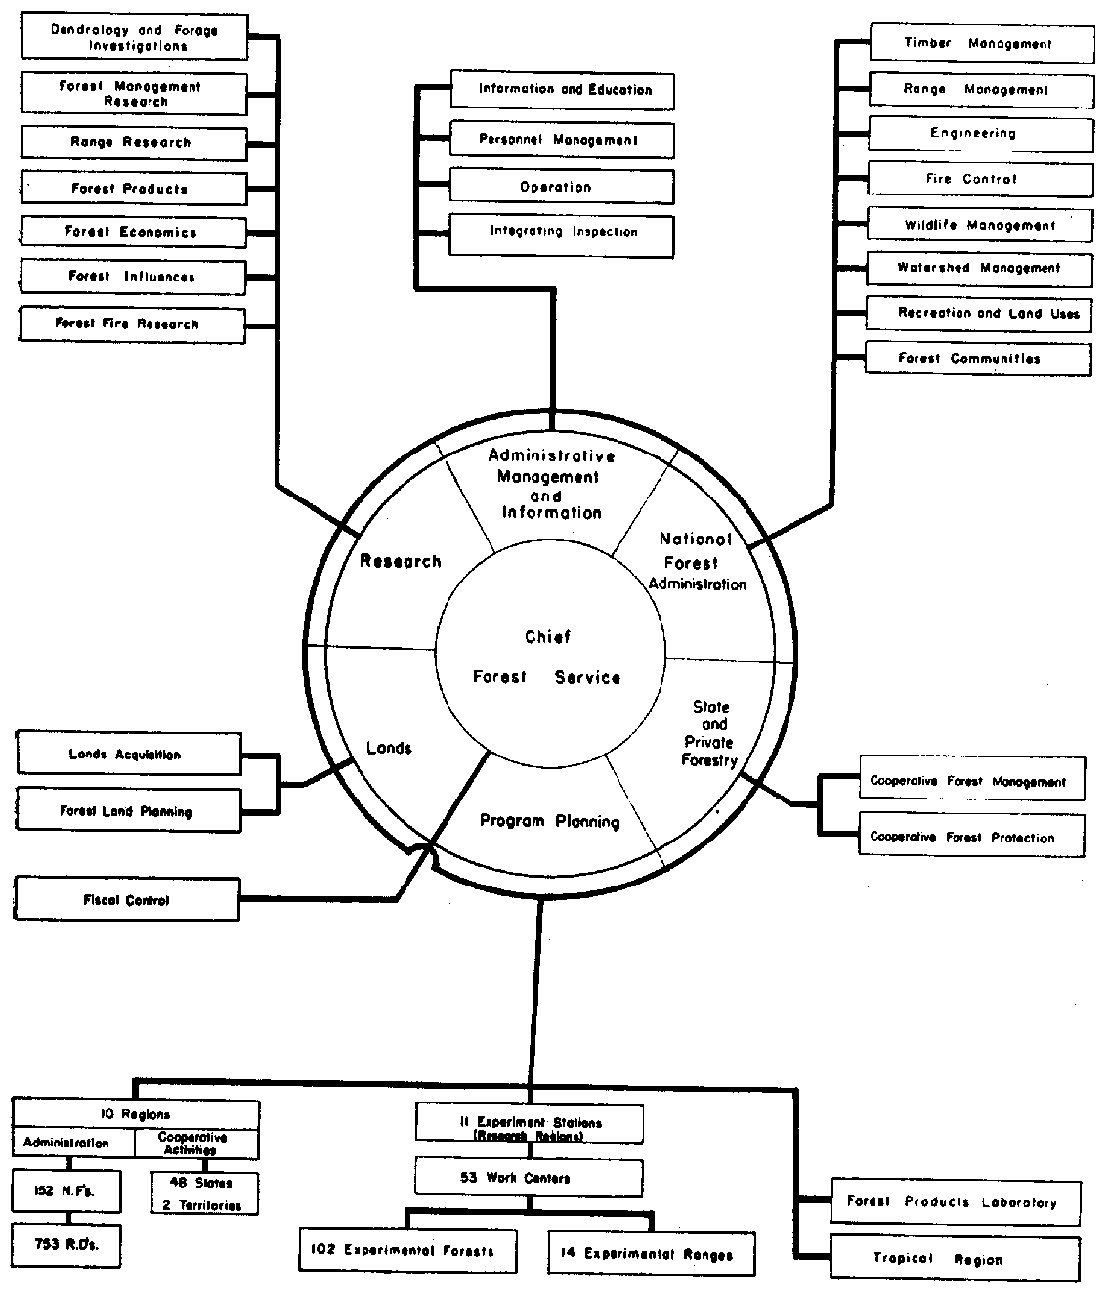
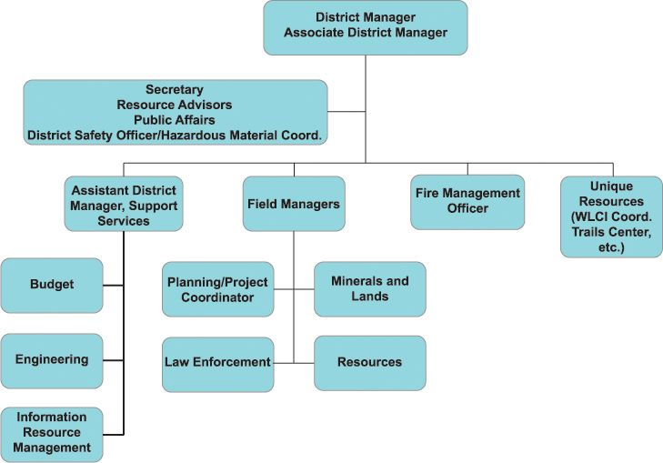
Agency Structure
Bureau of Land Management
Forest Service

Slide 7
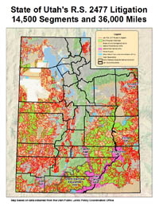
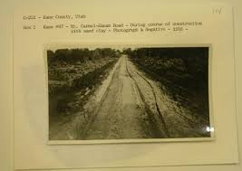
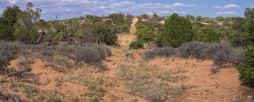
Statutory Differences
Level of specificity of planning mandates, generally and by reference to wilderness management
The role of R.S. 2477 rights-of-way

Slide 8
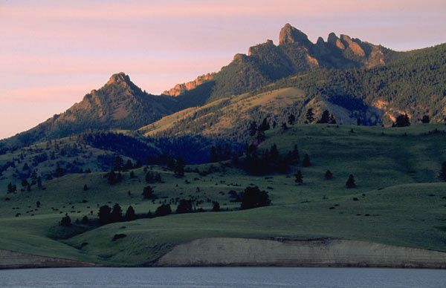
Congressional Commitment
Neglecting BLM lands with wilderness potential
Denigrating BLM lands
Barring imposition of administrative limits on R.S. 2477 claims
Blocking Secretary Salazar’s wild lands policy
Sleeping Giant WSA

Slide 9
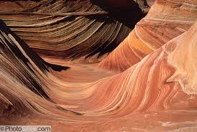
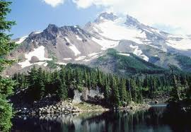
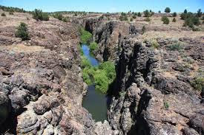
Recommendations
Expand conception of wilderness to include areas of ecological importance, even if they are not scenically spectacular
List wilderness as a multiple use under FLPMA
Codify restrictions on R.S. 2477 claims
Strengthen FLPMA’s planning requirements
Reorganize the BLM to counter capture by local commodity interests
Paria Canyon-Vermilion Cliffs Wilderness Area
Willamette National Forest
Pole Creek Wilderness

