Slide 1
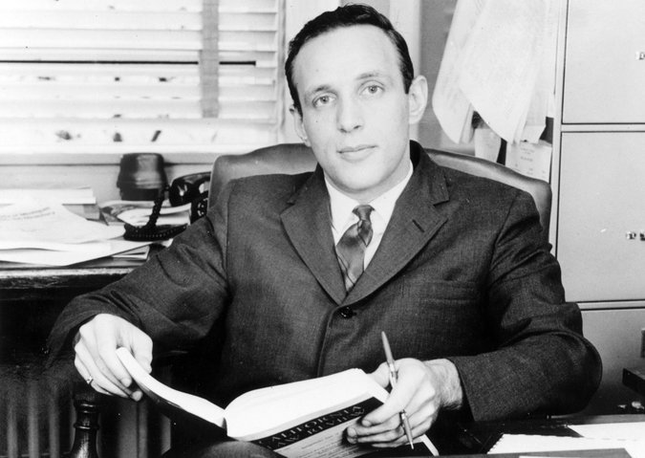
Developments in the
Public Trust
Environmental and
Natural Resources Law Symposium
Lewis & Clark Law School

Slide 2
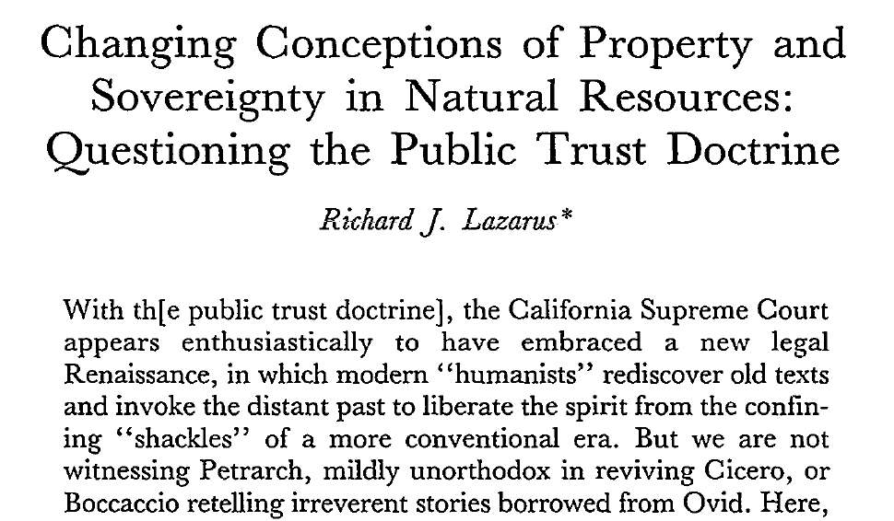
“Cynical”

Slide 3
“Conservative Scholar”

Slide 4
“Hopelessly Naive”

Slide 5
“Green Dissent”

Slide 6
Imagine Professor Lazarus sitting in his office in
Indiana, probably trying to attain tenure on the
faculty, wondering what great academic debate he
could create to satisfy the “publish or perish”
requirements of law school faculty.
What better way for a law school professor to
make a name for himself than to take on an
acknowledged expert in the field and challenge a
law review article over fifteen years old.

Slide 7
Judicial Missteps, Legislative Dysfunction,
and The Public Trust Doctrine:
Can Two Wrongs Make It Right?
Richard J. Lazarus
Harvard Law School

Slide 8
1. Wrong!

Slide 9
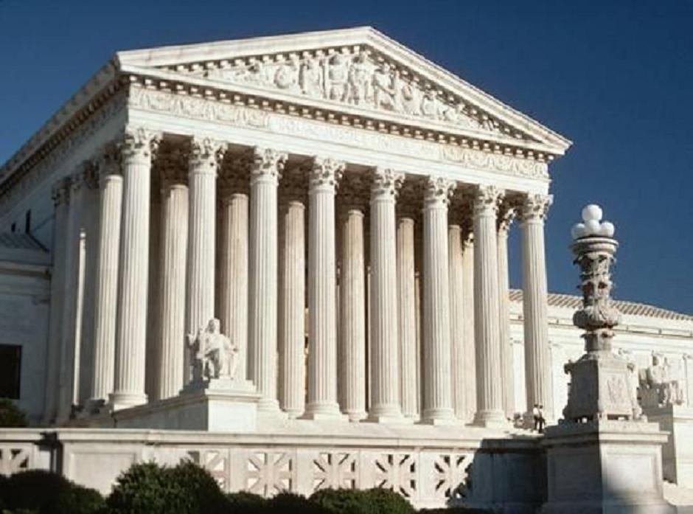
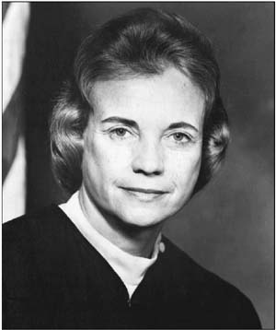
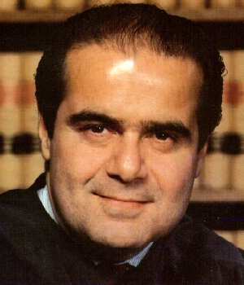

Slide 10
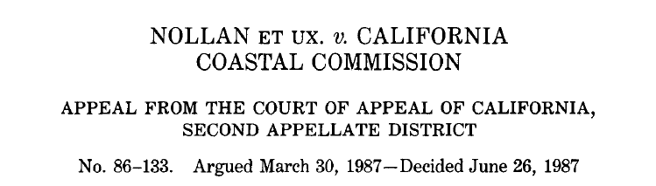
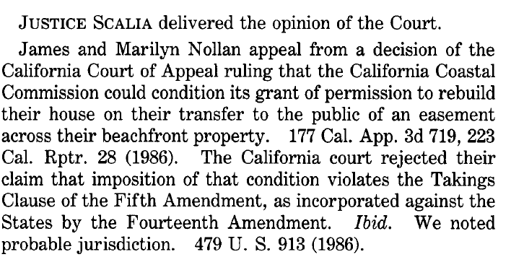

Slide 11
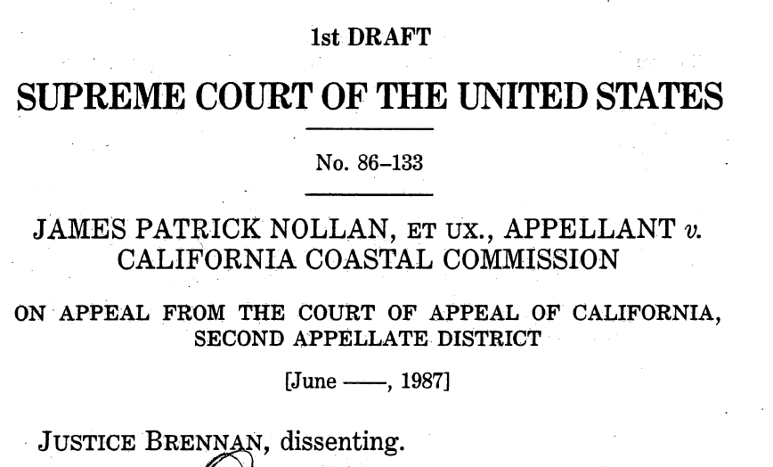
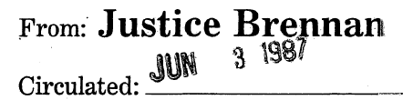
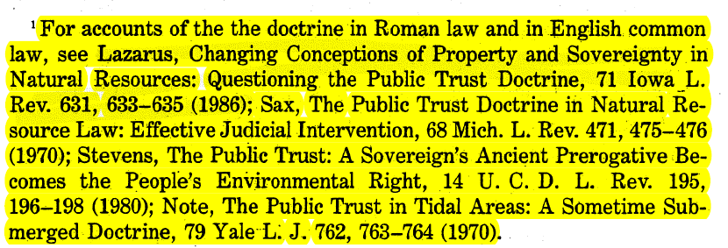
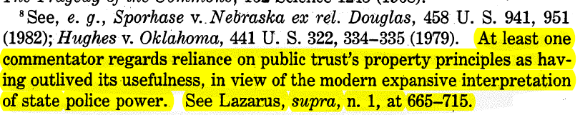
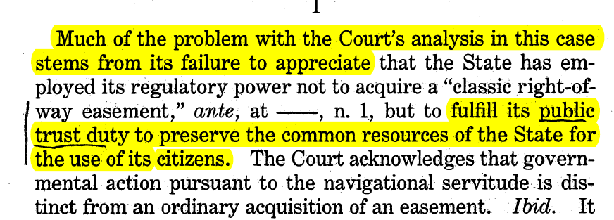

Slide 12
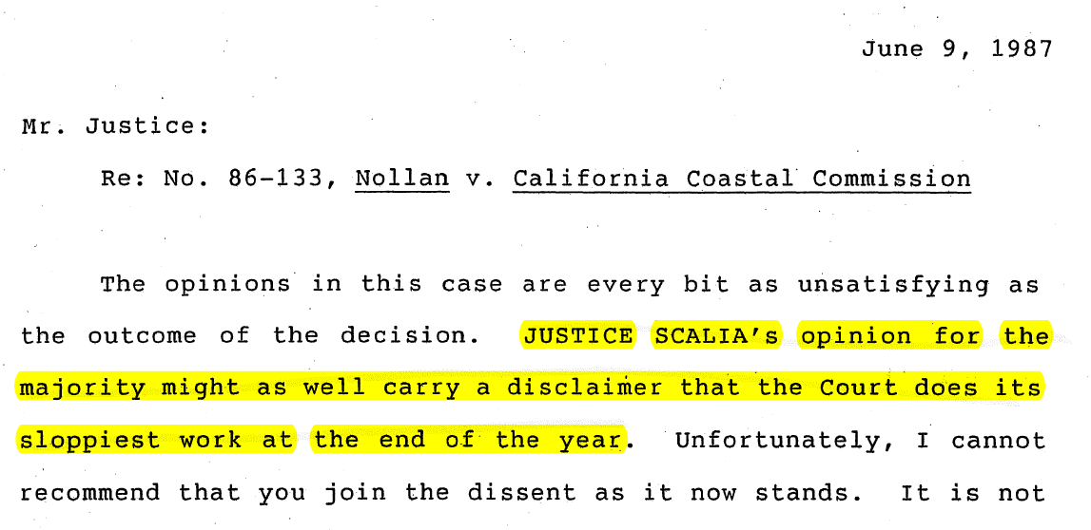
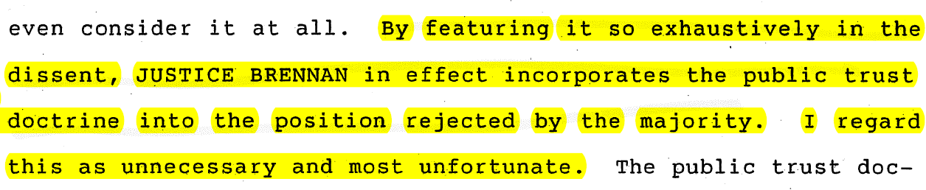
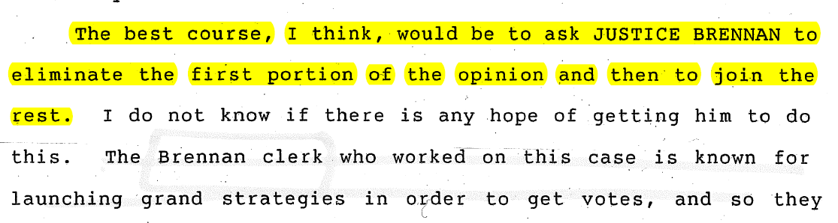

Slide 13
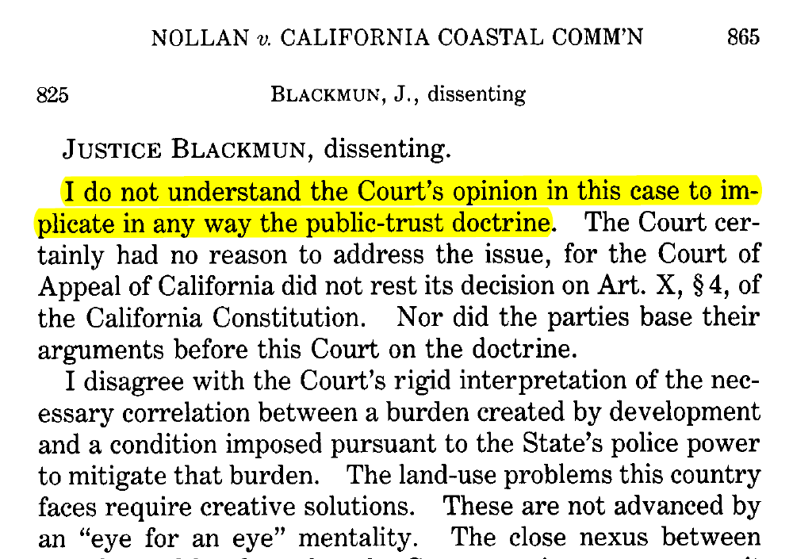

Slide 14
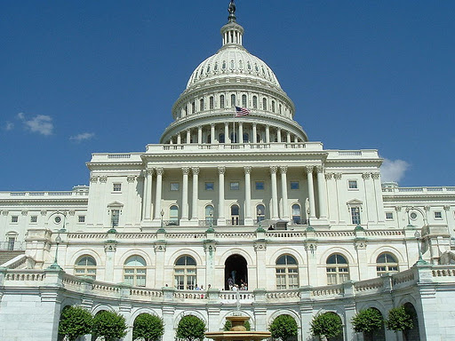

Slide 15
1970 National Environmental Policy Act
1970 Clean Air Act
1972 Federal Water Pollution Control Act
1972 Federal Insecticide, Fungicide, and Rodenticide Act
1972 Noise Control Act
1972 Coastal Zone Management Act
1972 Marine Mammal Protection Act
1973 Endangered Species Act
1974 Safe Drinking Water Act
1974 Forest Rangeland Renewable Resources Planning Act
1975 Federal Coal Leasing Act Amendments
1976 Toxic Substances Control Act
1976 Resources Conservation and Recovery Act
1976 National Forest Management Act
1976 Federal Land Policy and Management Act
1976 Magnuson-Stevenson Fisheries Management Act
1977 Clean Air Act Amendments
1977 Clean Water Act Amendments
1977 Surface Mining Control and Reclamation Act
1978 Outer Continental Shelf Lands Act

Slide 16
1980s
Comprehensive Environmental Response,
Compensation & Liability Act (Superfund) (1980)
Emergency Planning and Community Right to Know Act (1980)
Alaska National Interest Lands Conservation Act (1980)
Hazardous and Solid Waste Act Amendments of 1984
Safe Drinking Water Act Amendments of 1986
Superfund Amendments and Reauthorization Act of 1986
(Water Quality Act of 1987)

Slide 17
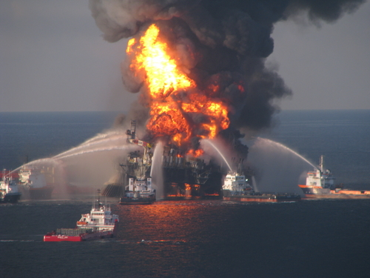
April 20, 2010
Gulf of Mexico

Slide 18
2. Revise!

Slide 19
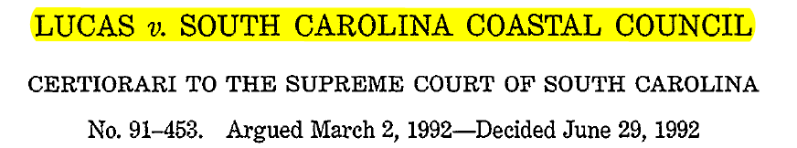
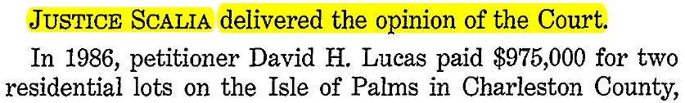
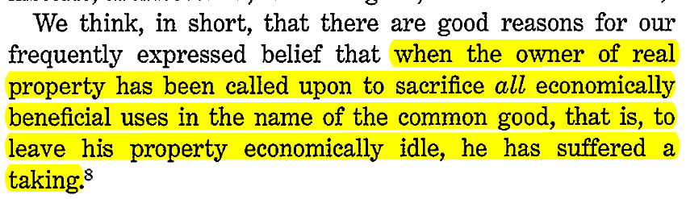

Slide 20
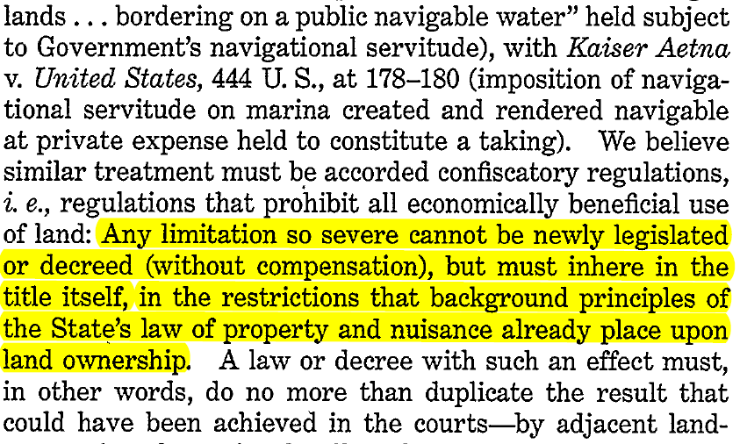

Slide 21
In re Water Use Permit Applications (Hawaii 2000)
Avenal v. State (La. 2004)
Fisher v. Town of Nags Head (N.C. App. 2012)
Palazollo v. Rhode Island (R.I. Super. 2005)
McQueen v. South Carolina Coastal Council (S.C. 2003)

Slide 22
Not!
(Hopelessly Naïve After All)

Slide 23
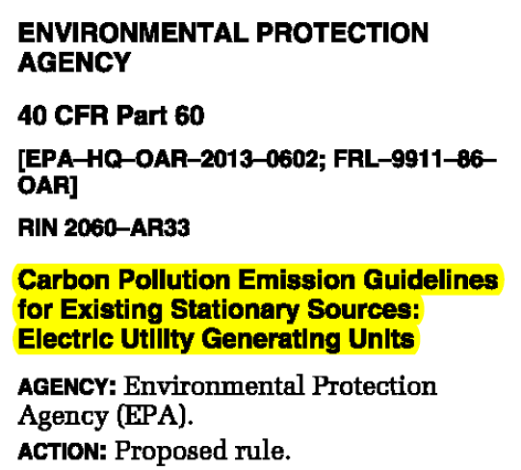


Slide 24
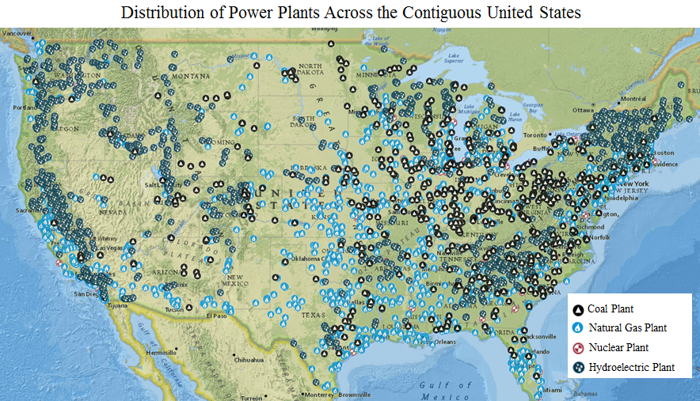
Source: http://www.c2es.org/federal/executive/epa/carbon-pollution-standards-map

Slide 25
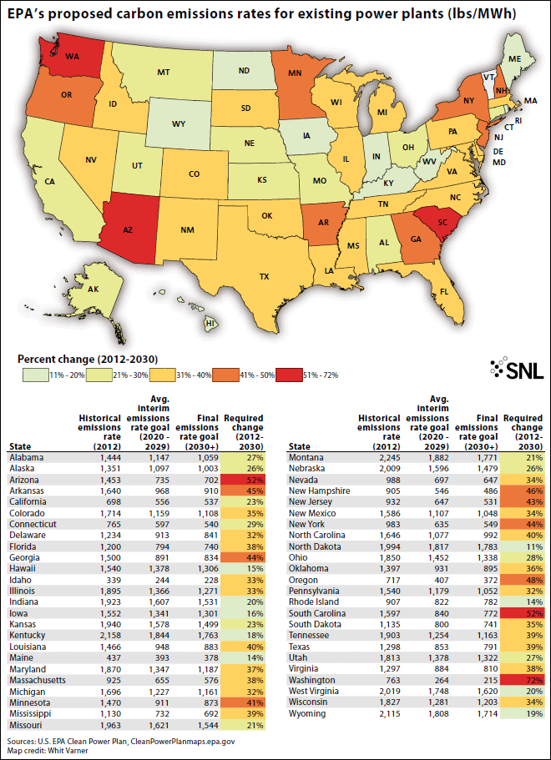

Slide 26
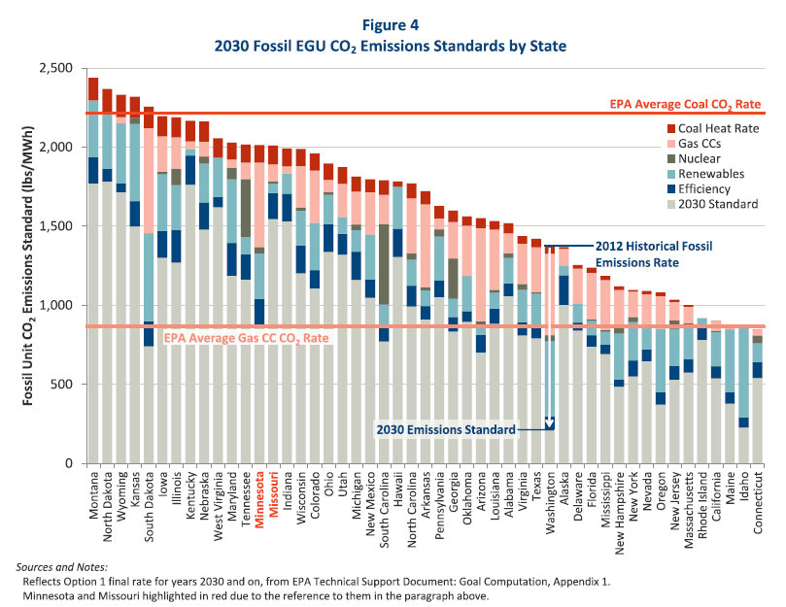
The Brattle Group

Slide 27

EPA Four Building Blocks
Improve efficiency of individual
coal-fired units
Substitute Natural Gas for Coal
Increase Nuclear and Renewable Power
Increase End-Use Energy Efficiency (Reduce Demand)

Slide 29
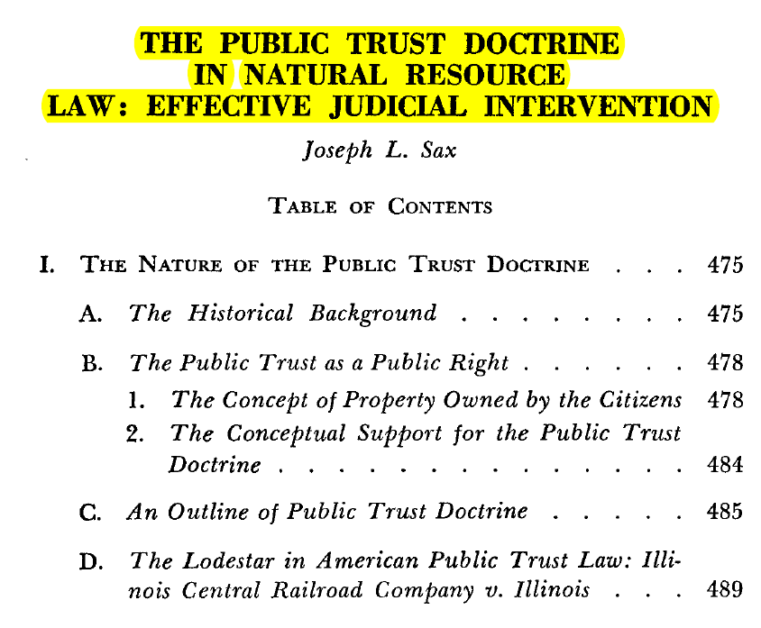

Slide 30
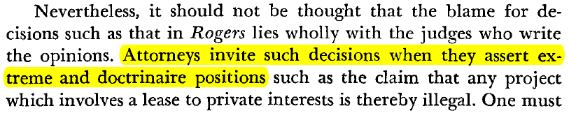

Slide 31
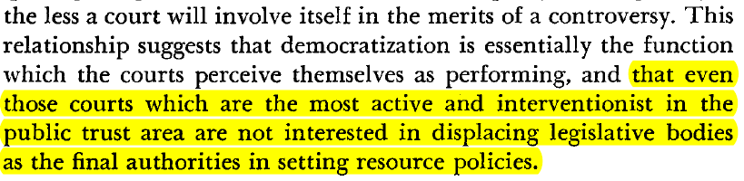
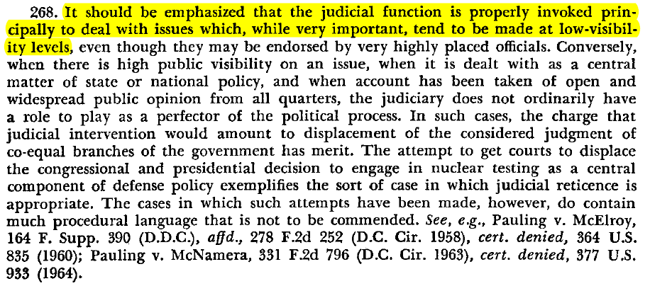
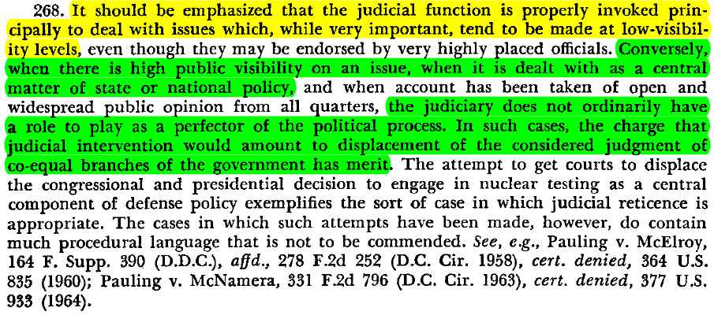

Slide 32
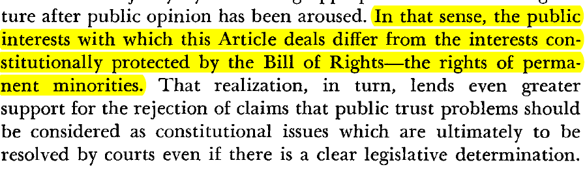
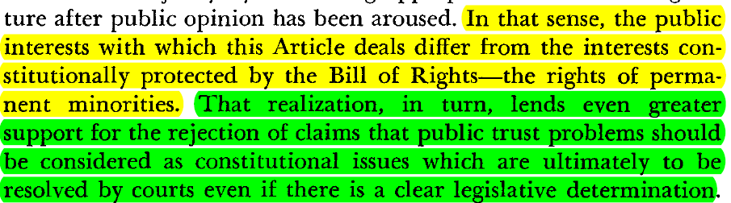

Slide 33
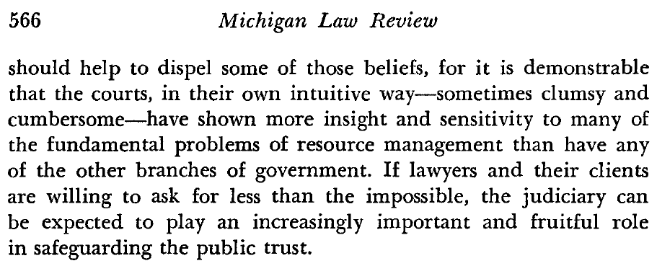
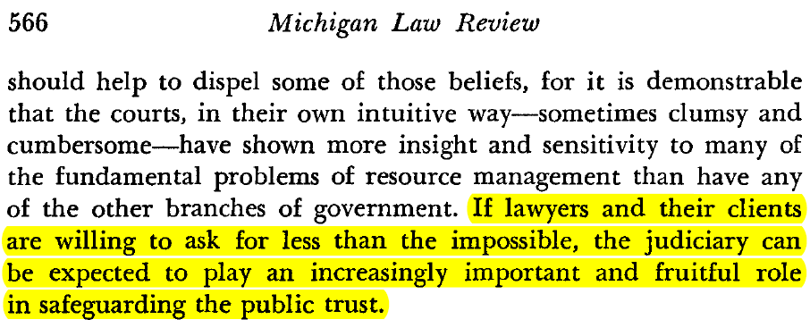

Slide 34
Developments in the
Public Trust
Environmental and
Natural Resources Law Symposium
Lewis & Clark Law School

