Slide 1
Wilderness Management in National Parks &
Wildlife Refuges
Lewis & Clark Law School
The Wilderness Act at 50 Symposium
Sandra Zellmer
University of Nebraska
College of Law
Apr. 11, 2014

Slide 2
Legal Framework: Conservation . . . Plus
Applicable Across the Public Lands: Wilderness Act
Park Service
Organic Act of 1916:
  Conserve Unimpaired for Present & Future Enjoyment
  General Mgmt. Plans encouraged
FWS
Refuge Act (Amd. 1997):
Conservation, management & restoration of fish, wildlife & plants & habitats for benefit of present and future generations.
Secondary uses limited to uses “compatible with” this purpose.
“Wildlife dependent” uses (e.g., hunting) presumed compatible
Comp. Mgmt. Plans required

Slide 3
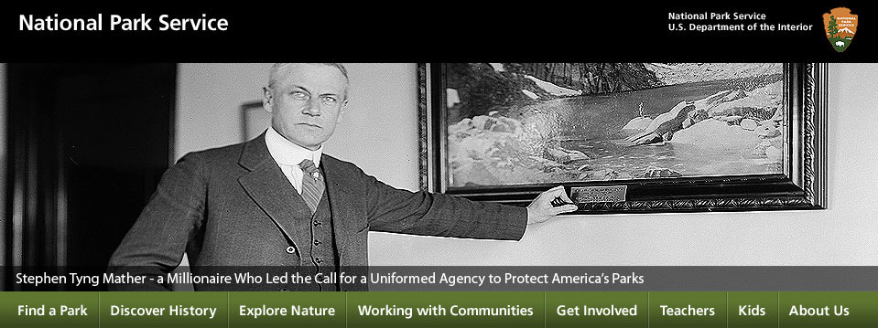
Institutional Setting
National Park Service
Created: 1916 Organic Act
Land management ethos; Tourism & law enforcement
Centralized under a Director, whose Director’s Orders carry weight
Fish & Wildlife Service
Created: 1956 Fish and Wildlife Act (but existed since 1940)
Biologists; Game management; ESA
Not quite as centralized
Shared Asst. Secretary and Deputy Solicitor
Interior agencies are “a crazy mosaic,” with the range of each agency or bureau within it enough “to make the head spin, Patricia Limerick

Slide 4
Physical Setting
National Park System
44M acres of wilderness
40% of the Wilderness System; almost 50% of all NPS lands
Other lands: Nat’l Monuments; Battlefields; Historic Sites; Seashores; Parkways
Wildlife Refuge System
21M acres of wilderness
18% of the Wilderness System; about 25% of the Refuge System
Forests and tundra in Alaska
Deserts in the Southwest
Islands and estuaries along both coasts and the Gulf
Grasslands and prairie potholes in the Southeast & Great Plains (much was privately owned)

Slide 5
Wilderness Act
Management: as “undeveloped Federal land retaining its primeval character and influence”
Section 4(c) Prohibitions
  No commercial enterprise
  No permanent road
  No Temporary Road, Motor vehicles/Boats, Mechanical Transport, Motorized Equipment, Structure or Installation
#3 is subject to exceptions of 4(c) - (d)
How are the agencies doing?

Slide 6
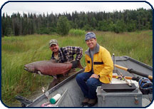
§ 4(c): No Commercial Enterprise:
Both Agencies Blow It
Commercial fishing: If it’s okay in Glacier Bay Nat’l Park or Kenai Refuge, what about the adjacent Wilderness?
  Assume no adverse effects are shown, and Alaska fishing association really really wants it.
  Not no, but Hell No!
    Alaska Wildlife Alliance v. Jensen (1997); Wilderness Soc’y v. FWS (2003).
Notes:
Congress spoke clearly in Wilderness Act to prohibit commercial enterprise in designated wilderness, regardless of the form of commercial activity and regardless of whether it was aimed at assisting the economy with minimal intrusion on wilderness values, and therefore reviewing court owed and could give no Chevron deference to determination by Fish and Wildlife Service (FWS) regarding permissibility of sockeye salmon enhancement project introducing hatchery-reared salmon fry into lake located within designated wilderness in national wildlife refuge to the extent that project qualified as commercial enterprise. The Wilderness Society v. U.S. Fish & Wildlife Service, C.A.9 (Alaska) 2003, 353 F.3d 1051.
Whether an activity within designated wilderness bounds should be characterized as a commercial enterprise prohibited by Wilderness Act turns on an assessment of the purpose and effect of the activity.

Slide 7
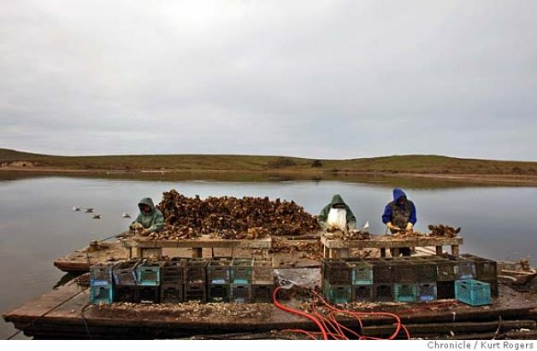
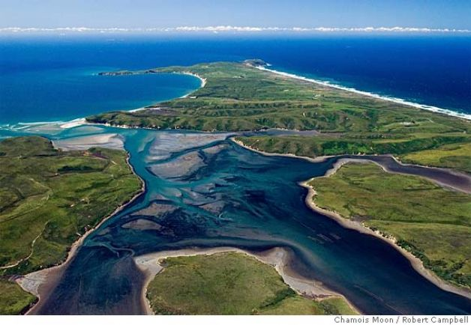
§ 4(c): No Commercial Enterprise:
NPS Steps Up
Secretary’s decision to deny a special use permit to oyster farmers upheld:
Drakes Estero was a potential wilderness, and
Removal of commercial operations would result in long-term beneficial impacts to the natural environment.
  Drakes Bay Oyster Co. v. Salazar (2013).
Cr: Kurt Rogers, Robert Campbell, Chamois Moon
Notes:
Congress spoke clearly in Wilderness Act to prohibit commercial enterprise in designated wilderness, regardless of the form of commercial activity and regardless of whether it was aimed at assisting the economy with minimal intrusion on wilderness values, and therefore reviewing court owed and could give no Chevron deference to determination by Fish and Wildlife Service (FWS) regarding permissibility of sockeye salmon enhancement project introducing hatchery-reared salmon fry into lake located within designated wilderness in national wildlife refuge to the extent that project qualified as commercial enterprise. The Wilderness Society v. U.S. Fish & Wildlife Service, C.A.9 (Alaska) 2003, 353 F.3d 1051.
Whether an activity within designated wilderness bounds should be characterized as a commercial enterprise prohibited by Wilderness Act turns on an assessment of the purpose and effect of the activity.

Slide 8
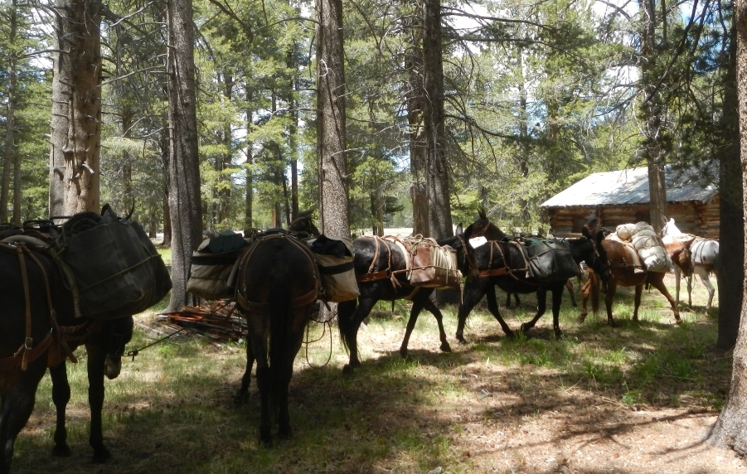
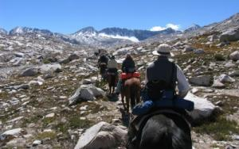
4(d)(5): Except “Necessary”
Commercial Services: NPS Blew It
If “necessary for activities which are proper for realizing the recreational or other wilderness purposes.”
Plan for Sequoia & Kings Canyon Parks permitted outfitters’ use of packstock without making the required finding of necessity.
NPS lacked a thorough assessment of the necessity for, and effects of, services: “[W]hen there is a conflict between maintaining the primitive character of the area and any other use. . . maintaining the primitive character of the area must be supreme.” High Sierra Hikers v. Interior (2012).
Notes:
The court remanded the case and imposed a deadline for NPS to complete a comprehensive wilderness plan. But Congress subsequently passed the “Sequoia and Kings Canyon National Parks Back-country Access Act,” H.R. 4849, 112th Cong. (2012), which superseded the order by allowing commercial stock use and lifting the deadline.
T]he agency’s primary responsibility is to protect the wilderness, not cede to commercial needs. An agency can only override this responsibility and promote competing interests such as those related to commercial activity, if it first engages in a “comparative and qualitative analysis where the variables are considered in relation to one another and the interests at stake are weighed.”… Once this analysis is complete, “the administering agency must determine the most important value and [justify] its decision to protect that value

Slide 9
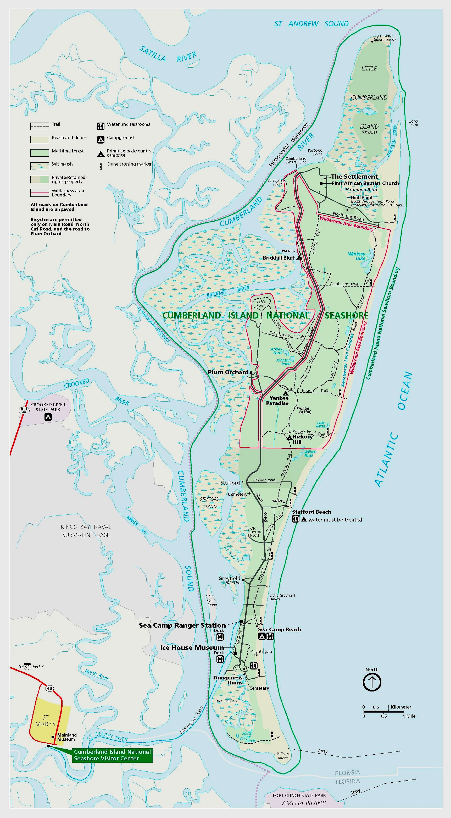
4(d)(5): Except “Necessary”
Commercial Services
NPS AGAIN. . .
NPS transported tourists in a passenger van across Cumberland Island Wilderness in order to provide public access to historical structures.
Services aren’t “necessary” just because they make visitor access more convenient, even if there was “no net increase” in effects to the land. Wilderness Watch v. Mainella.
Pink lines - Wilderness boundary
Visitor Center

Slide 10
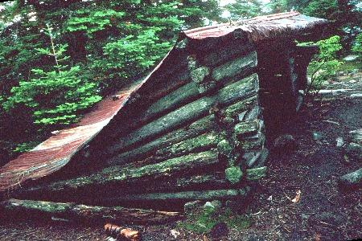
Except necessary “measures required in emergencies”
NPS - proposed using helicopters to replace collapsed hiker shelters in wilderness areas.
  It said new shelters were necessary to prevent emergencies.
Imminent threats to human health and safety— “matters of urgent necessity”—must be demonstrated before structures, installations, or vehicles can be deployed in wilderness.
Olympic Park Assocs. v. Mainella.

Slide 11
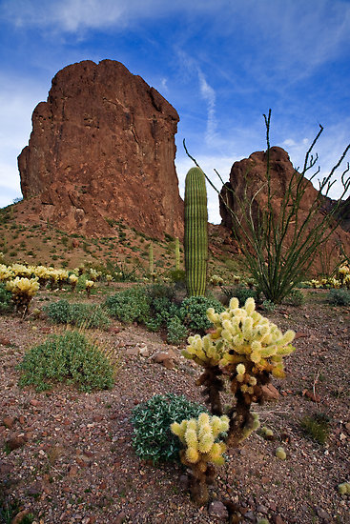
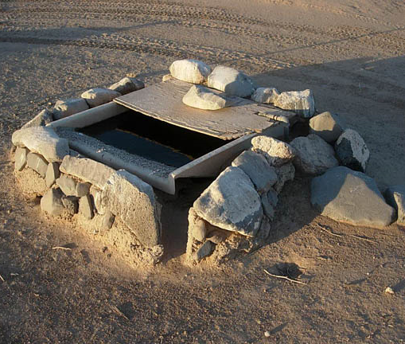
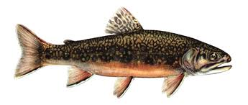
4(c): “Necessary Minimum Requirements of Wilderness Admin.”
FWS this time -
Wildlife guzzler? Wilderness Watch v. FWS
Eradicating “Undesirable” Species; Assisting Migration of Desirables?
  Californians for Alts to Toxics
Kofa Wilderness
Notes:
I. Kofa averages 7” a year. During a period of extended drought, FWS, with AZ, constructed water tanks, pipes, & “guzzlers” to augment water for bighorn sheep.
--Constructed with backhoes & other motorized equipment and mechanized tools.
--Comprised mostly of PVC pipe buried underground and designed to catch rainwater and channel it into concrete weirs or troughs.
--During droughts, W is transported with motorized vehicles and equipment
Wilderness Watch (9th Cir. 2010) successfully sued. While the facilities might be useful to sheep threatened by drought and high temperatures, they were “installations” that unlawfully trammeled the W, contrary to the explicit terms of the Act.
-FWS failed to establish that they were “necessary” “mini rqmts” of wilderness
Californians for Alts. to Toxics, No. CIV. S-10-1477 FCD/CMK, 2011 WL 3915966, at *23 (E.D. Cal. Sept. 6, 2011)—Enviro’s won again.
The U.S.’s plan to “conserve” Paiute cutthroat trout by killing competitive species with rotenone applications in the Carson-Iceberg Wilderness “would impede progress towards preserving the overall wilderness character” by eradicating primitive endemic species.
-U.S. did not appeal

Slide 12
Scorecard
Park Service System
Advantages:
High elevation & back-country less impacted by development
Historic land management agency, with attitude
Disadvantages:
Pressure from recreationists & gateway communities
Greater access via roads, etc.
Refusal to plan & issue regs
Wildlife Refuge System
Advantages:
Clear mission: Conservation of wildlife comes first
Regulations: Substantive Standards & Planning requirements
Disadvantages:
Pressure from state F&G
Diverse & more degraded land

Slide 13
Improvements
Agencies: Rulemaking
  Enhance commitment to wilderness stewardship
  Foster greater public (& inter-agency) involvement
  Allow greater recourse when wilderness characteristics may be trammeled by conflicting uses
Department: Create a high-level wilderness stewardship office by presidential or secretarial order
  Synthesize policies across the agencies
  Oversee resolution of system-wide conflicts
  Solidify the preservation commitment of all agencies

