Slide 1
Fencing in and Fencing Out
Dan Farber
Public Trust Conference
April 10, 2015

Slide 2
A Case of Duality
We think of cap-and-trade and the public trust as being very different.
Cap and trade is the epitomizes the economic approach.
The public trust epitomizes the environmentalist approach.
But I’d like to suggest that they might have more in common than we think.

Slide 3
Public Trust: The Paradigm of Fencing Out
The public trust doctrine designates certain areas as protected – most notably, navigable waters.
It prevents use of those areas, essentially fencing them off as public property and establishing a gatekeeper to control their use.

Slide 4
Other “Fencing Out” Devices
Conservation easements, fencing uses out of designated areas.
In-stream flow protections.
Habitat conservation plans.
Federal reserved water rights.
Federal navigational servitude.

Slide 5
ETS: The Paradigm “Fencing In” Strategy
The “cap” establishes a limit on the allowable use of the resource by private parties.
Emitters can reallocate use between themselves inside the cap, but they’re not allowed outside the cap.

Slide 6
Other “Fencing In” Strategies
Section 402 permits put individual caps on water pollution sources.
Fishing quotas play a similar role (and are sometimes tradable).
State implementation plans cap emissions on a state-wide basis.

Slide 7
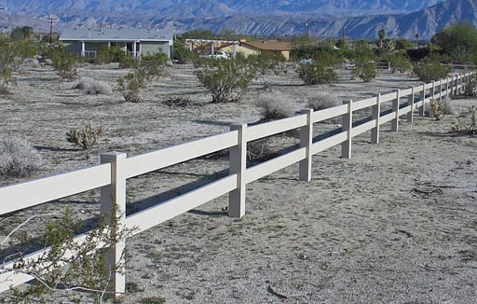
A Simple Insight
Every fence has two sides!

Slide 8
Alternate Strategies
Fencing separates two areas. So we can think of it in two ways:
As fencing in those on one side of the fence.. .
Or as fencing out those on the other side.
For this reason, “fencing in” and “fencing out” are complementary strategies.

Slide 9
Looking Across the Fence
We can view each of these devices in reverse.
The public trust doctrine fences people into the private domain.
Cap and trade fences emitters out of using the resource above the cap. In effect, a domain is reserved to the public.

Slide 10
Public/Private Boundary 1
Public Zone:
No Private Appropriation
------------------------------Ordinary High Tide-------------------------------
Private Zone:
Governed by Market

Slide 11
Public/Private Boundary 2
Public Zone:
No Private Appropriation
------------------------------------The Cap-------------------------------------
Private Zone:
Governed by Market

Slide 12
A Difference in Perspective
As we have seen, fencing in and fencing out are functionally similar – every fence does both of those things.
So why do we see them differently? Mostly because of historically based background assumptions.

Slide 13
The Role of Background Assumptions
We assume people are entitled to unlimited use of their own property, so we see regulation as fencing them in.
But we think of certain domains as public, so we view doctrines like public trust as protecting those domains from private parties.
But in reality these may just be two sides of the same coin.

Slide 14
Take-Away Points
The public trust doctrine is a form of regulation, and hence need to consider conflicting values (which Sax certainly knew).
Regulations reserve part of a resource for the public’s benefit. Cap and trade in effect establishes public ownership of the remaining resource above the cap.
In short, there’s a regulatory aspect to “property” and a property aspect to “regulation.”

Slide 15


