Slide 1

Celebrating
50 Years of Doug!
May 6, 2022

Slide 2
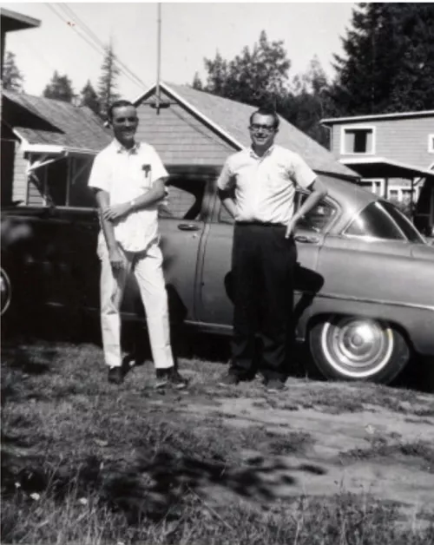
In 1965, professors-to-be Doug Newell and
Bill Williamson smile after finishing law school together at Harvard

Slide 3
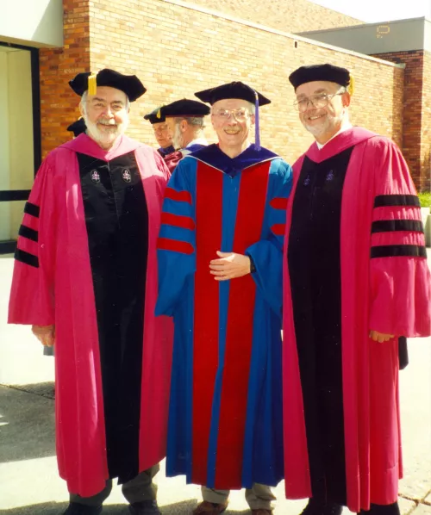
Professors
Bill Williamson,
Bernie Vail, and
Doug Newell attend Commencement in 2001

Slide 4
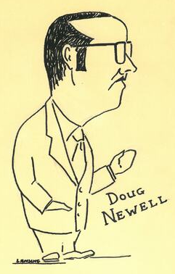
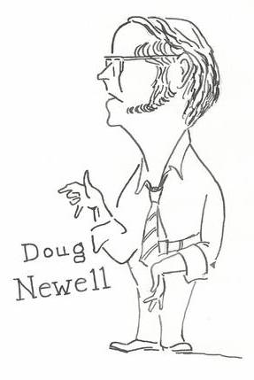
Caricatures of Doug, drawn by Emeritus Professor of Law Ron Lansing

Slide 5
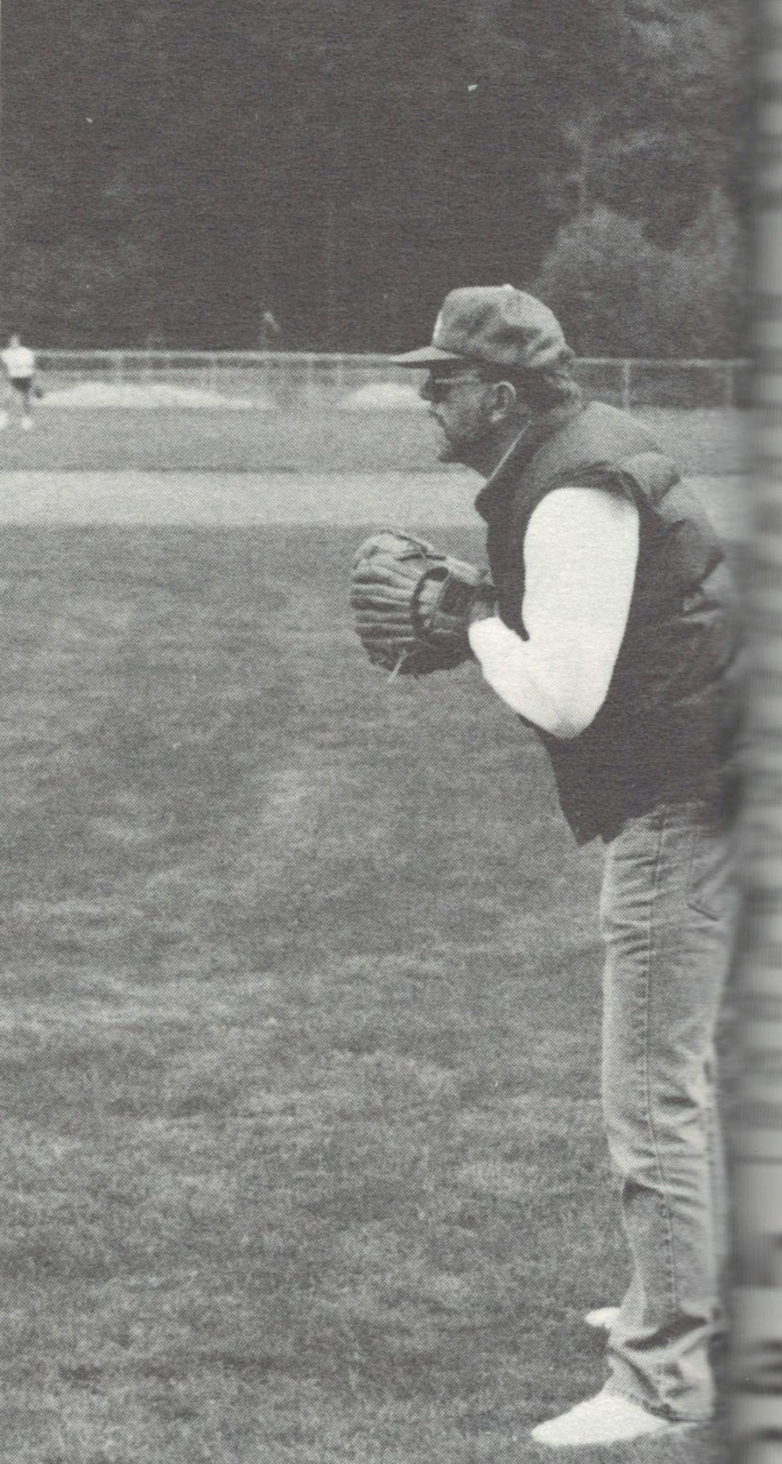
Doug at first base, on the faculty team of an alumni softball tournament

Slide 6
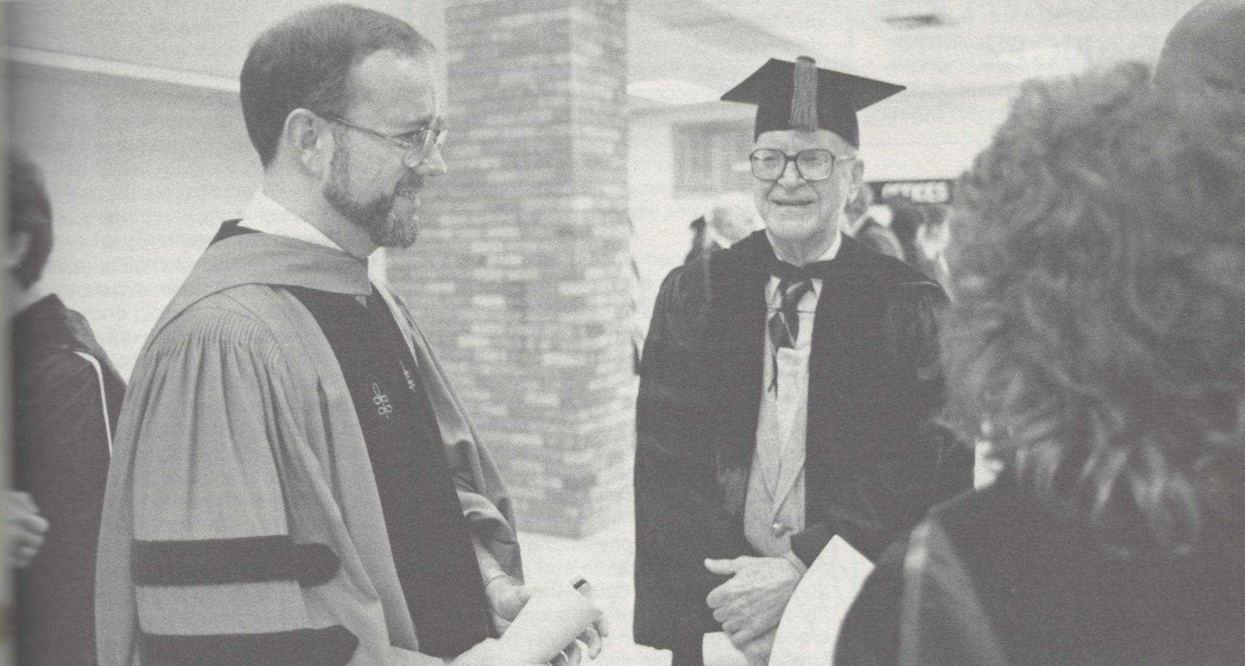
Doug with
Ed Belsheim at
the 1984 Commencement Ceremony

Slide 7
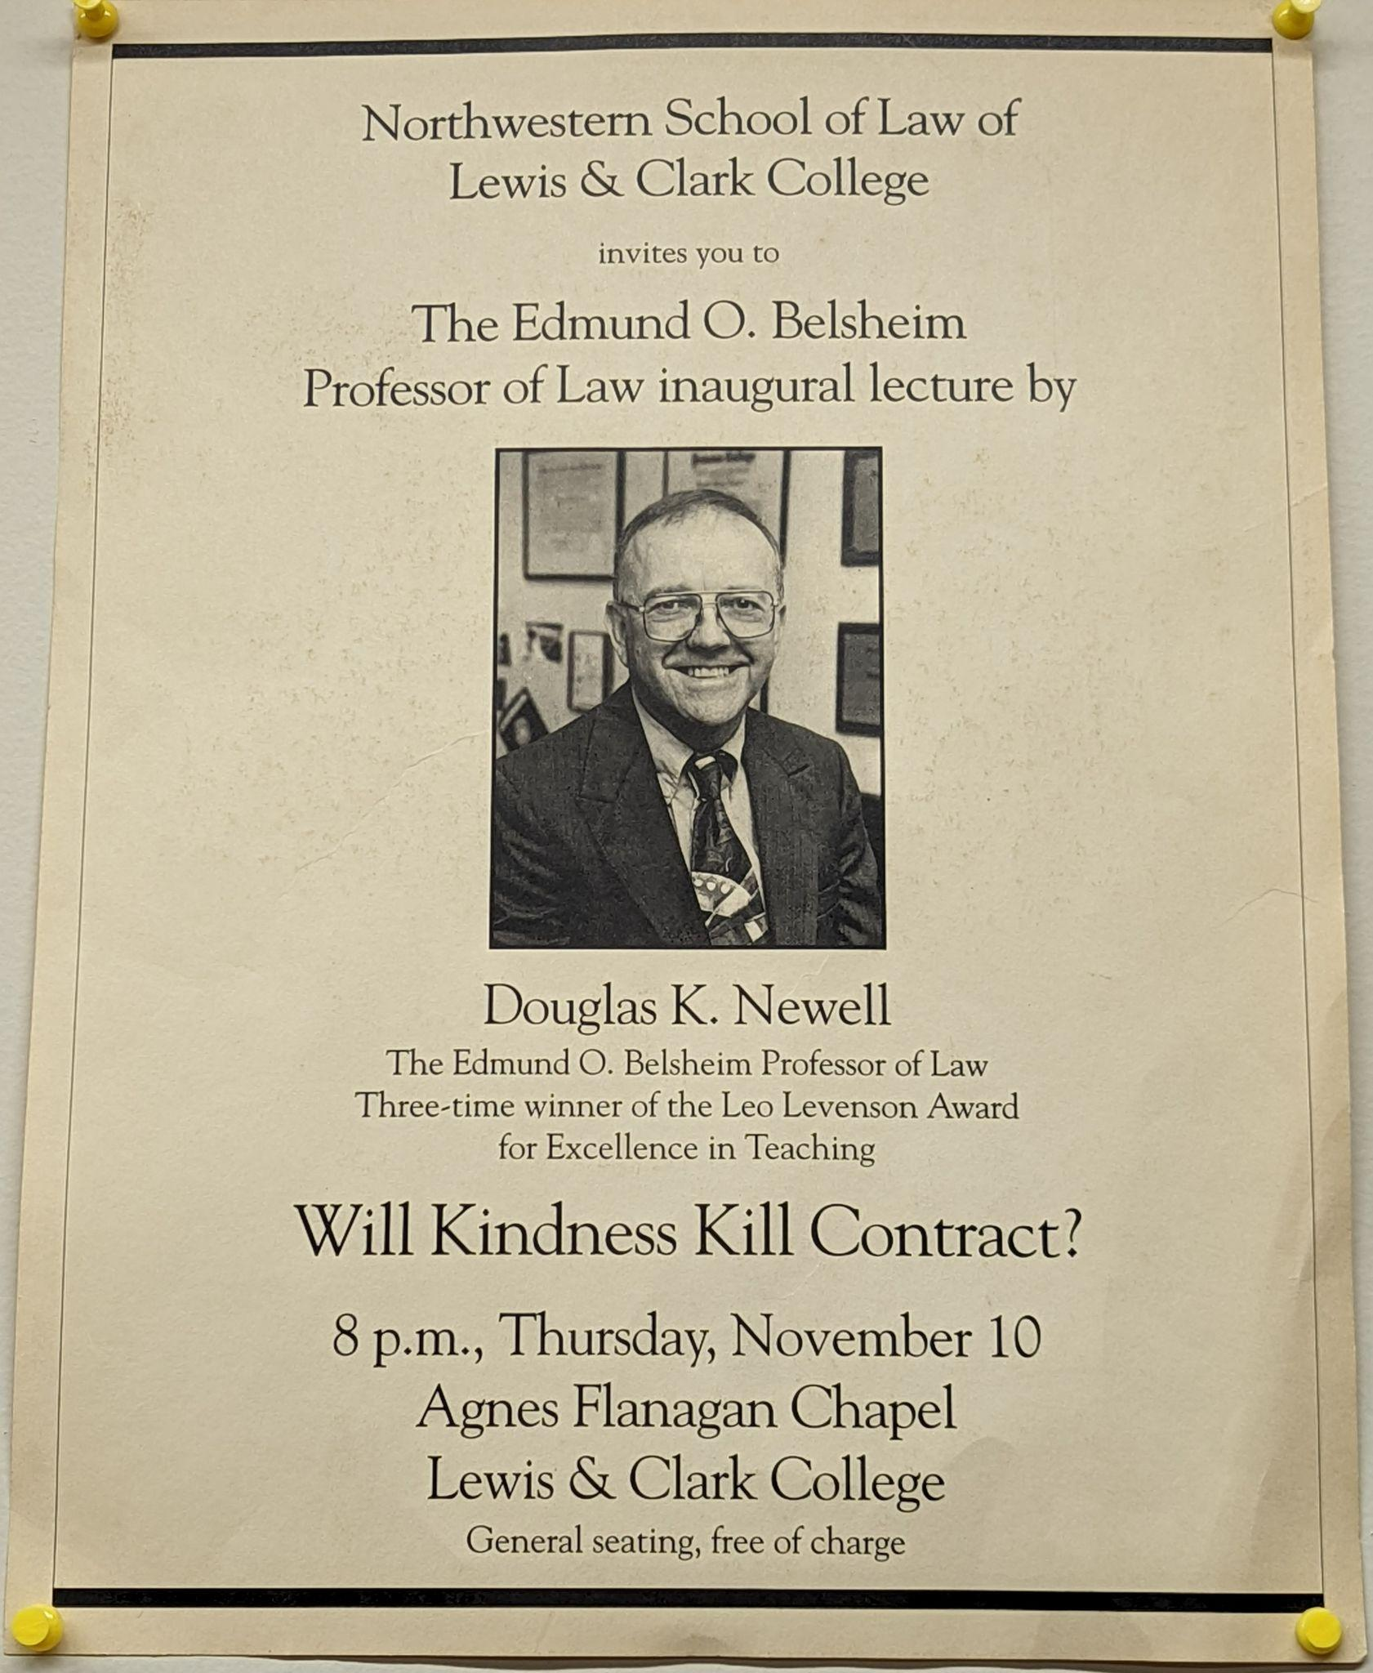
Doug was named the Edmund O. Belsheim Professor of Law in 1994

Slide 8
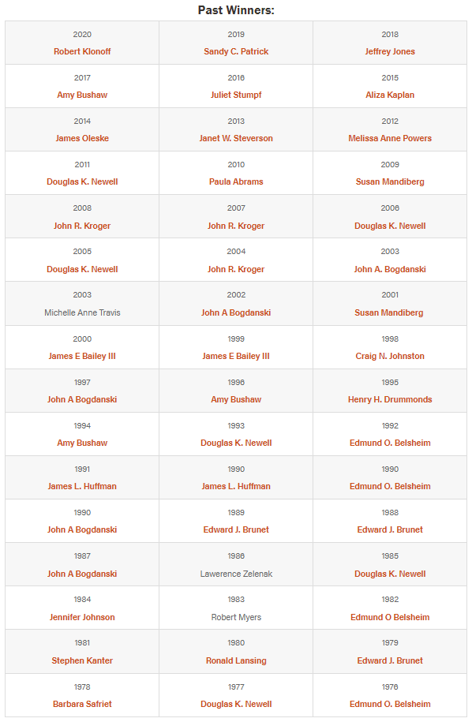
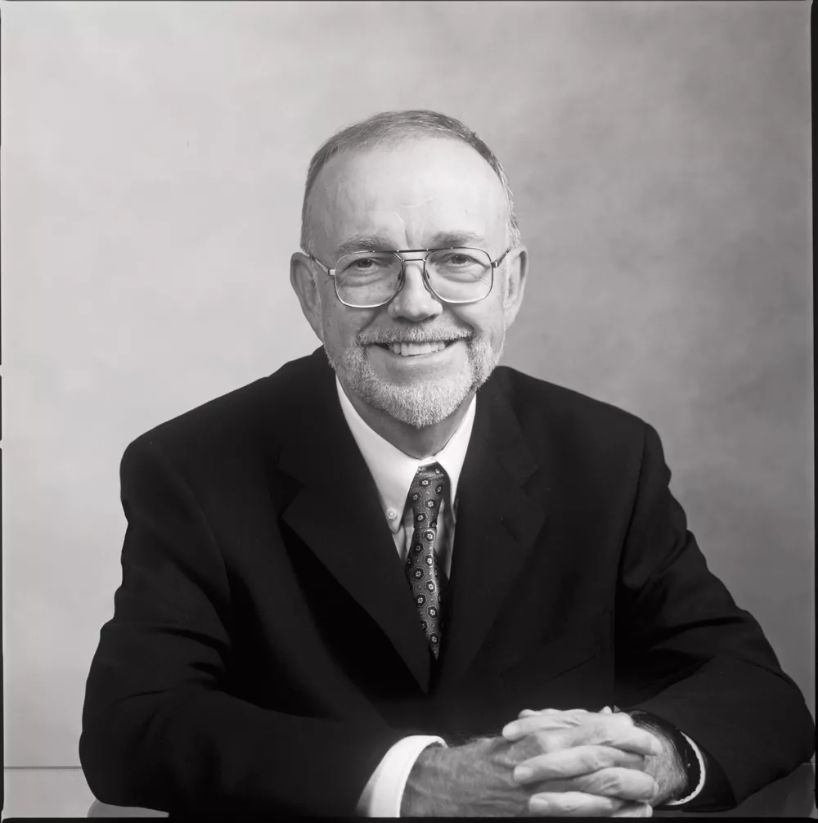
Doug is a 6-time winner of the Leo Levenson Award for Teaching Excellence

Slide 9
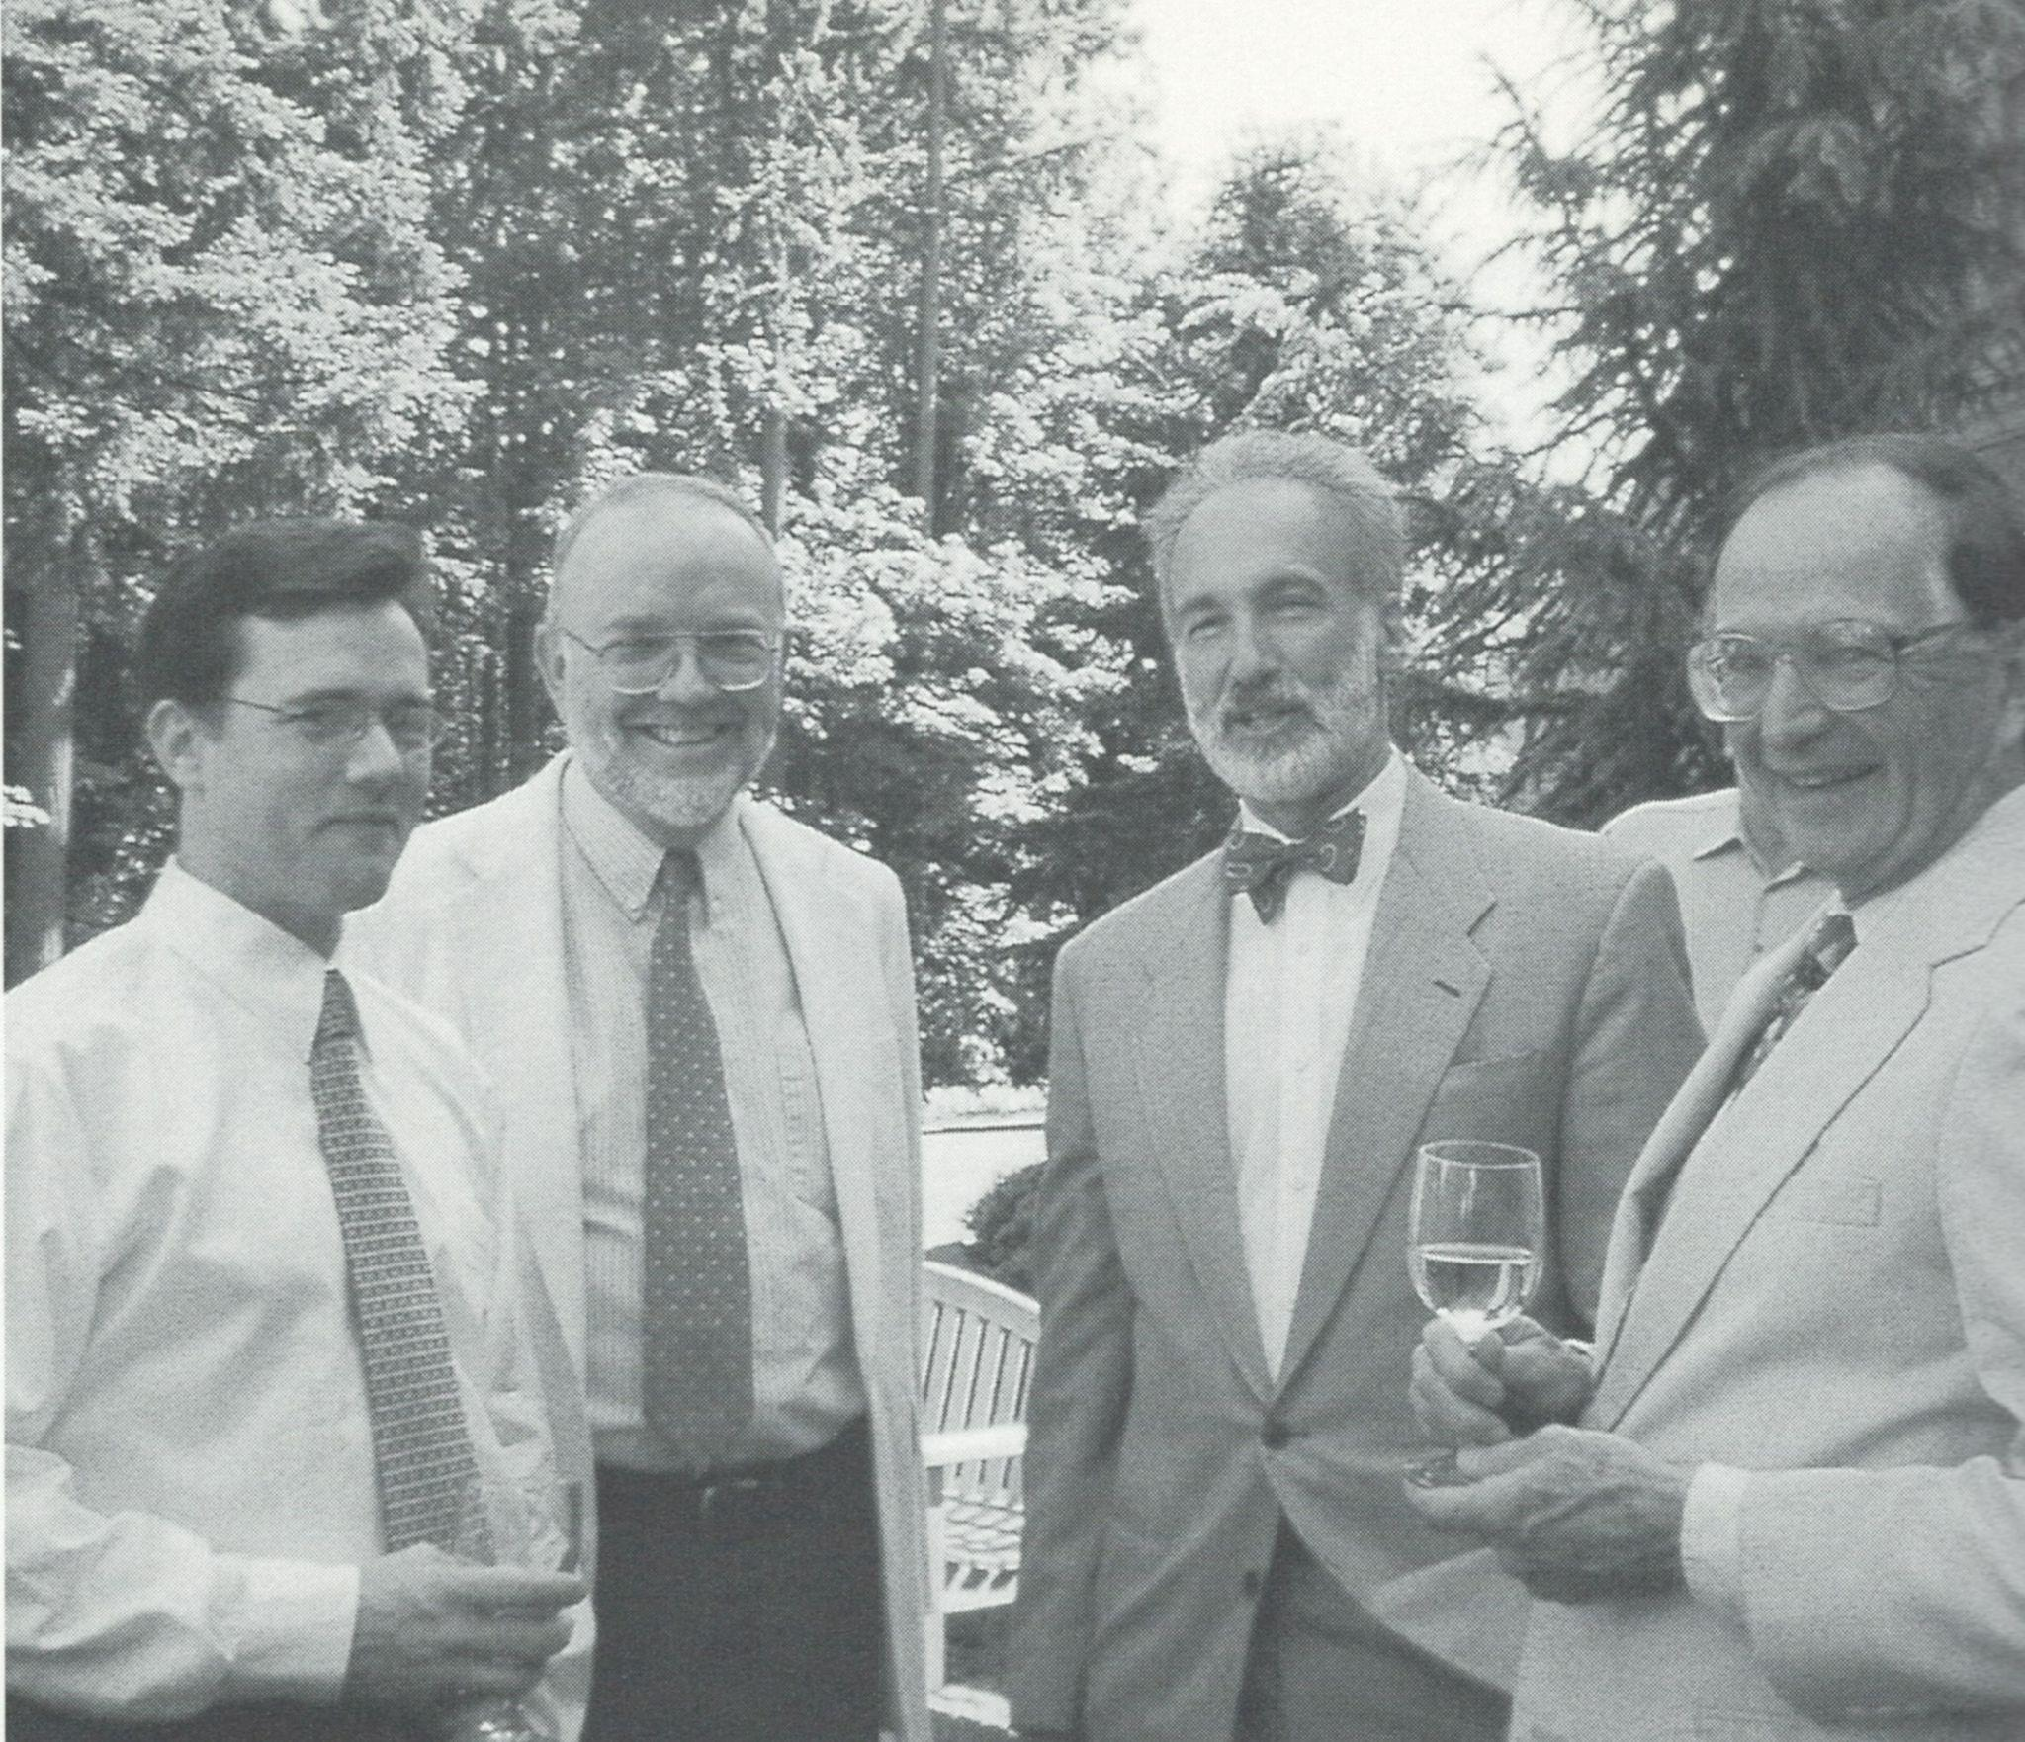
Doug at the Cornelius Honors Society Reception with
Peter Irvine ‘02,
Dean Jim Huffman, and Peter’s father, William Irvine

Slide 10
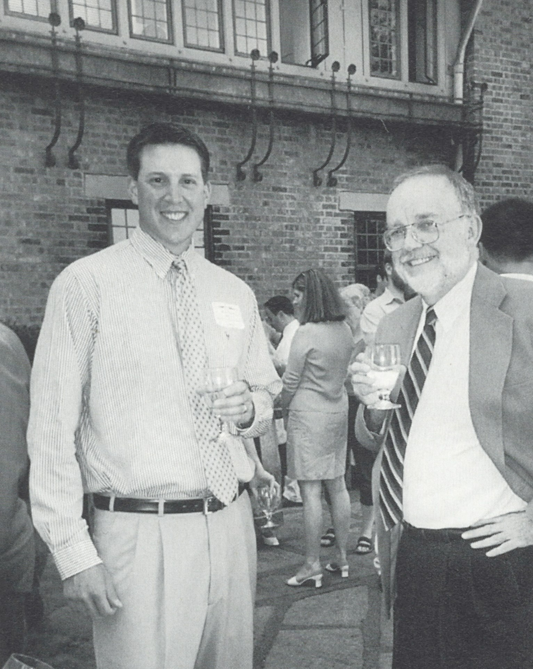
Doug at a Cornelius Honor Society Reception with
Ryan Steen ‘03

Slide 11
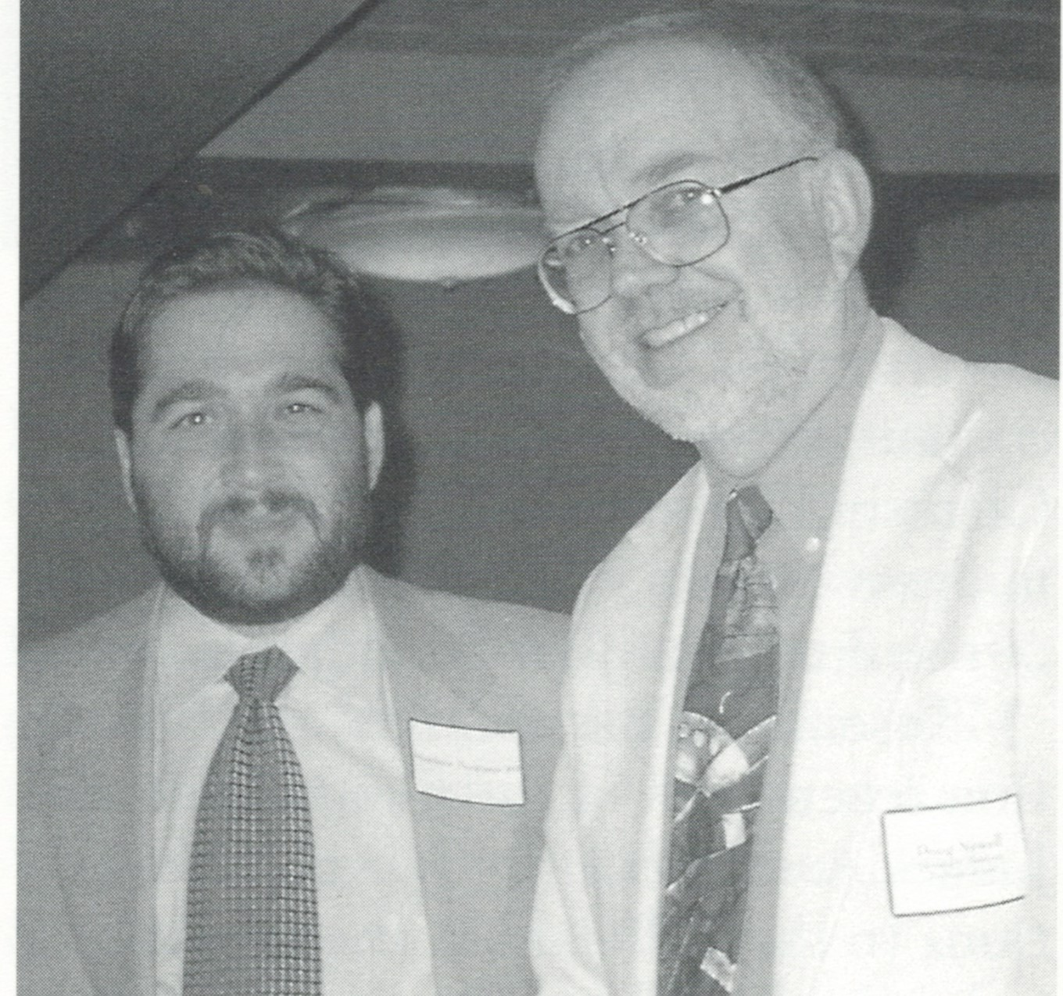
Doug with
Matt Bergman ‘89

Slide 12
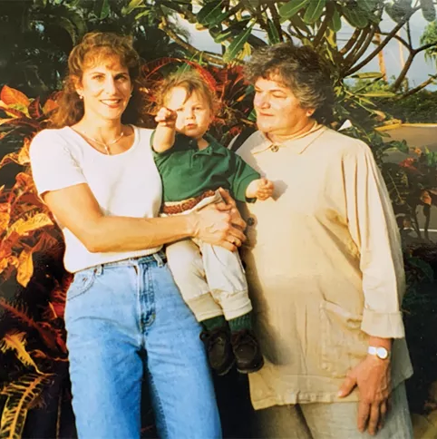
Jo Zucker ’88
Nicky Blumm,
JD Candidate ’22
Linda Zucker ’74
Doug has taught 3 generations of the Zucker/Blumm Family: Jo Zucker ’88; her son Nicky Blumm, JD
Candidate ’22; and her mother, Linda Zucker ’74
Former students

Slide 13
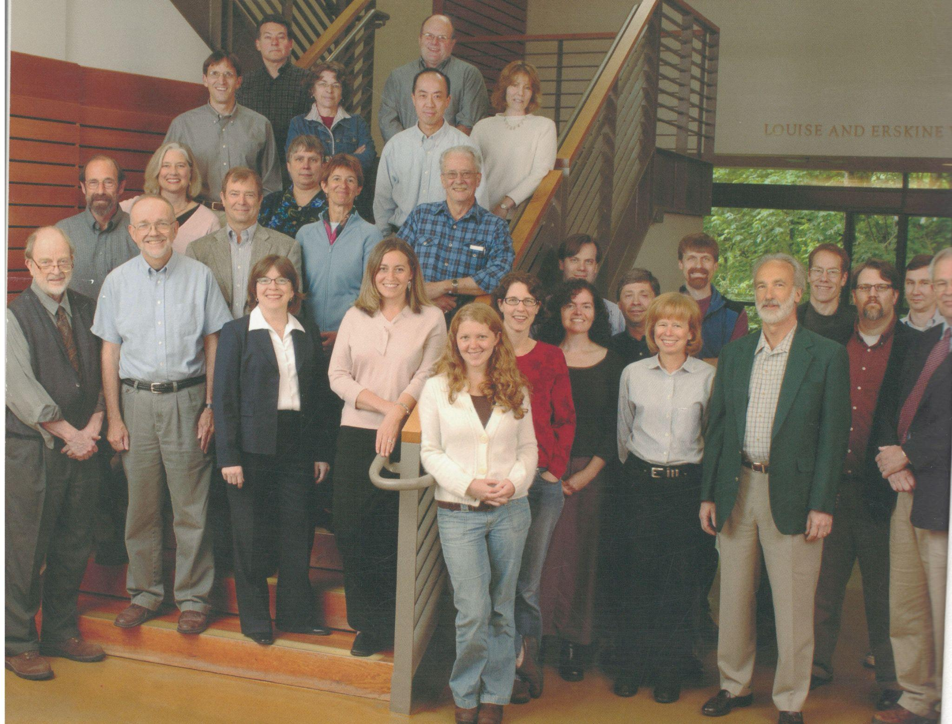
Doug with his fellow faculty

Slide 14
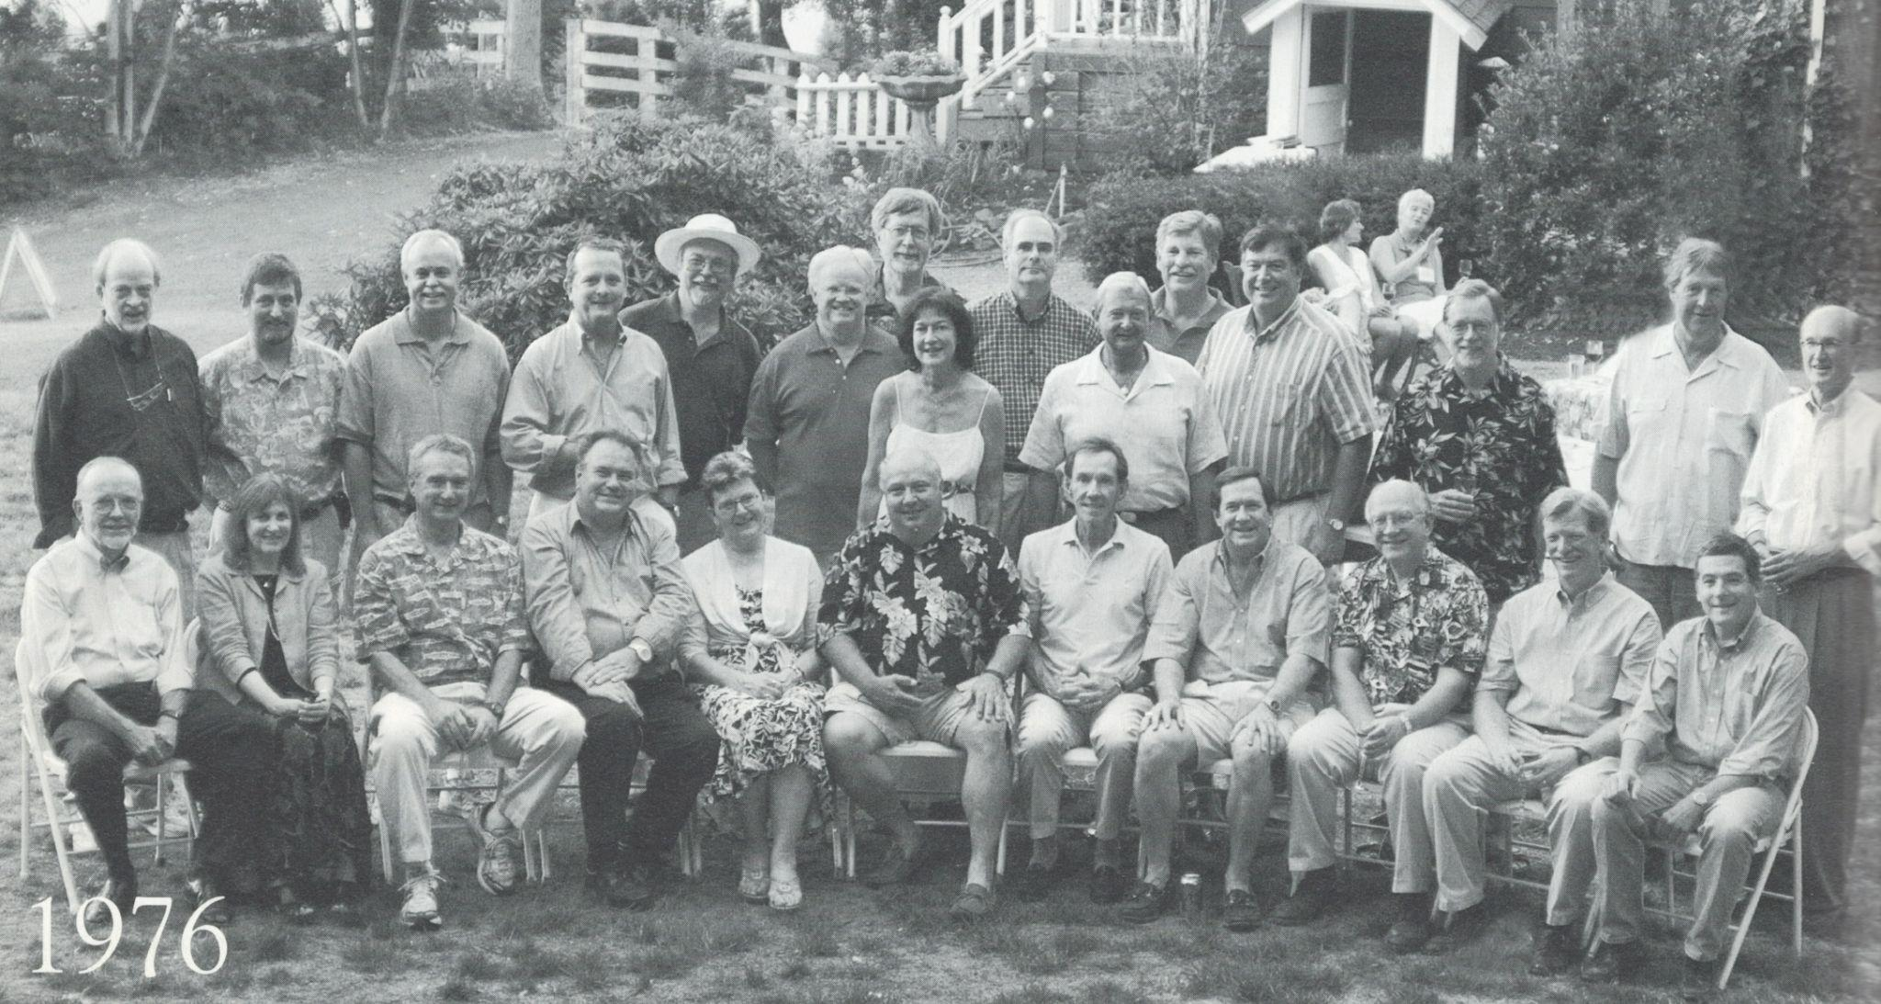
Doug with the Class of 1976

Slide 15
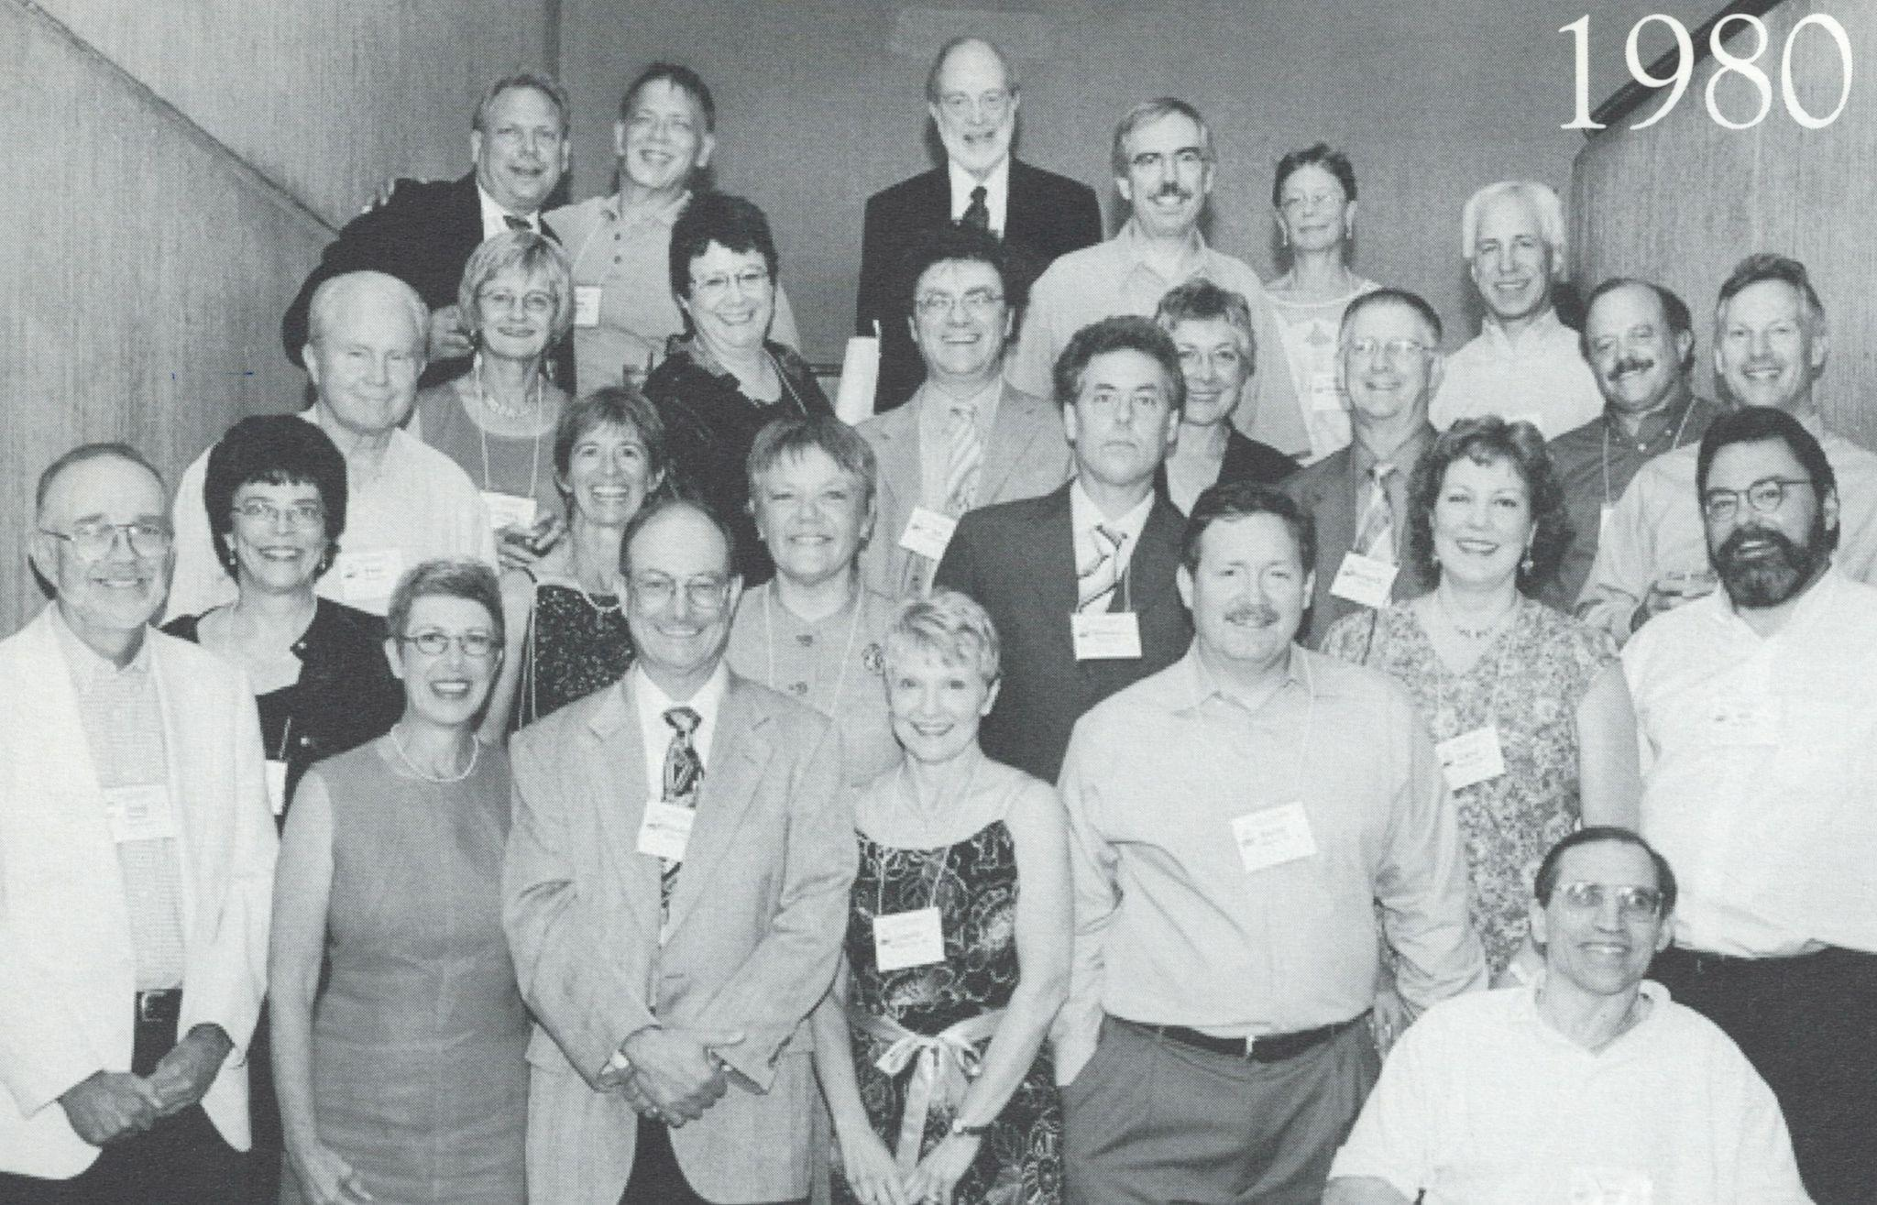
Doug with the Class of 1980

Slide 16
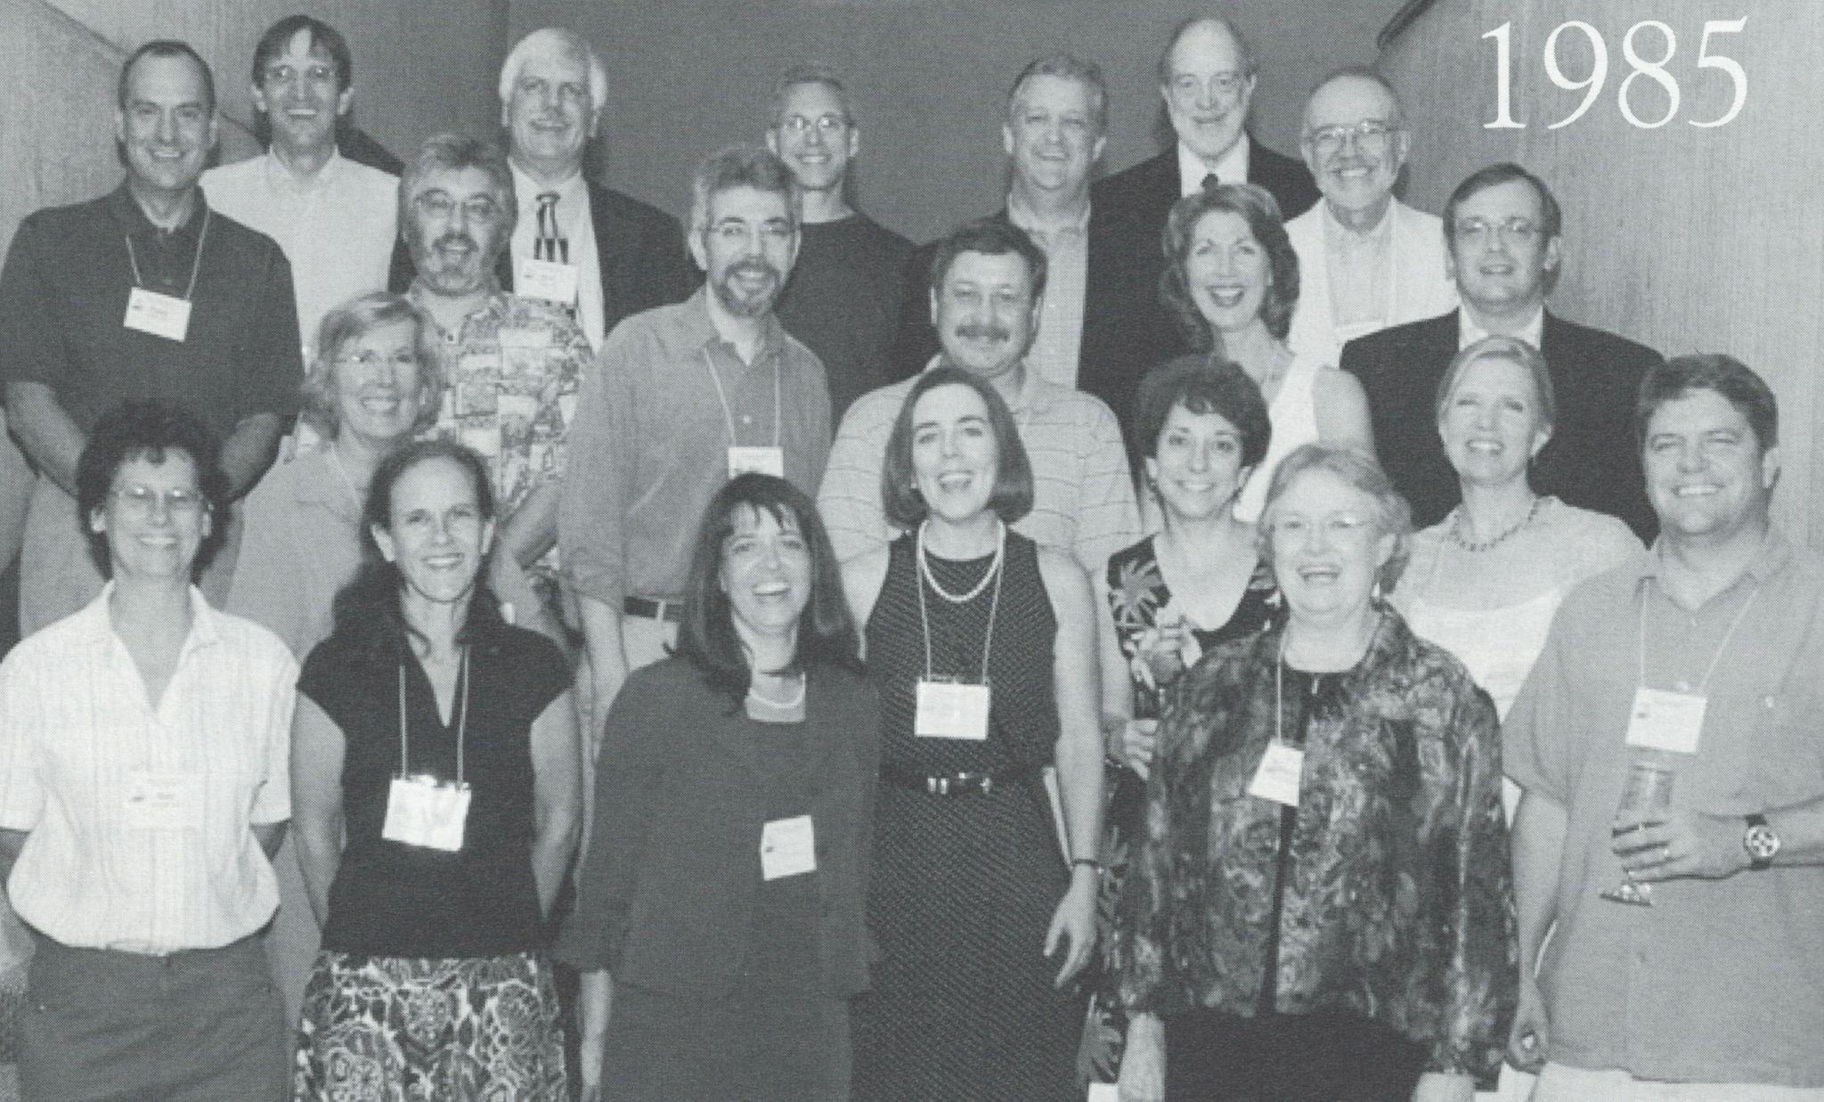
Doug with the Class of 1985 - including Governor Kate Brown

Slide 17
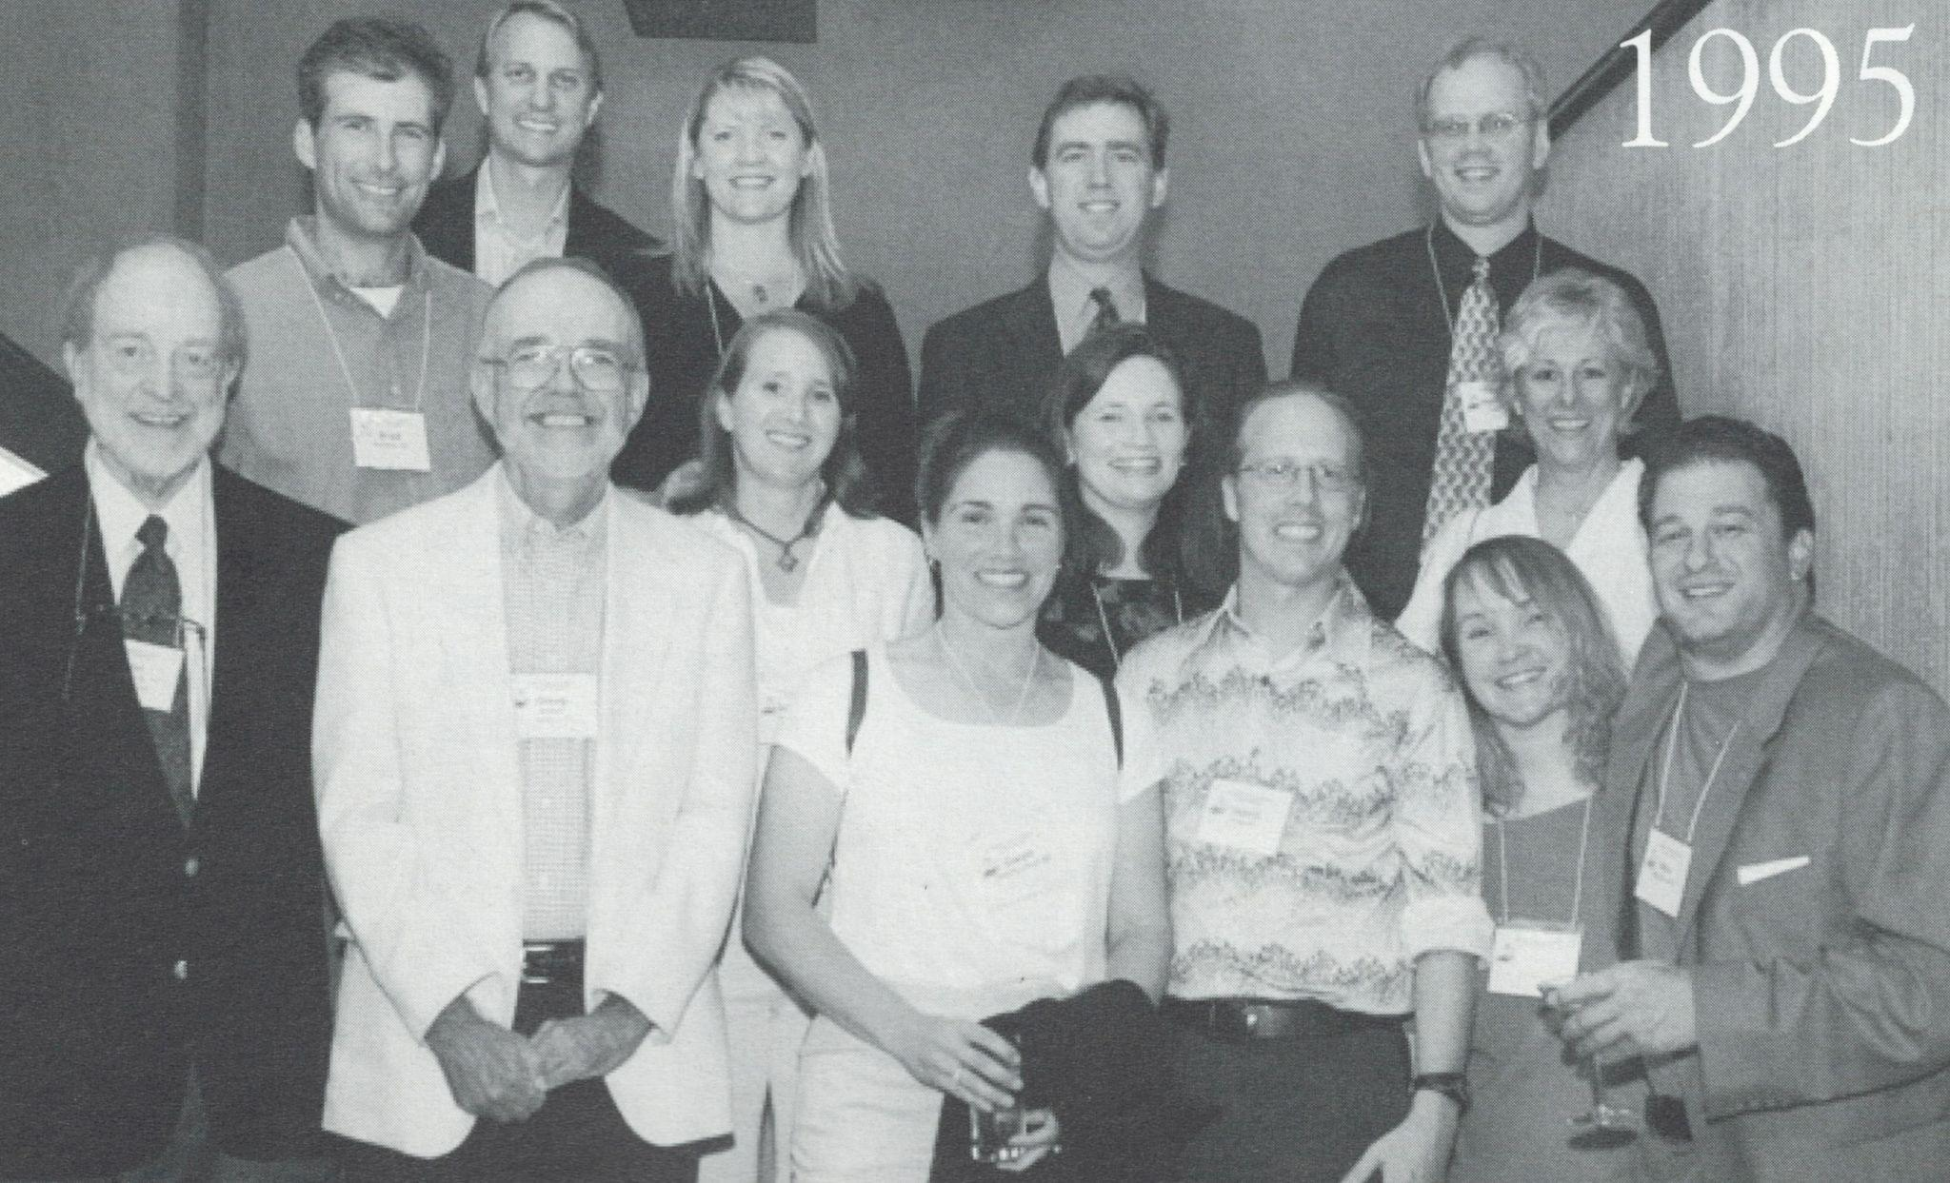
Doug with the Class of 1995

Slide 18
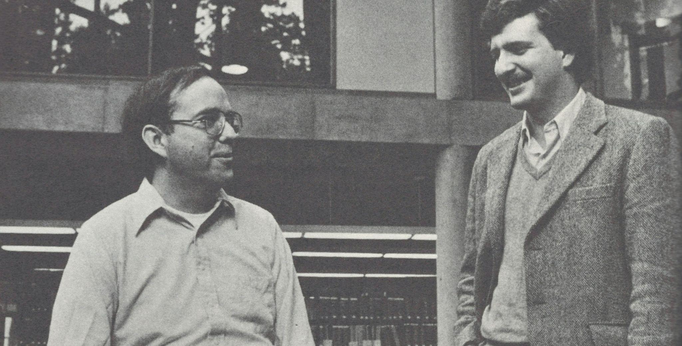
Doug with alum Lin Thompson ‘83

Slide 19
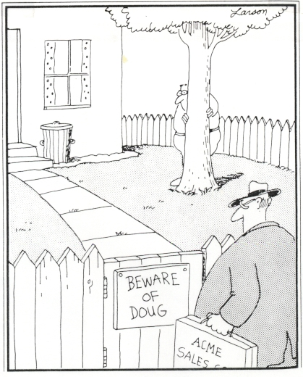
This cartoon hangs on the door to Doug’s office

Slide 20
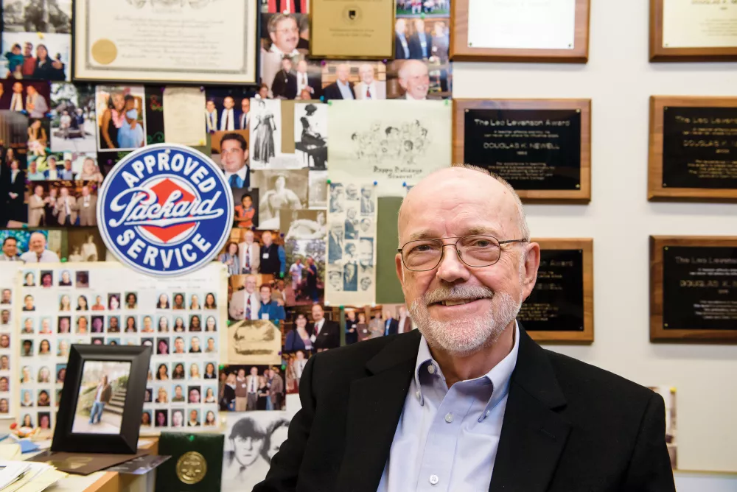
The walls of Doug’s office are a wealth of memorabilia

Slide 21
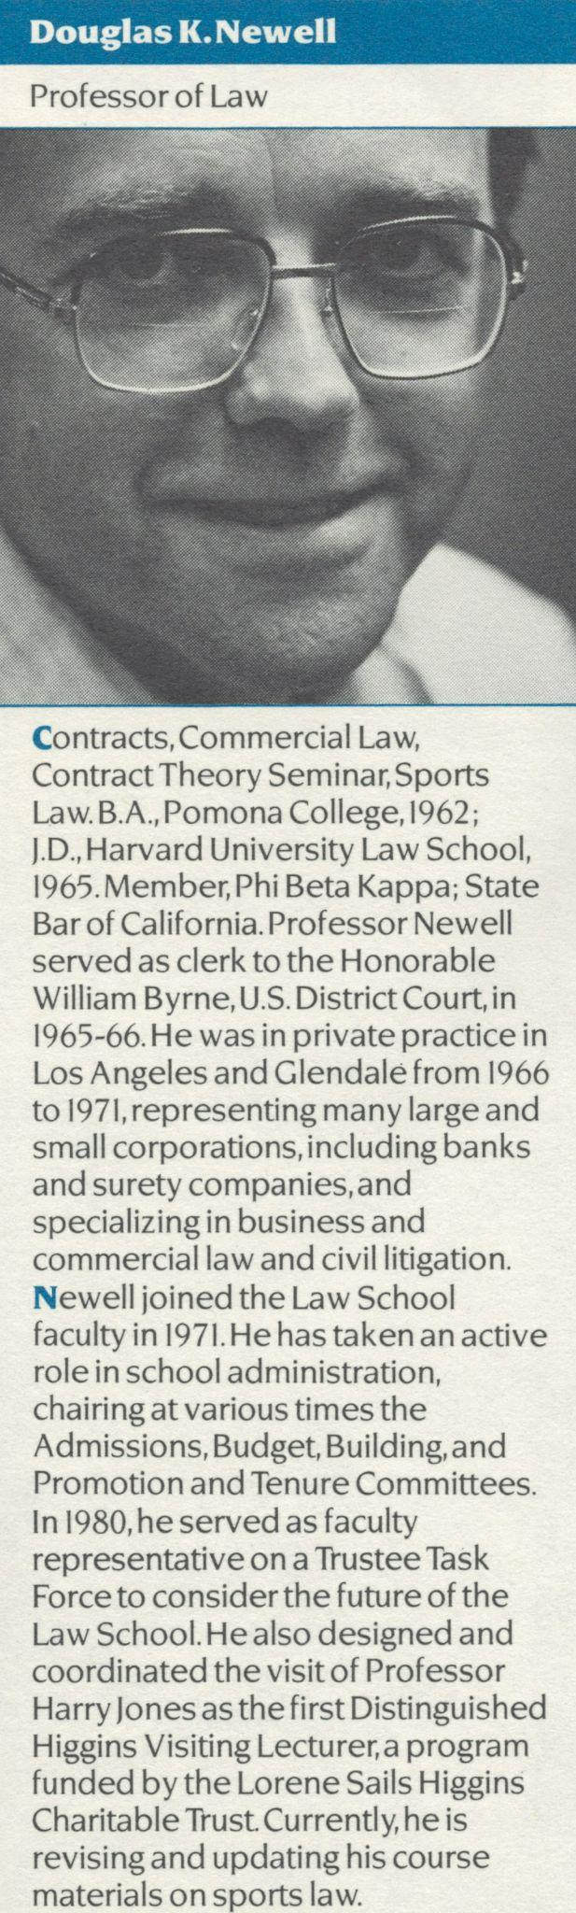
“As creator of the Leo Levenson Award in 1976 I attest that Professor Newell was one vote shy of receiving a 7th Leo Levenson award. The class of 1976 selected another highly respected Professor, Ed Belsheim, for the award by a one vote margin. The students were the winners having had the good fortune of experiencing both excellent educators.”
- William C. Cox ‘76

Slide 22
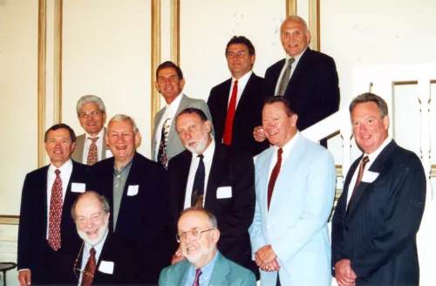
Doug and Professor Ron Lansing with members of the Classes of 1962 and 1972 at a reunion in 2002

Slide 23
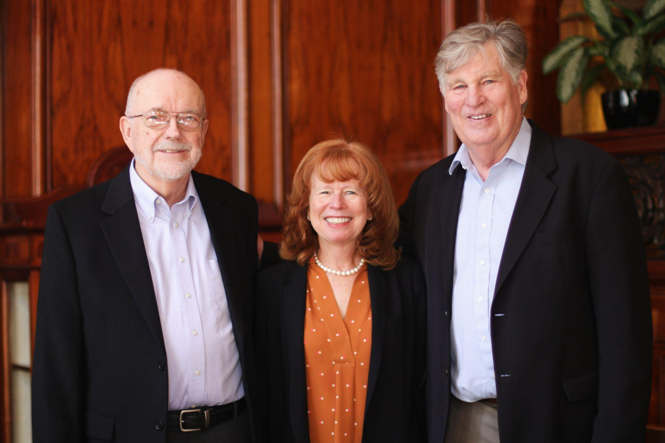
“Congratulations Doug and you have done so much for so many law students!”
- Rex Malott ‘76
Doug with Dean Jennifer Johnson and Rex Malott BS ’73, JD ’76 at the 2019 Business Law Spring Luncheon

Slide 24
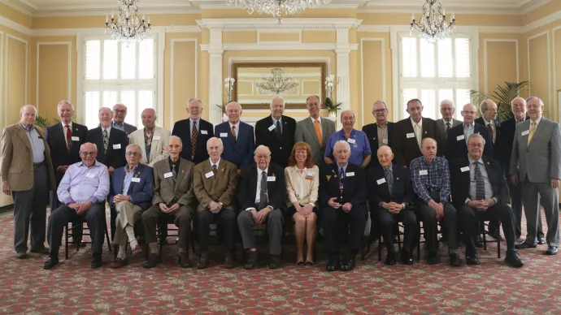
Doug at the McCarty Society Luncheon in 2019

Slide 25
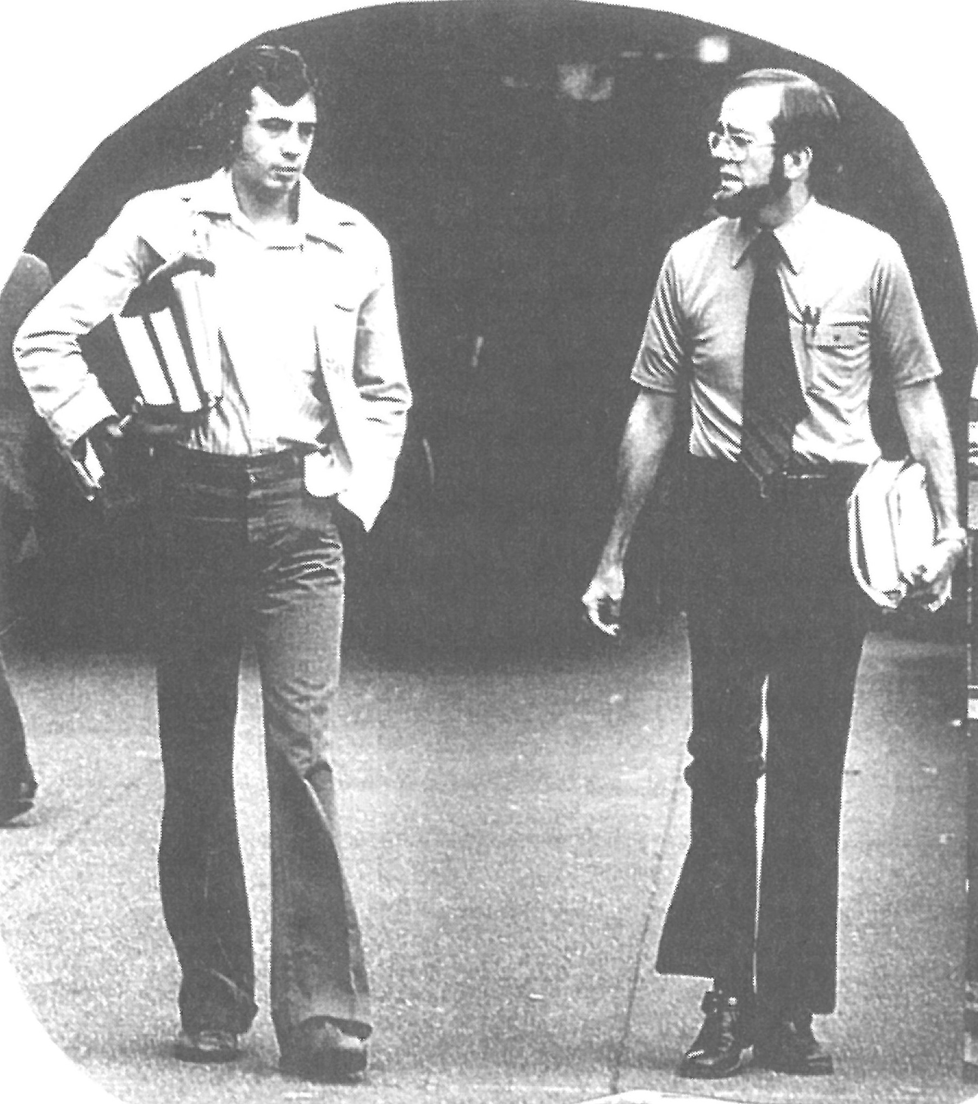
“Professor Newell was a respected fixture at the law school even in 1978.”
- Mary Viitums (Nietupski) ‘81

Slide 26
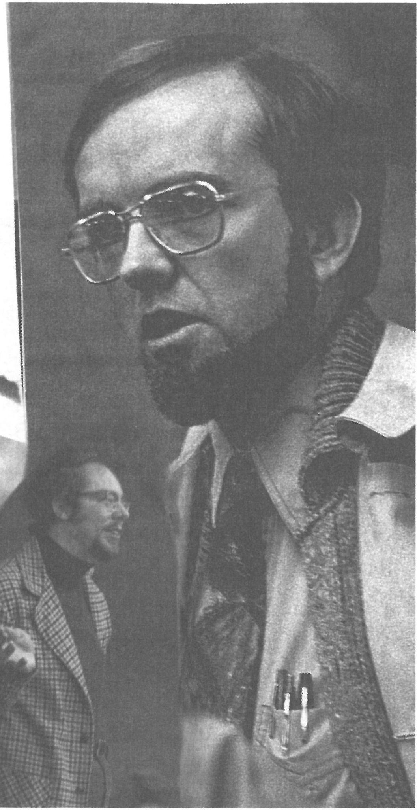
“Doug is one of the finest gentleman you could ever meet and certainly a great and caring teacher who treats first year law students like they were Supreme Court justices. If not for him I may have dropped out in my first year.”
-Gary Eichenbaum ‘76

Slide 27
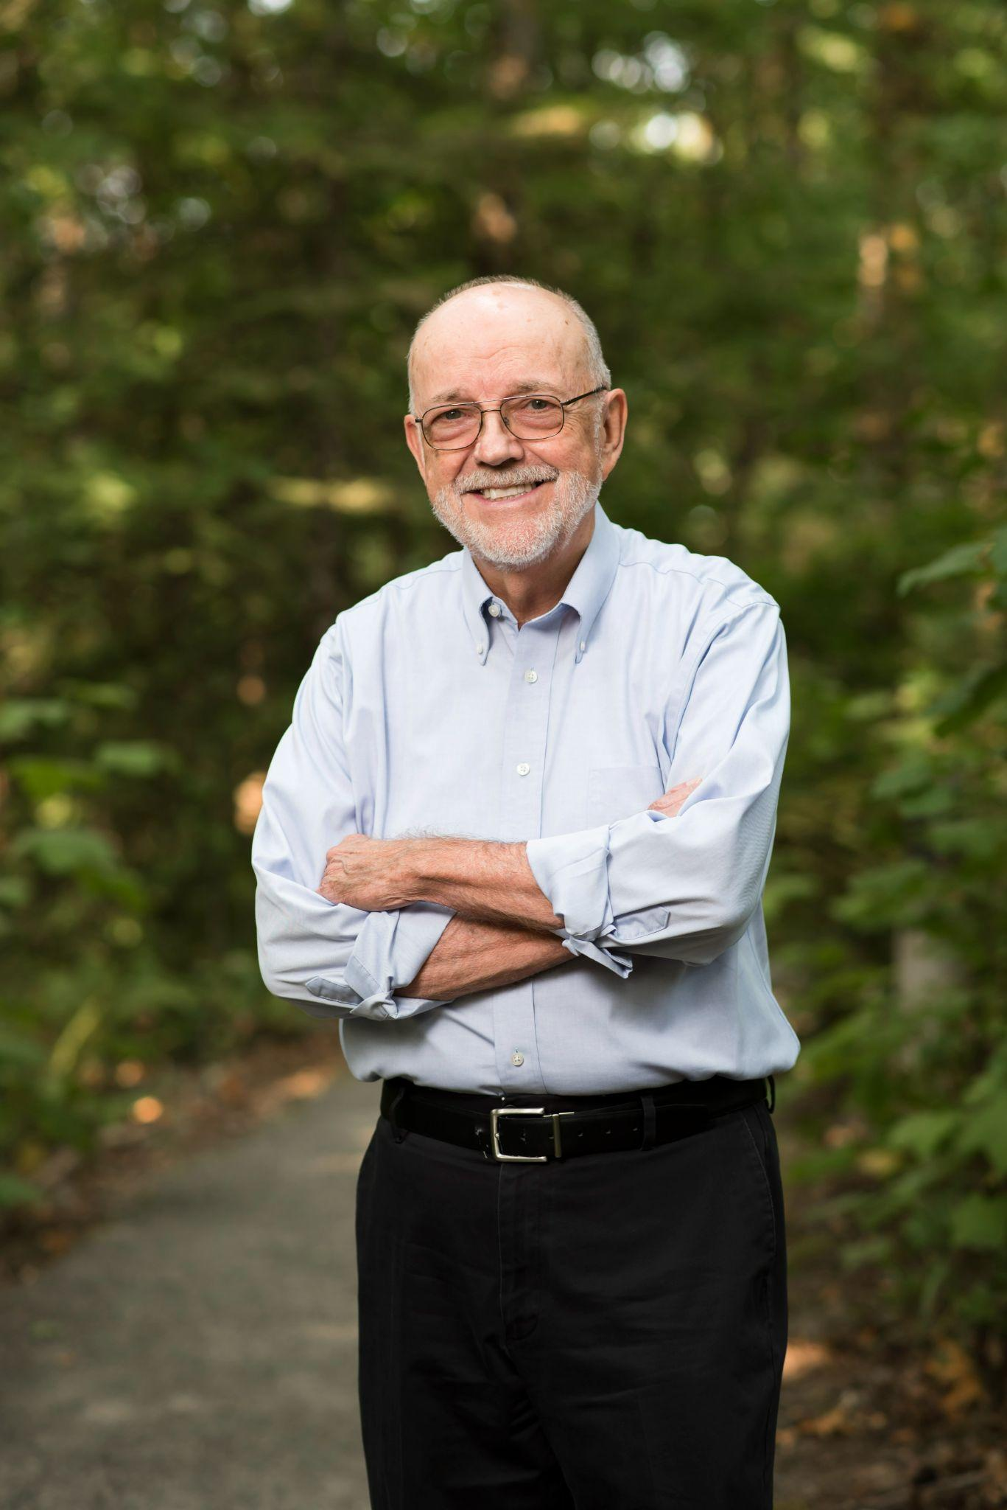
“I was a student in Professor Newell’s 1L contract class and boy was I awful at contracts. I had no idea what was going on, or what to do about it. Professor Newell was generous with his time and used the traditional socratic method in a way that was empathetic and thoughtful.”
- Natalie Hollabaugh Johnstone JD ‘21

Slide 28
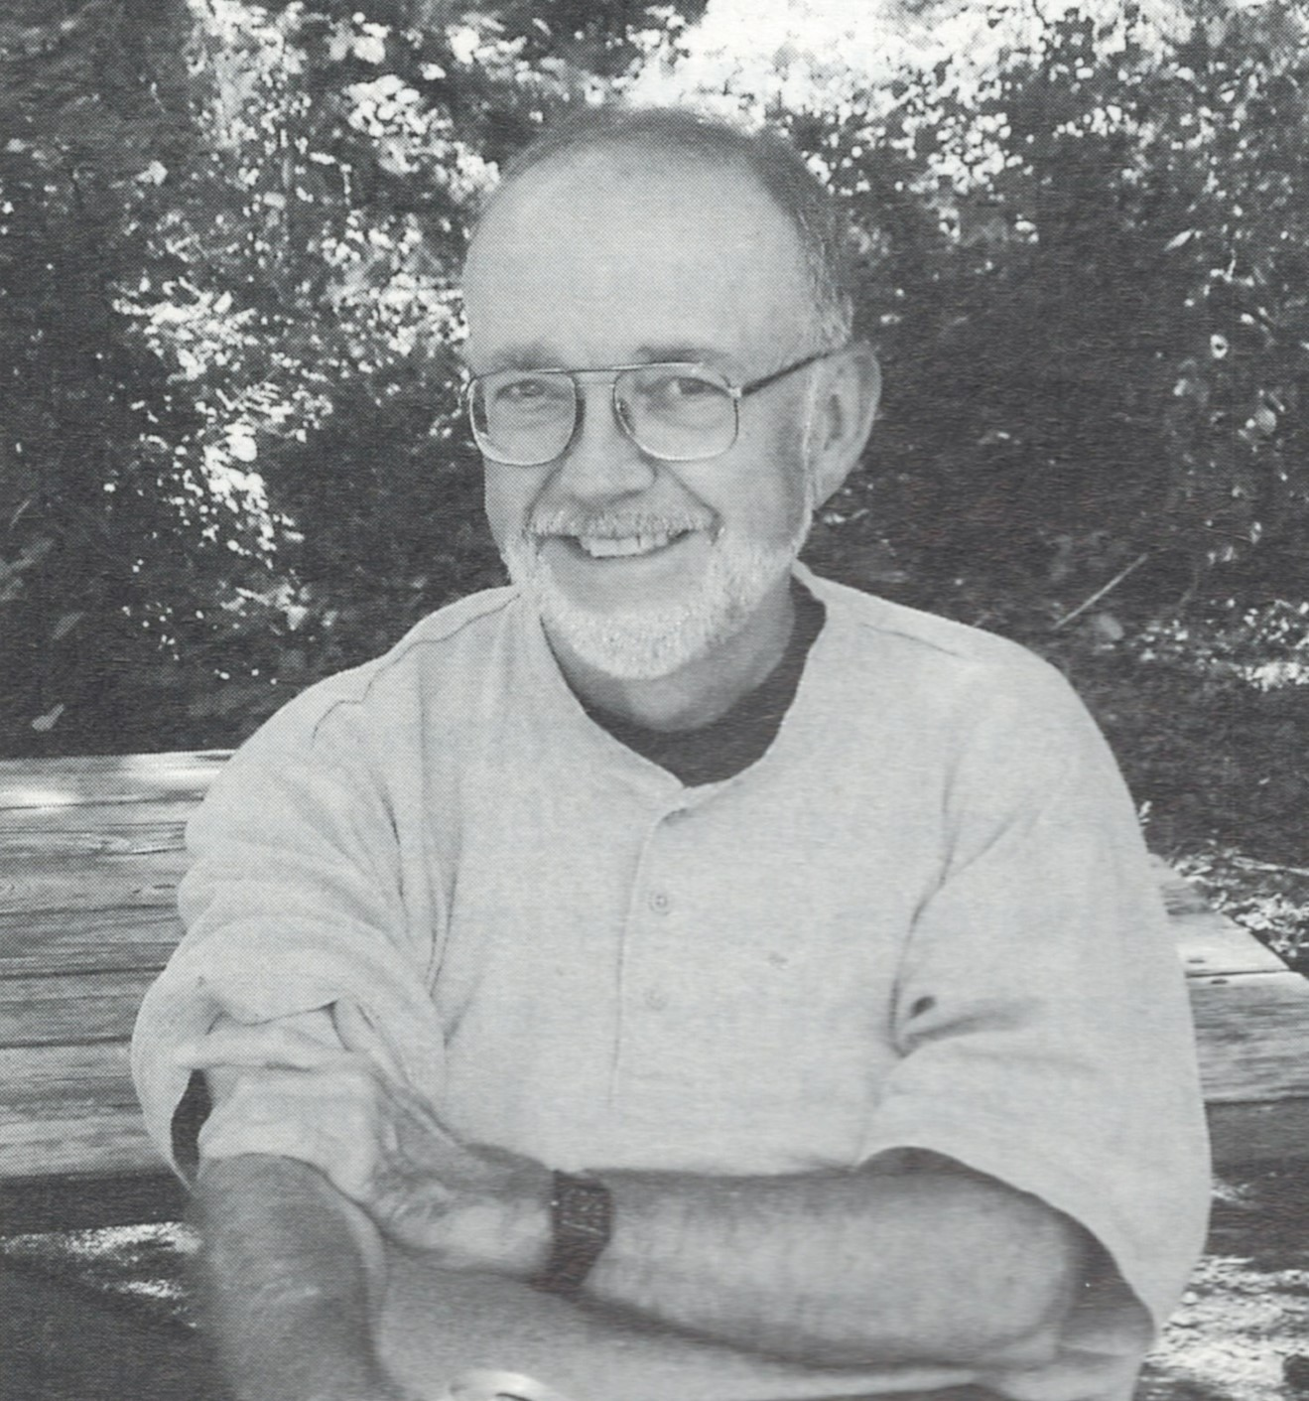
“On the first evening of Secured Transactions, Professor Newell started the class with a statement that gave me tremendous relief. He said in this class, ‘There will always be a right answer. Read the code, get the right answer, and don’t complain if you get it wrong.’ That was a a breath of fresh air after a few semesters of lack of certainty!”
- Jerry Carleton ‘07

Slide 29
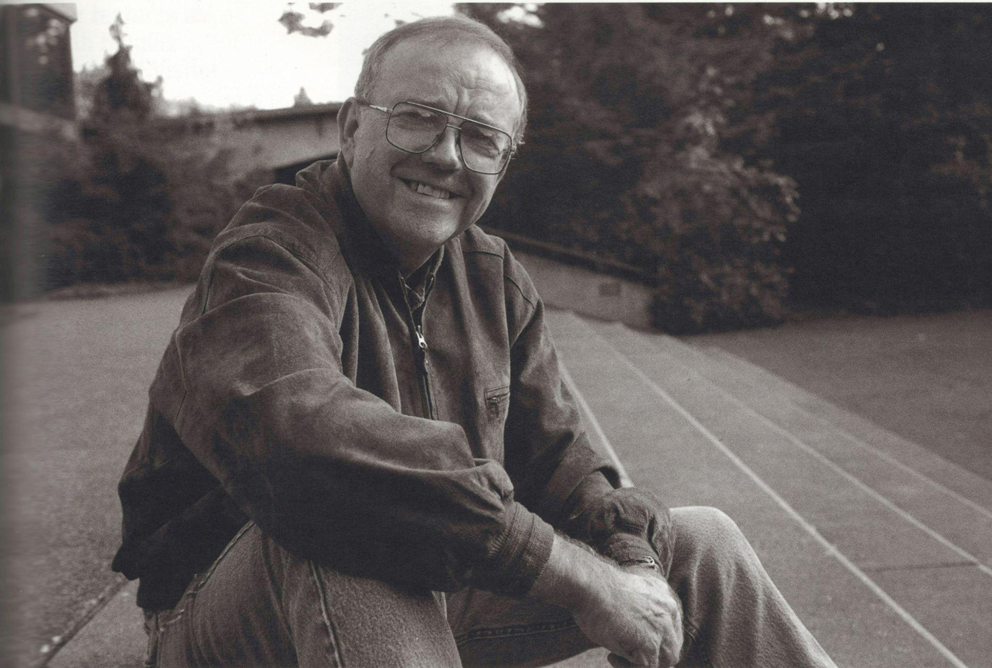
“At the orientation day, fall of 1980, Professor Newell told us, to the effect, “I don’t know what, if anything you might take with you from this orientation, but if you take anything, you should know that you’d damn well better not park in the faculty parking lot!” Plus he magically got me through UCC. Somehow.”
- Nathan Callahan ‘84

Slide 30
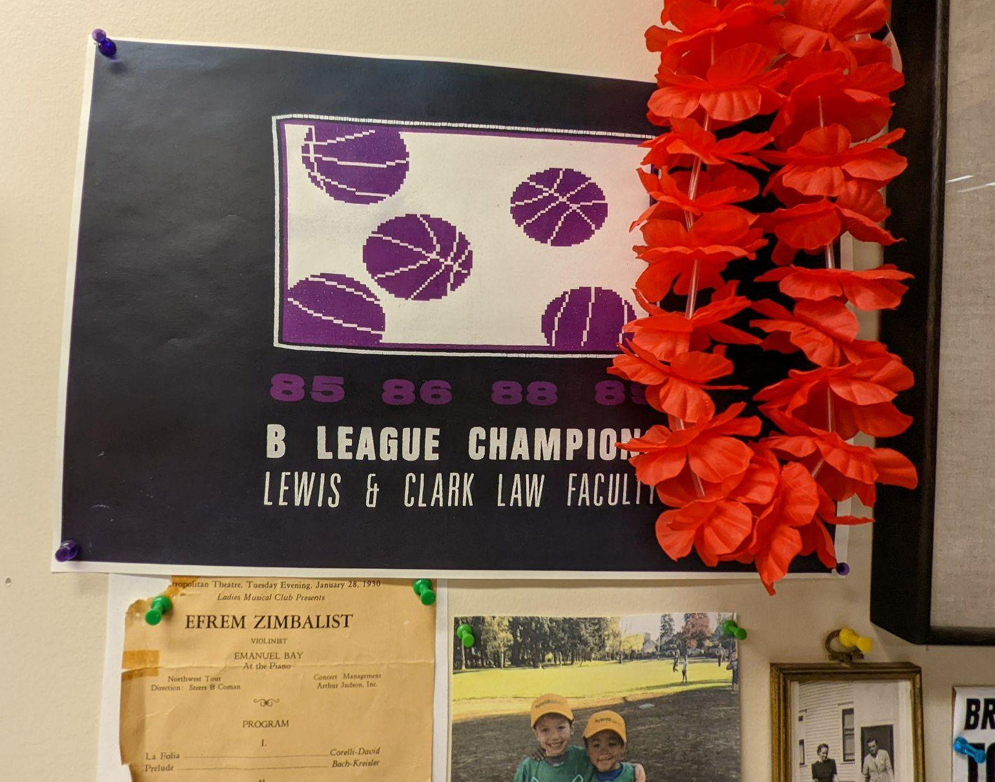
“Graduation Day (1977) was also the day that the Portland Trailblazers won their only NBA championship. Doug and his good pal Professor Billy Williamson were at the game. Doug and Billy showed up at the VERY last minute, and he later said they were both not at all sure what they would have done had the game gone to overtime. I totally believe him that it would have been a tough choice for them!”
- Al Larsen ‘77

Slide 31
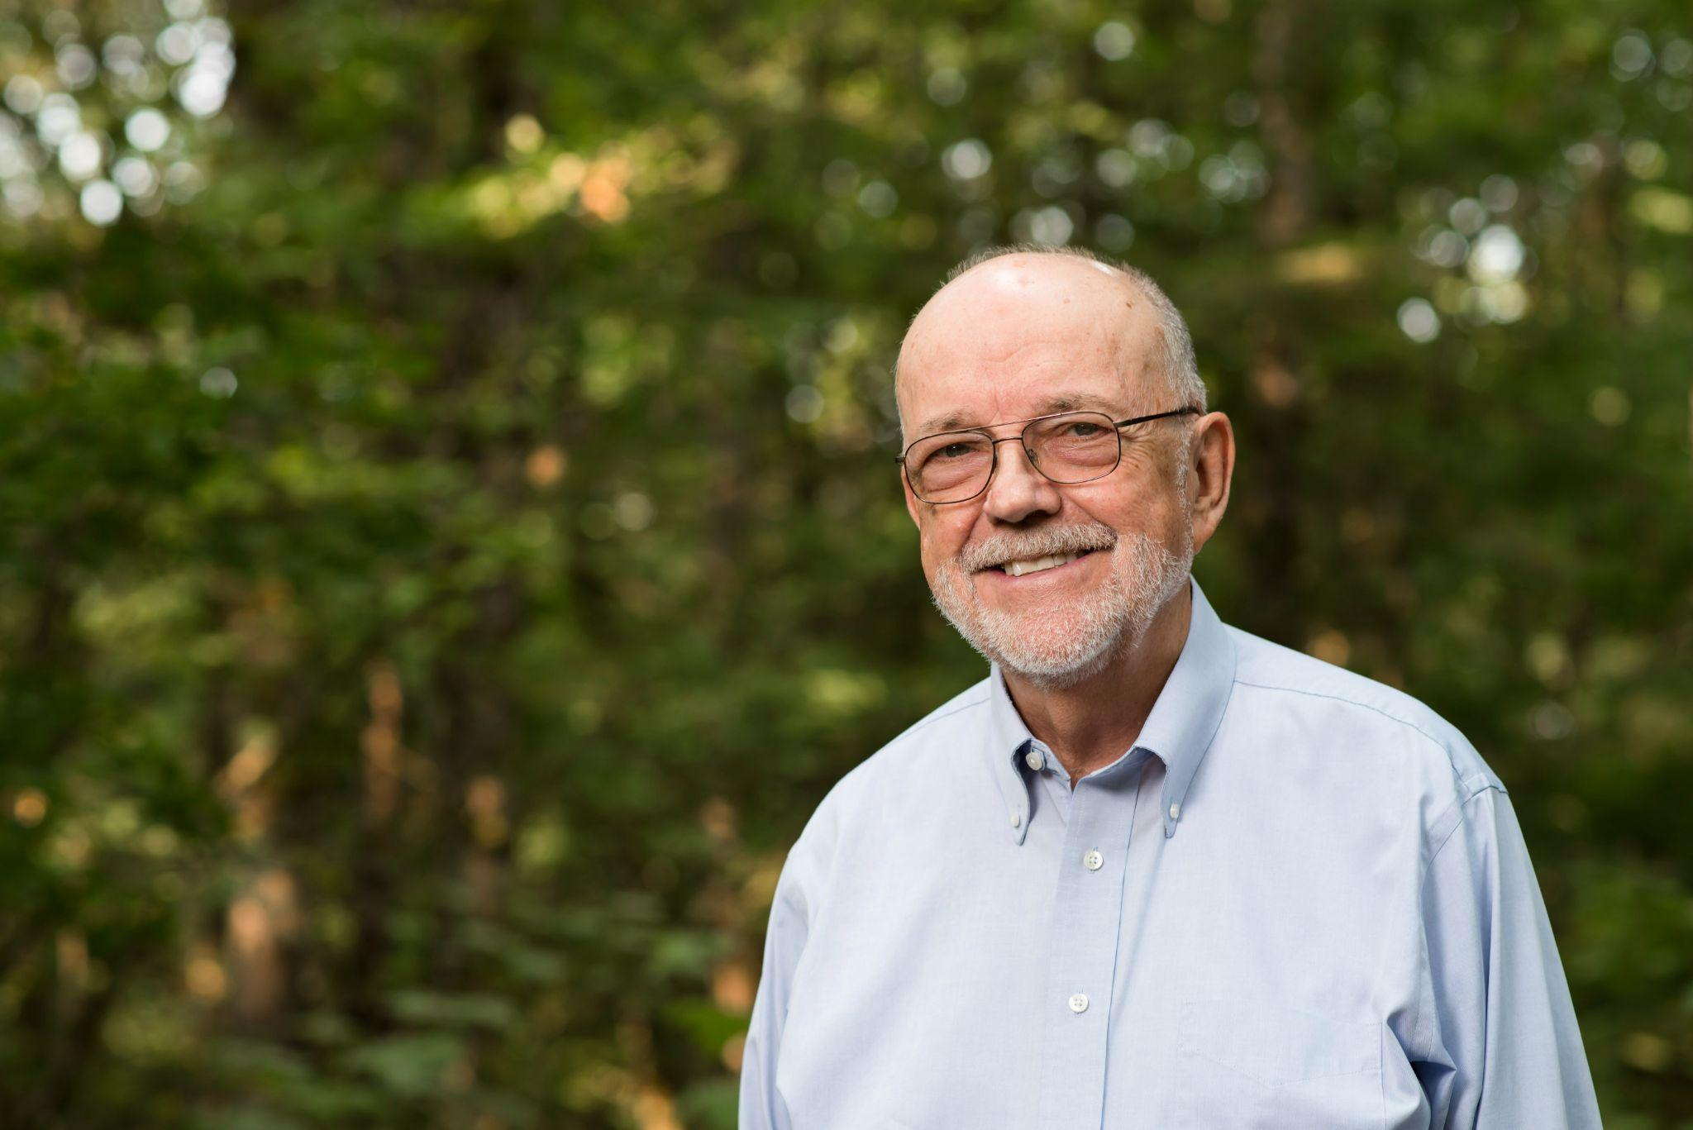
“I wish I had an embarrassing story to tell about Doug, but after 34 years in an office just down the hall in the Bat Caves from his, I do not. Having just passed 50 years of teaching myself, but at 4 schools and not at 1, I am more than impressed by Doug’s continued dedication to his students and to scholarly research. Lewis & Clark will be poorer when he retires, which hopefully will not be for a few more years.”
- Professor Don Large

Slide 32
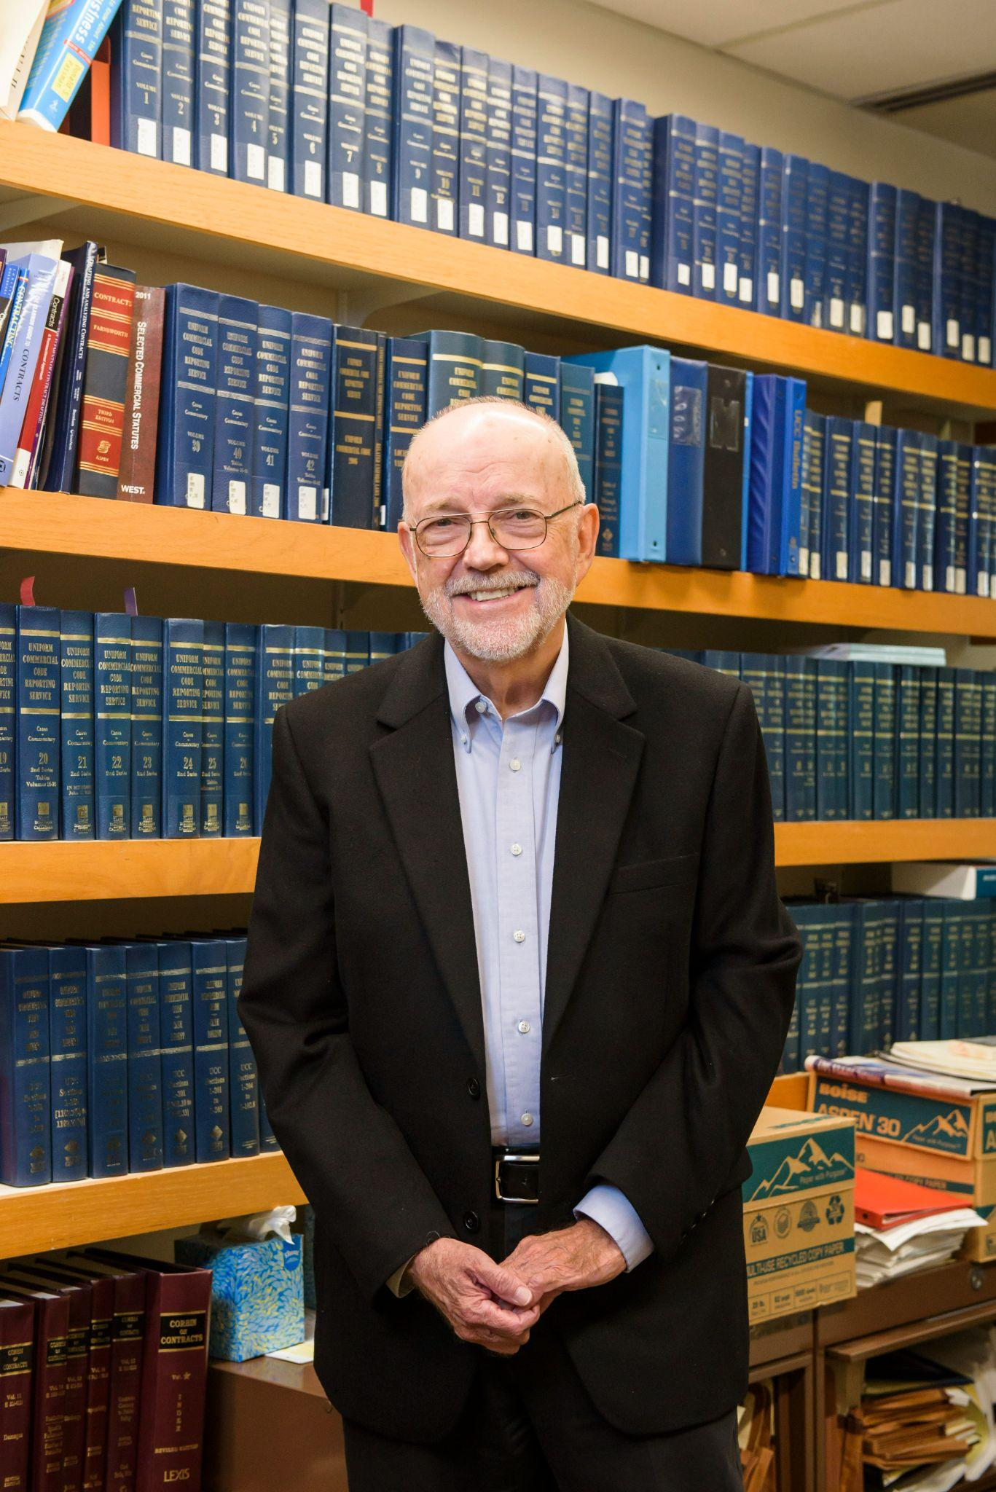
“Professor Newell gave us his phone number on the first day of contracts class and said to call him anytime with questions. He made time to expand on concepts that were fuzzy for me or alternatively to talk about how to ensure that I actually accepted the offer of my first summer externship.”
- Glenda Valdez ‘23

Slide 33
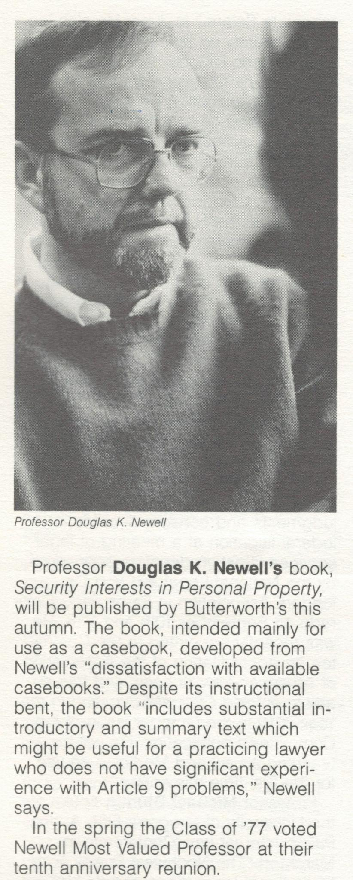
“I collected my 1977 classmates’ ballots for that year’s Leo Levenson Award for Excellence in Teaching. Professor Newell was the obvious winner. I presented the award and read some of the comments to the audience. One comment that I read, which I completely agreed with, was ‘Professor Newell somehow made the UCC interesting.’”
- Steve Rosen ‘77

Slide 34
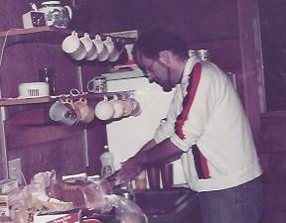
“As I began my first year (1972), I recall very strong feelings of doom and trepidation that I would surely not survive more than a month in a class on contract law. And I still remember how amazed and delighted I was to realize that I truly enjoyed that class.”
- Katie Allan '75
About this photo: Doug, displaying a different, though no less laudable skill, during a law school retreat at the Sitka Center Cascade Head, Oregon (@1980)

Slide 35
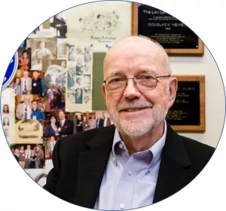
“My best to Doug Newell, an outstanding professor and a warm and and engaging human being”
- Frederick Black ‘75

Slide 36
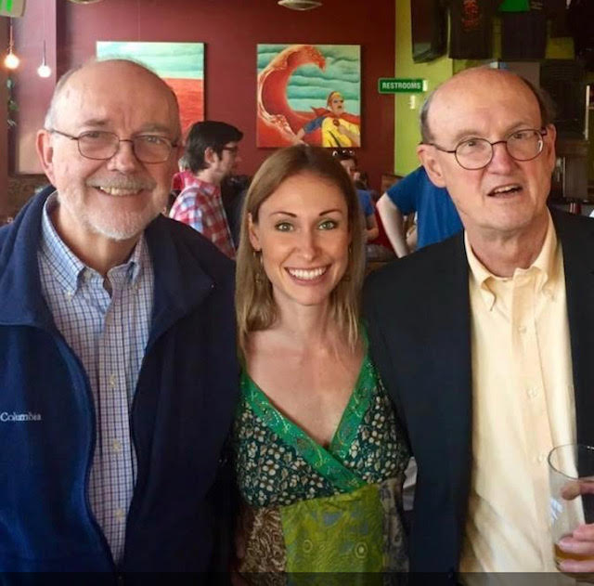
“Law school did not come naturally for me and I remember crying in his office because I could not understand some hypothetical or case at the beginning of 1L year. He seemed just as frustrated as me and handed me a box of tissues as he said (exasperated) “Well I just don’t know what else to say. I’m not sure that anything I’m going to say is going to make you get it.” Haha.
At the end of the day I did in fact get it. I’m grateful to have had him in my life and journey.”
- Dayna Louise ‘18

Slide 37
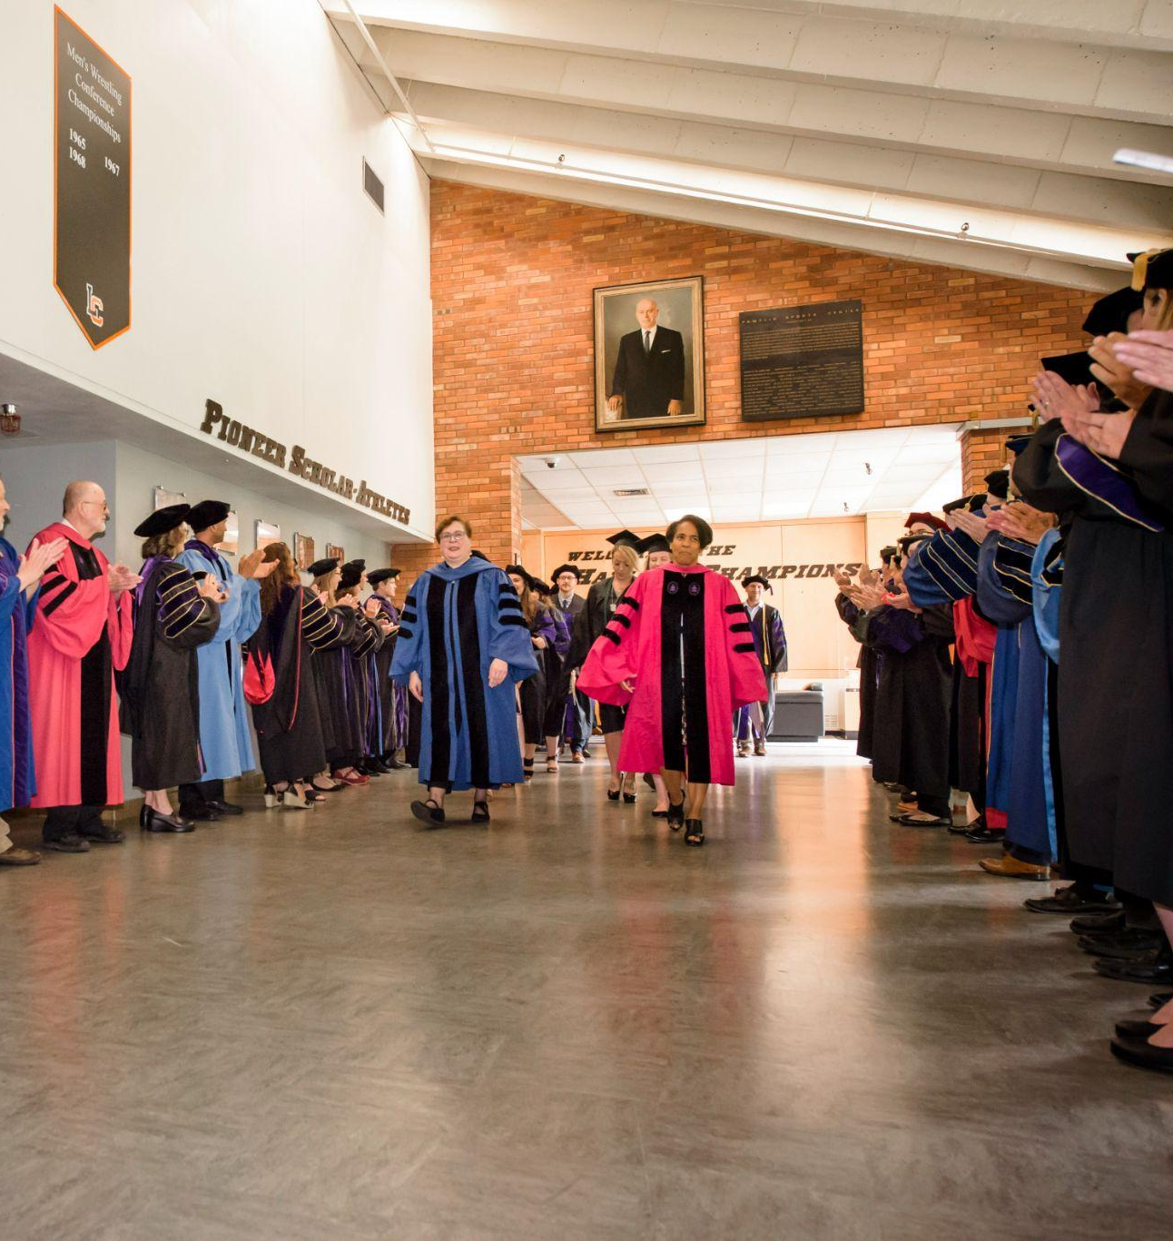
“Doug Newell is a great professor and human being. They don't make people better than him.”
- Stephen Leasia ‘83
Doug with his fellow faculty at a law school Commencement ceremony

Slide 38
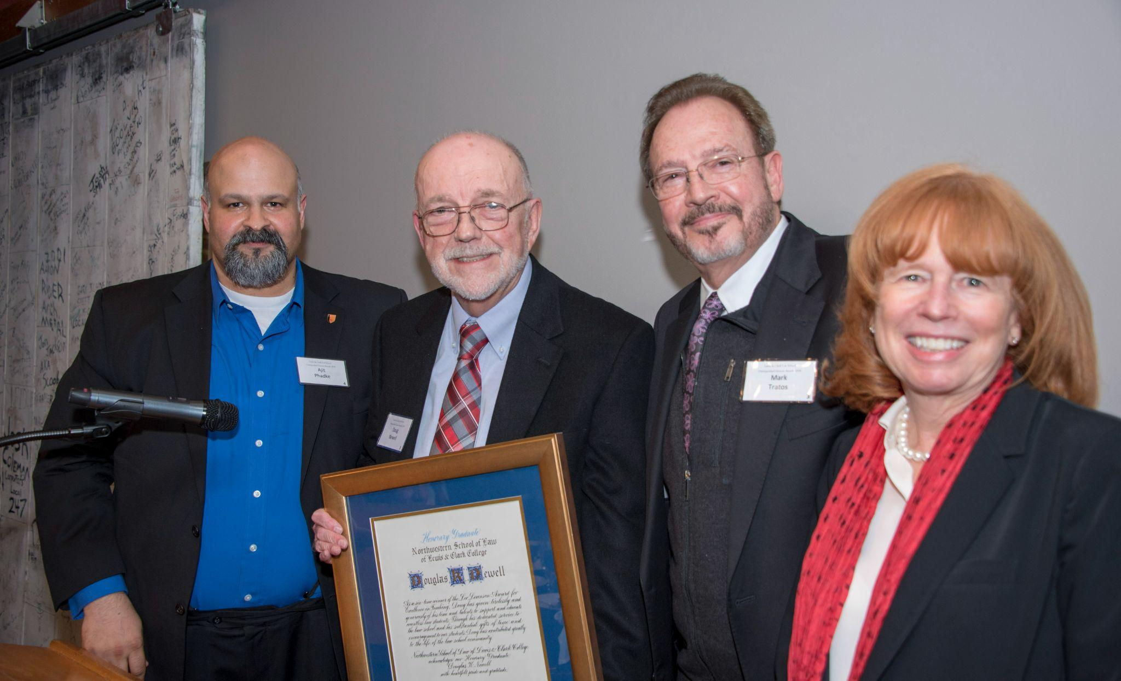
“Whoa, 50 years! I still hear his voice in my head.”
- Laura Graser ‘79
Doug receiving his 2018 Distinguished Honorary Graduate Award
with Ajit Phadke ‘98, Mark Tratos ‘79 and Dean Jennifer Johnson

Slide 39
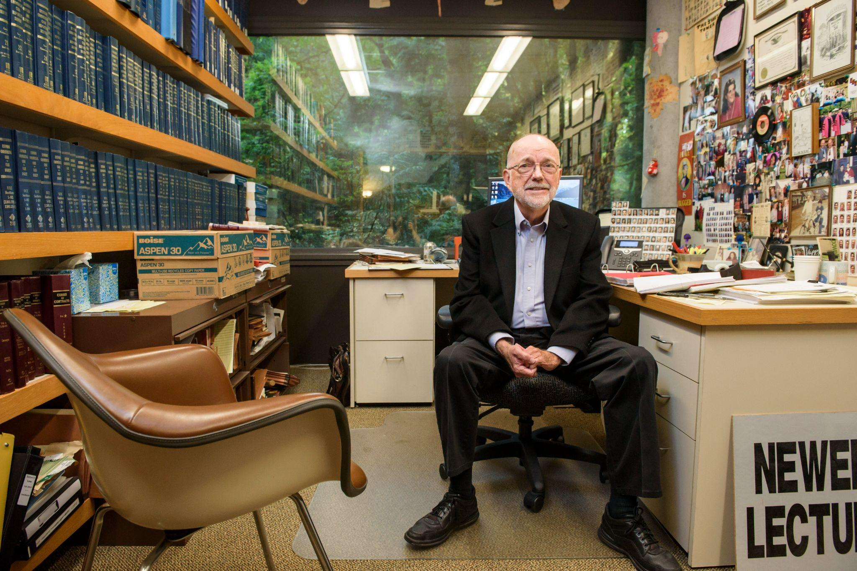
“Professor Newell is a great man and had a significant influence on all of us. He is a Professor with great wisdom and compassion for the human condition.”
- Tom Sherwin ‘74

Slide 40
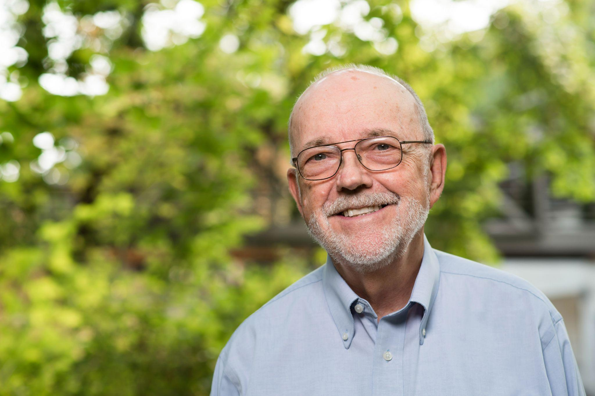
“My mom and I each took classes taught by Professor Newell, more than 35 years apart!”
- Chester Hill ‘16

Slide 41
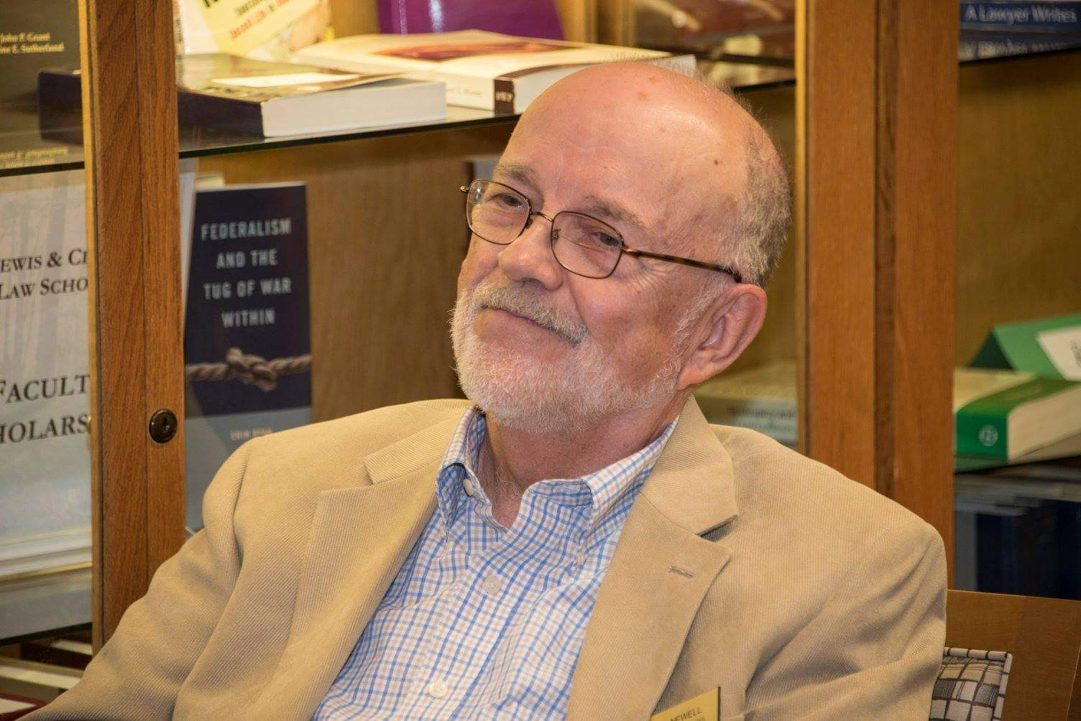
“Professor Newell is an extraordinary professor! It is a pleasure to honor him!”
- Turid Owren ‘83

Slide 42
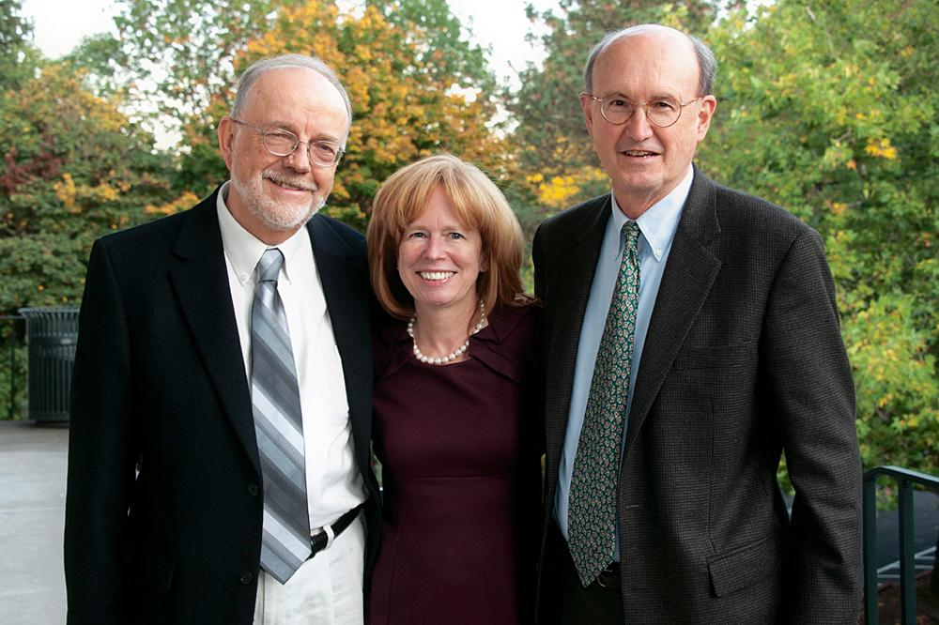
“Near the end of the year contracts, Professor Newell called on my good friend R.J. Smith, seated about three rows behind me. R.J. was however well prepared. As a low murmur of laughter behind me turned into a roar, I turned to observe that in R.J.’s place the only thing visible was a white flag on a stick waving above his seat.”
- Keith Meisenheimer ‘76
Doug with Dean Jennifer Johnson and Professor of Law Emeritus Ed Brunet in 2011

Slide 43
“I specifically recall the Contracts mid-term examination. I think we had 2 hours, maybe 3. In under an hour I had written down everything I knew, not quite before everyone else, but certainly within the first five.
I left the classroom in near tears, wondering whether or not I had made a grave mistake in career direction. I could have been a Master, teaching in Australia and here I was pretending that I could learn to master and love the law.”
- Jack Lundeen ‘79

Slide 44
“Doug generously lobbied for me to be accepted as a professor at the law school. I was also his student many years ago. My first year class adored him. He’s is an exceptionally gifted teacher and a great sense of humor in the classroom. Thank You so much Doug for all you have done for me and so many others.”
- Love, Doug Beloof ‘81 (Emeritus Professor of Law)

Slide 45
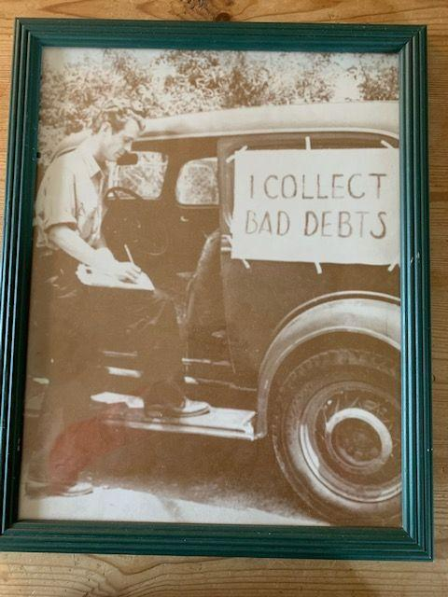
“I found this photographic print in a bin 20 to 25 years ago.
I picked this one up with Doug Newell in mind. I’ve been *thinking* of sending it to him ever since, perhaps as a classroom visual aid for UCC 9. The somewhat desperate but earnest fellow featured here would assist with “self-help“ for unsecured AND “secured transactions!”
- John Schilling ‘88

Slide 46
“I told Professor Newell that I didn’t think I was doing very well understanding contracts and would never make it as a lawyer. He said something like “Mr. Spicer, believe me, there are lots of good lawyers out there who didn’t understand Contracts and they’re doing just fine and so will you.” I stayed the course and ended up being a litigator with a very successful law practice.”
- Dave Spicer ‘80

Slide 47
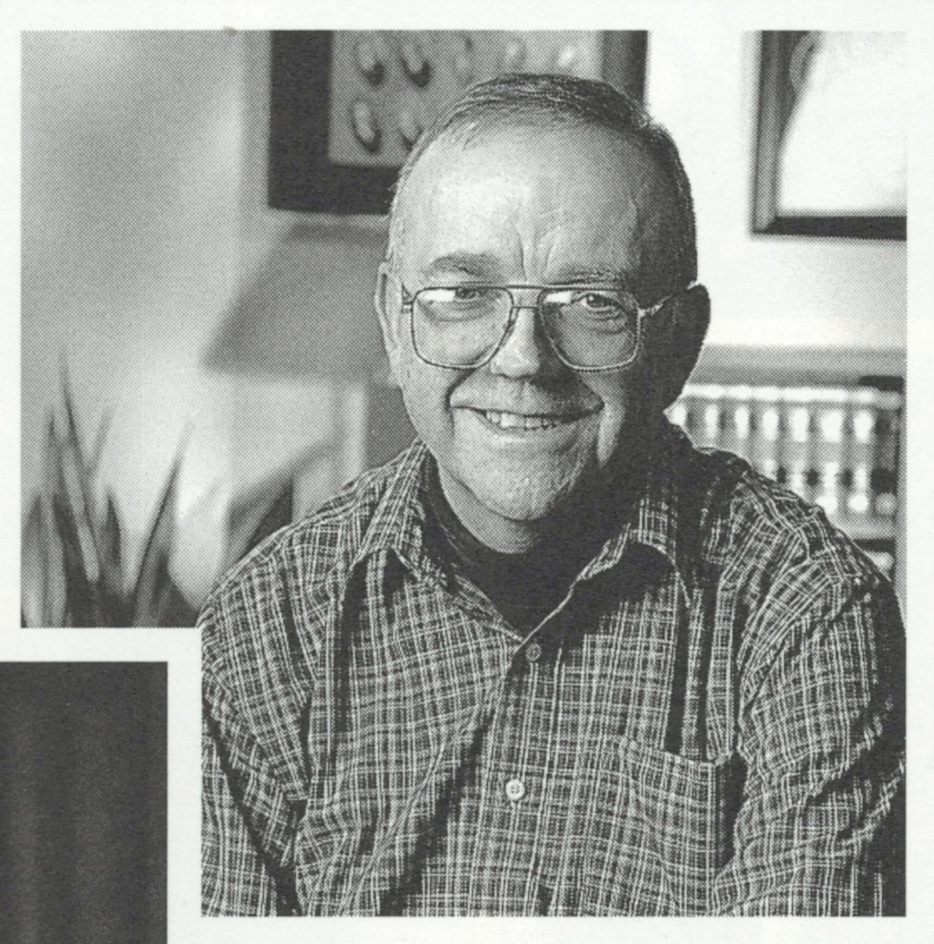
“As with his many stellar classes, Doug masterfully taught us the intricacies of the UCC while engaging and entertaining us with a repartee that challenges the best of the late night talk show hosts. . .”
- Julie E. Frantz ‘75

